Slide 1
Working with

Slide 2
Background to the project
The aim of the project is to give you some space and thinking time to consider and explore possible future careers.
You will then investigate the Yorkshire Dales National Park Authority (YDNPA).
What it is?
What it does?
The types of careers and opportunities available.
The aim of the project is to help you understand that there are many different careers available in an organisation.
You will investigate the ‘obvious’ and ‘hidden’ careers available to help you understand the opportunities available.

Slide 3
The world of work is changing
Starter Activity
Watch this video: Future of Work

Slide 4
Learning outcomes
To consider pupils’ individual career aspiration
To explore pupils’ career choices, the challenges and opportunities
To consider what actions they may need to take to achieve their career goal
First you need to know how where you are now, and how this
relates to your career path and ideas for your future.
Key questions to ask yourself
Your starting point – where you are now?
What are your career aspirations?
What do you need to do to achieve your career goal?
What are the stepping stones to success?
If you are unsure what sort of career you might be interested in, it might help to start off by completing this quiz.

Slide 5
Key questions to ask yourself about your possible future career:
What are your top three career choices?
Why do these interest you?
Investigate your three career choices? Find out:
What skills do you need?
What qualifications do you need to enter the career?
What attracts you to the career? Why?
Use the internet to explore these careers in more detail. List three things you learnt during your investigation.
Share your career choices and ideas with a partner. Discuss what you have found out. What are the opportunities and challenges in achieving your career aspiration?

Slide 6
What is my starting point?
From your investigation identify any action(s) which you would need to undertake to work towards the career you are interested in.
Annotate the arrow to show the steps you need to follow to achieve that career?
What do I want to be?
What do I need to do to achieve
my career goal?
My starting point,
where I am now

Slide 7
What is my starting point
Use the table to show how you are going to find out about your career and what you learnt from your exploration.
List what you need to find out about your top chosen career | Write here what you found out e.g. skills you need for the career choice

Slide 8
What is a SWOT analysis?
Learning
outcomes To carry out a SWOT analysis to identify strengths, weaknesses, opportunities and threats
To consider the outcome, to think about if the findings have any impact on pupils’
choices and
goals
Businesses often use a SWOT analysis to help them think about an issue or problem and to help them look at the issue within the ‘whole picture’ of the organisations activities or situation.
Today you are going to conduct a SWOT analysis on yourself - this will help you to start to think about the skills, strengths and attributes which you have and which will be useful in your chosen career.
It will also help you to identify the things you will have to do to work towards your chosen career.

Slide 9
SWOT analysis
Activity
Use the SWOT analysis diagram to complete a SWOT analysis of yourself
S = Strengths – List all your positive features and skills. The things you are good at
W = Weaknesses – List all the areas which you think you need to develop or work on
O = Opportunities – What are the career opportunities available to you? Who could help you?
T = Threats – What are the difficulties or challenges you might face and need to overcome to achieve your career goal

Slide 10
SWOT analysis of yourself
Strengths - the things you are good at
Weaknesses – the things you need to work on and develop
Opportunities – what career opportunities are available to you?
Threats – or challenges the things you need to overcome

Slide 11
SWOT analysis
Activity
For each weakness and threat (challenge) you have listed on your SWOT analysis list a possible solution
Possible weakness or threat
Possible weakness or threat

Slide 12
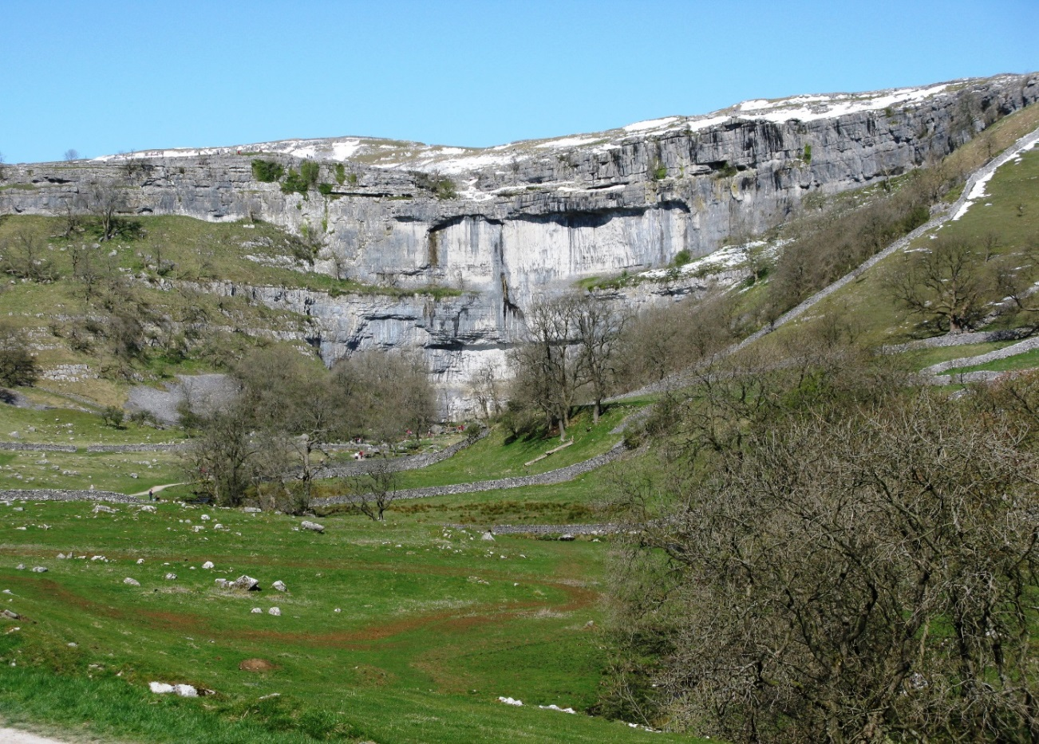
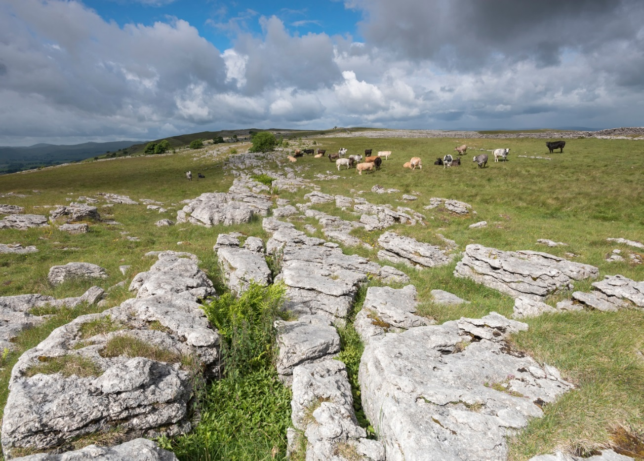
Starter
Where is this? What do you think about when you see pictures of these landscapes?
Photographs by Paul Harris

Slide 13
Key questions
With a partner discuss the following:
What is a national park? Why do you think they were set up? By whom? Do you know how many there are in the UK? Can you name any? Have you ever visited any? If so which? What did you do there?
What sorts of careers might there be in a national park? List them.

Slide 14
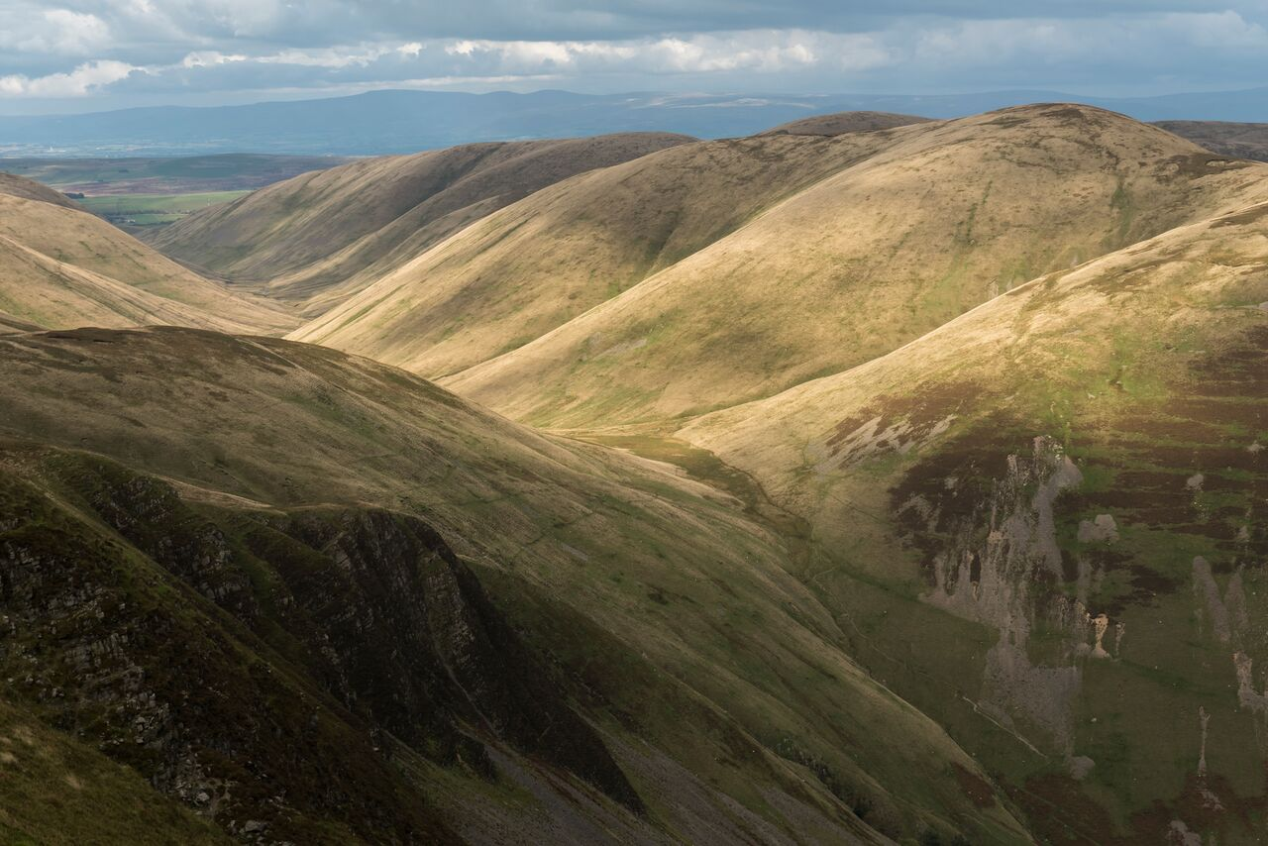
What will we be doing?
Over next few lessons you are going to investigate careers and job roles at the Yorkshire Dales National Park Authority (YDNPA)
Photograph by Paul Harris

Slide 15
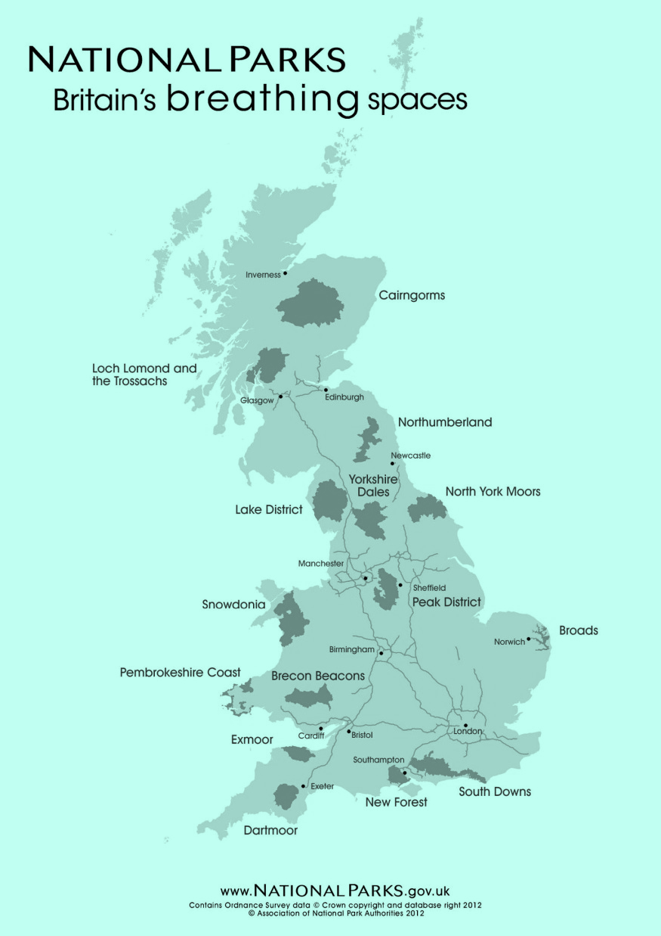
What are National Parks?
In the UK there are 15 National Parks , they are all designated as protected areas because of their beautiful countryside, wildlife and cultural heritage. People live and work in the national parks and the farms, villages and towns are protected along with the landscape and wildlife.
National parks welcome visitors and provide opportunities for everyone to experience, enjoy and learn about their special qualities.

Slide 16
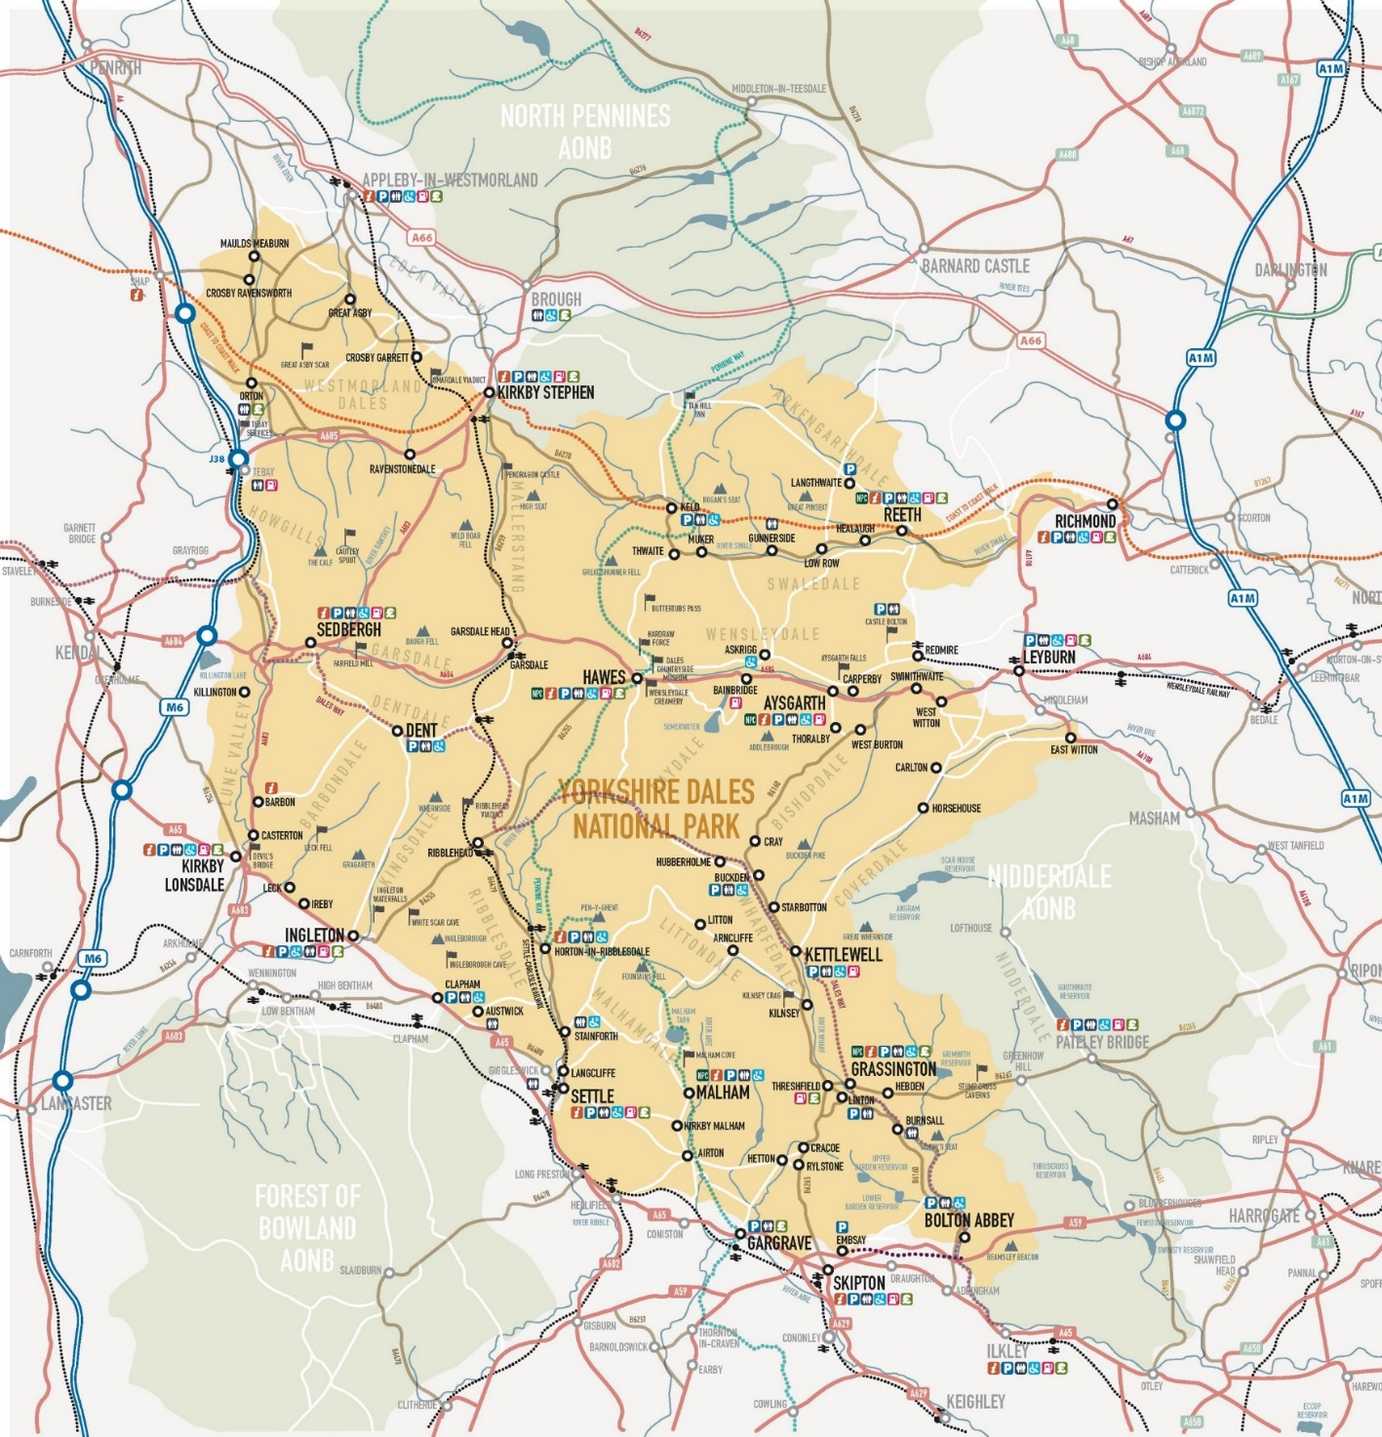
Where is the Yorkshire Dales National Park?

Slide 17
What are the different elements that make up the National Park?
Each National Park is looked after by an organisation called a National Park Authority, which includes members, staff and volunteers.
National Parks are large areas of land, including towns and villages, which means that lots of people and organisations help to look after them. The national park authority manages this.
Organisations
that work to protect natural and cultural heritage, many of them own land within National Parks. They include:
The National Trust
The Forestry Commission
RSPB
Wildlife Trusts
the Woodland Trust
English Heritage
Historic Scotland
Members
Staff
Volunteers

Slide 18
Key facts about the YDNPA
The YDNPA employs 130 people
Staff operate from two main offices:
1. From Bainbridge in Wensleydale – ‘Yoredale’
2. From Grassington in Wharfedale – ‘Colvend’
ACTIVITY
What careers and job roles do you think there are at the YDNPA? List them.

Slide 19
Background information
The Yorkshire Dales National Park (YDNP) was established in 1954. This is the physical landscape.
The Yorkshire Dales National Park Authority (YDNPA) became an independent body, within the framework of local government, in 1997.
The YDNPA provides some services similar to those provided elsewhere by district and county councils. It is for example the local planning authority.
YDNPA purposes
The National Park Authorities role is clearly defined in Parliament by two statutory purposes. These are:
To conserve and enhance the natural beauty, wildlife and cultural heritage of the National Park
To promote opportunities for the understanding and enjoyment of the special qualities of the area by the public.
In pursuing these purposes, the YDNPA must also:
Seek to foster the economic and social well-being of local communities within the National Park.
Sum up, the YDNPA aim is to conserve and enhance the National Park and to help others to share in and enjoy it.’
ACTIVITY
Collect and complete the YDNP and YDNPA sort exercise from your teacher.
Match up the key words and definitions with a partner

Slide 20
What careers and opportunities do you think exist in the YDNPA?
ACTIVITY
Working with a partner list all the possible job roles you can think of at the YDNPA.
Don’t forget what the purpose of the YDNPA is, as this will help you

Slide 21
Careers in National Parks
For many people the most obvious career in National Parks is the National Park Ranger, but there are many other areas of work and people are employed to carry out a wide range of roles.
The YDNPA is split into 3 directorates
Park Services
Corporate Services: Finance & Resources
Conservation and Community
There is also a senior leadership team headed up by the Chief Executive Officer CEO who has overall responsibility for the overall day to day running of the YDNPA.

Slide 22
List of job roles in the Conservation and Community directorate
Director of Conservation and Community
Head of Development Management
Head of Sustainable Development
Head of Land Management
Senior Policy and Performance Officer
PA to Director
Head of Land Management
Senior Farm Conservation Officer
Farm Conservation Adviser
Conservation Support Officer (Farming)
Senior Trees & Woodland Officer
Trees & Woodland Officer
Woodland Project Officer
Senior Wildlife Conservation Officer
Wildlife Conservation Officer
Parish Wildlife Project Officer
Apprentice Land Management and Conservation
Conservation Support Officer (Wildlife, Trees and Woodlands)
Planning Policy Officer
Sustainable Development Officer
Enforcement Officers
Principal Planning Officer (South)
Senior Planning Officers
Planning technicians
Administrative Assistant
Planning Support Officer
Senior Planning Technician
Senior Listed Building Officer
Building Conservation Officer
Senior Historic Environment Officer
Countryside Archaeology Adviser
Historic Environment Project Officer
Community Heritage Officer
Apprentice
Minerals and Waste Planning Officer
Principle Planning Officer (North)
Planning Officer (Career Grade)
Planning Assistant
Senior Planning Officers
Principle Planning Officer (Enforcement)

Slide 23
List of job roles in the Corporate Services directorate
Head of Finance
IT Manager
Estates Manager
Maintenance Officer
IT Officer GIS
IT Officer South
IT Officer
Senior Administrator
Finance Officer
Finance Clerk
Head of HR and Communications
Communications Manager
Web and Social Media Officer
Media Officer
Communications Officer
Committees Officer
Receptionist North
Receptionist South
HR Admin Officer
Apprentice Comms YDNPA
Director of Corporate Services
Corporate Services Officer

Slide 24
List of job roles in the Park Services directorate
Museum Manager
Museum Officer
Information Advisors
Destination Co-ordinator
Museum Admin officer
Head of Visitor Services
Centre Manager
Tourism Officer
Visitor Support Officer
Head of Access and Engagement
Education and Events Manager
Learning and Engagement Officer
Young Rangers Officer
Interpretation Officer
Volunteers Development Officer
Access and Recreation Officer
Access Support Officer
Volunteers and Engagement Support Officer
Director of Park Services
Head of Park Management
Personal Assistant to Director
Area Manager (West)
Area Manager (North)
Area Manager (South)
Interpretation Officer
Volunteers Development Officer
Access and Recreation Officer
Access Support Officer
Volunteers and Engagement Support Officer
Director of Park Services
Head of Park Management
Personal Assistant to Director
Area Manager (West)
Area Manager (North)
Area Manager (South)
National Trails Partnership Manager
Rights of Way Officer
Pennine Bridleway Officer
Park Management Admin Officer
Access Ranger Colvend
Access Rangers 3 Peaks
Access Ranger Hawes
Access Ranger Orton
Apprentice Stonedykes and Colvend
Apprentice Hawes
Area Ranger Orton
Area Ranger Aysgarth
Area Ranger Reeth
Area Ranger Malham

Slide 25
In addition the YDNPA has a Senior Leadership Team made up of:
Chief Executive
Deputy Chief Executive Directorate of Conservation and Community
Treasurer, Director of Corporate Services
Director of Park Services
Solicitor / Monitoring Officer
Senior Legal Officer
Legal Assistant & Administrative Officer
PA to Chief Executive & Chairman

Slide 26
Investigating YDNPA career roles in more detail
ACTIVITY
You are going to work in a group over the next few lessons to undertake an investigation into one of the YDNPA’s directorates :
Conservation and Community directorate
Corporate Services directorate
Park Services directorate
Your teacher may allocate you a group or you may work in a group based on your previous work on a possible career route, For example you may wish to work outdoors, or indoors and this may influence the choice of directorate you investigate.

Slide 27
Once you have been allocated the directorate you are investigating key questions to address through your investigation
The investigation will form the basis for your presentation, which you will present to your peers.
Where is the Yorkshire Dales National Park ?
What does the YDNPA do? What is the organisations’ purpose?
Outline the careers people do in the YDNPA: include the less obvious jobs. Give a detailed overview of the careers and job roles in the directorate you have investigated. What do they do? Why are they important?
Give a detailed example of at least one job role in the directorate you are investigating. To get you started: What skills and attributes do you need to be successful in the job role?
Include in your presentation the 5 most interesting things you have found out about the YDNPA and the directorate you are investigating.

Slide 28
Obvious Vs ‘Hidden’ jobs
During your investigation you will find out about both the obvious and the ’hidden’ jobs at the YDNPA.
To find out more about what ‘hidden’ jobs are click on the link below and watch the video. List all the jobs and then compare your list with a partner.

Slide 29
Planning the YDNPA investigation
Recap of the ACTIVITY
Your group’s task is to create a presentation about the YDNPA directorate you have been allocated. You need to cover:
Where are the Yorkshire Dales National Park and YDNPA offices located?
What does the YDNPA do? What is the organisation’s purpose?
Outline the careers people do in the YDNPA - the ‘hidden’ and obvious jobs. Give a detailed overview of the careers and job roles in the directorate you are investigating.
Give a detailed example of at least one job role in the directorate you have been given to investigate. What skills and attributes do you need to be successful in that job role?
Include in your presentation the 5 most interesting things you have found out about the YDNPA and the directorate you are investigating and the job roles available

Slide 30
What do you know so far?
ACTIVITY
What do you already know about the employer (the YDNPA) you have been asked to investigate? Complete the diagram adding what you already know.
What I know about the Yorkshire Dales National Park and Yorkshire Dales National Park Authority

Slide 31
How will you approach the investigation?
Consider how you will approach the investigation and project tasks.
Think about:
What do you already know about the YDNP and YDNPA?
What are the gaps? What do you need to find out to complete the project?
Where will you find out this information?
2. You also need to think about who is going to do what in the group and think about what type of presentation you will give at the end of the project.
What are the strengths of the people in your group?
What are the gaps – what skills will you need to develop to complete the project?
What will make your presentation stand out and be different?
Who will you be presenting too?

Slide 32
To help organise your investigation in your team complete the action plan
Think about what needs to be done, who will do what?
Think about the amount of time you are being given to complete the project and plan accordingly.
Don’t forget you who you are going to present your findings to, use a presentation style that is appropriate for your audience.
Remember action plans are used by business to help them think about what needs to be done and when. These can change and develop as the project evolves but they are a good reference point to keep you on track.

Slide 33
Resources available to help your investigation
There are a number of additional information and resource sheets available from your teacher these include job descriptions to help you delve into career roles in each directorate
Your teacher also has links to talking heads videos from individuals who currently work for the YDNPA in each of the directorates which are being investigated
Make sure you access the correct talking heads videos for the directorate you are investigating
Think about how you can use this additional information to enhance your investigation and presentation

Slide 34
Action plan template
Action Plan Name of team………………………………………………. Team member(s)…………………………………………… Yorkshire Dales National Park Authority directorate being investigated…………………………………………..
List of what needs to be done E.g. key facts about the business, how it is organised? What careers and jobs are available? | Who will be responsible | When does it need to be completed by?
Resource sheet 3

Slide 35
Time to extract the key facts
ACTIVITY
The table can be used as a prompt to extract the key facts and information about the YDNPA and the directorate you are investigating from your research.
Remember
It is important that what you present is accurate, relevant and up to date. How would you check this?
A good place to start is to see if the employers website has information about itself as an organisation, this will often give you some key facts and an insight into the business.
A note of caution - when using the internet as a source of information make sure you use the correct business logo and branding for the business/ employer don’t just rely on google images!
Check your facts and figures, is the source of your information reliable?

Slide 36
Key questions to help your investigation
ACTIVITY – use the prompts in the table to help your investigation
Key questions
Where are the YDNP and the YDNPA offices located? Does the YDNPA have more than one site? Where are their headquarters? Where does the site nearest to you fit within the larger organisation? How many employees are there? Find out what a CEO is? Who is the CEO?
What does the business do? What products and services do they provide or sell?

Slide 37
More key questions
How is the YDNPA organised? Many businesses have an organisation chart to show all the different areas Where does the directorate you are investigating fit in this?
What types of careers and jobs are available in the business? Can you give any examples of the types of careers and opportunities there are in the directorate you are investigating?
What are the ‘hidden jobs’ in the business the ones which are less obvious, and those you have found out about?

Slide 38
Further key questions
What does the business want to be known for? For example some businesses have ethical or environmental objectives or want to for example be the best provider of…. or be known for excellent customer service etc. What are their aims and objectives?
What is it like to work for the business and employer? What have they achieved recently? Outline the key reasons why people work for the business what are the benefits and opportunities in the organisation? The ‘talking heads’ videos will help with this
Add any other questions you have here

Slide 39
Business aims and culture
Learning Outcomes
To understand what business objectives and culture are
To explore some examples of business mission statements and culture
To investigate the business/ employer purpose, objectives and culture
All businesses have aims and objectives ,these can be financial, for example making a profit, or non-financial, such as personal satisfaction or doing good within the community or having an ethical focus.
Businesses often have a ‘mission statement’.
Mission statements are important because they help customers understand the business. The best mission statements are short, clear and don’t use jargon.
Businesses often talk about their culture.
A businesses culture includes things like the way the business gets things done, how people are expected to behave, how the business works with other organisations, how it looks after it’s employees.

Slide 40
Mission statements
Some examples of mission statements – follow the links
Nike
Ben and Jerry’s Ice cream
Virgin Atlantic
ACTIVITY
Having looked at the links, which mission statement do you think is the best? Why?
Try and find out the purpose - aims and objectives for the YDNPA include your findings in your investigation. It would be useful to look at the ‘talking heads’ videos to help you with this.

Slide 41
Business culture
The links below give some examples of business cultures:
10 Companies which have a great culture.
Times 100 best companies to work for.
ACTIVITY
Is the YDNPA a good place to work? How would you find this out?

Slide 42
Presentation and key messages
When you have completed your investigation your group will present your findings!
Things to think about:
How long do you have for your presentation?
What are your key messages?
How you present your findings is important and remember to answer the project brief:
What the employer / business does?
Outline the careers which are available in the business – both the obvious and the hidden jobs
What is it like to work there?

Slide 43
Presentation and communication
How you present your findings is important. The presentation has to suit your audience and the subject of your investigation.
First impressions count! Make sure you have practiced what you are going to say and everyone in the group knows what they are delivering in the presentation.
If you use PowerPoint think about how many slides you use, use images and pictures to convey your message, and avoid too many words on each slide.
Would using props help to the information you are trying to get across?
Think about the size of the writing and use of images.

Slide 44
Tops tips for your presentation
Stick to the time limit you are given .
Get your message across clearly and concisely. Speak clearly and don’t rush.
Be creative , what will make you stand out, is your presentation interesting? Would using technology improve your presentation? Is your presentation slick?
If you use notes, try not to read from a page, use them as prompts to help you remember what you want to say.
Practice and plan what, and who is going to say what and when.
Put yourself in the position of the employers. Have you done your research is what you are presenting accurate?
Remember to have fun and enjoy the opportunity!

Slide 45
Pupil evaluation
What you have learnt from taking part in the investigation?
Has it made you think about: your future career, future choices?
Yes / No
Why?
What did you like about the project?
Is there anything you didn’t like about the project?
How could the project be improved for next time?
Please note any further comments you would like to make.

Slide 46
Student evaluation SWOT analysis
What you have learnt from taking part in the project.
Complete another SWOT analysis of yourself. Has it changed?
Strengths - the things you are good at
Weaknesses – the things you need to
work on and develop
Opportunities – what career opportunities are available to you?
Threats – or challenges the things you need to overcome

