Slide 1
Edge Foundation
Back to School
Carried out between 11 / 08 / 2020
To 13 / 08 / 2020
Sample: 1,003 14-19 year olds across the UK (including Northern Ireland, Scotland and Wales)

Slide 2
Question One
How do you think your school or college coped with delivering teaching and learning during lockdown? (Please select best match)

Slide 3
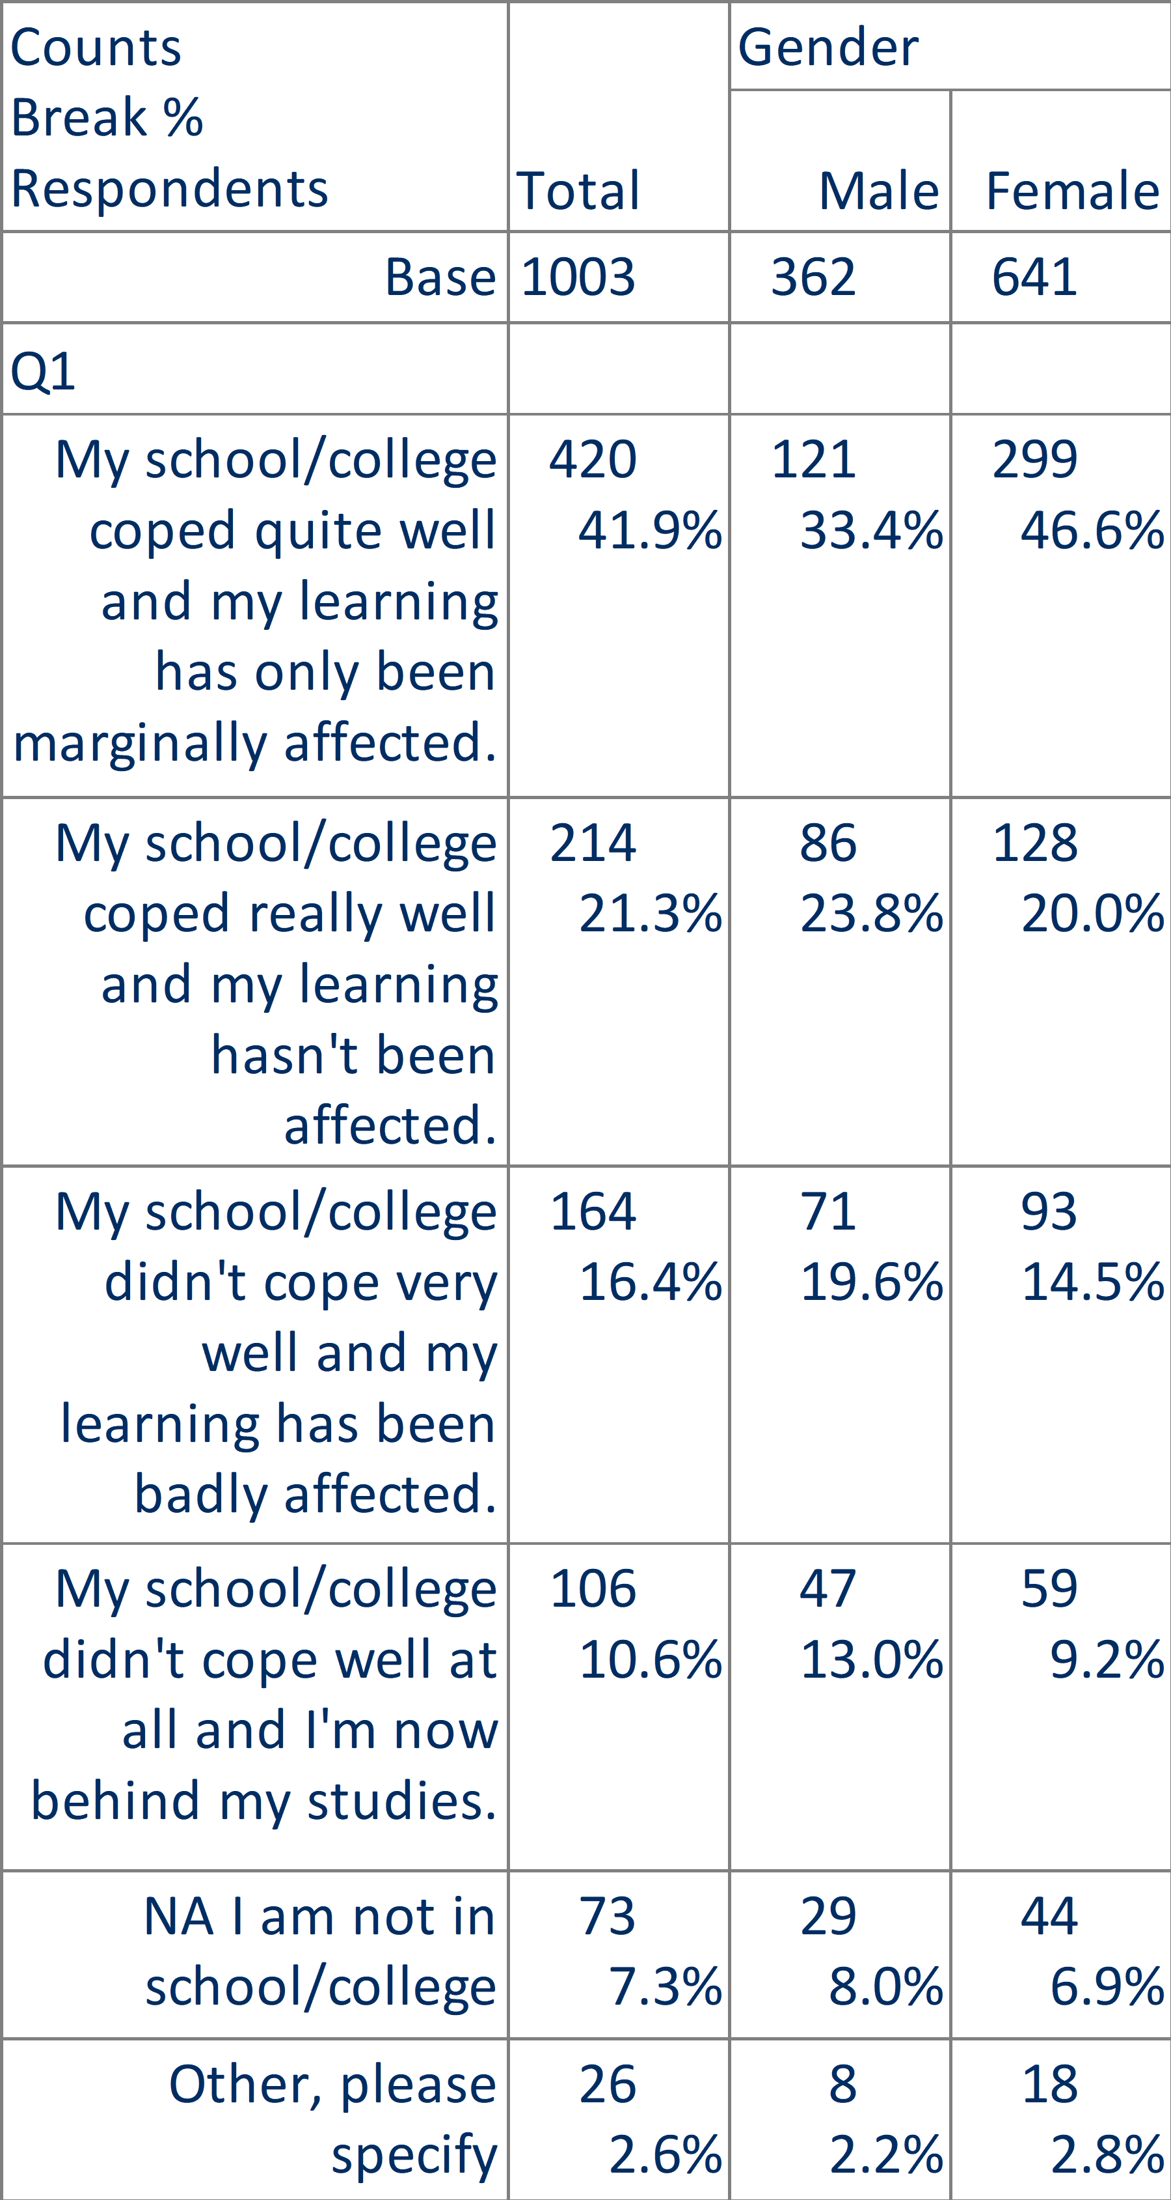
Question One Cross Tabulation with Gender
How do you think your school or college coped with delivering teaching and learning during lockdown? (Please select best match)

Slide 4
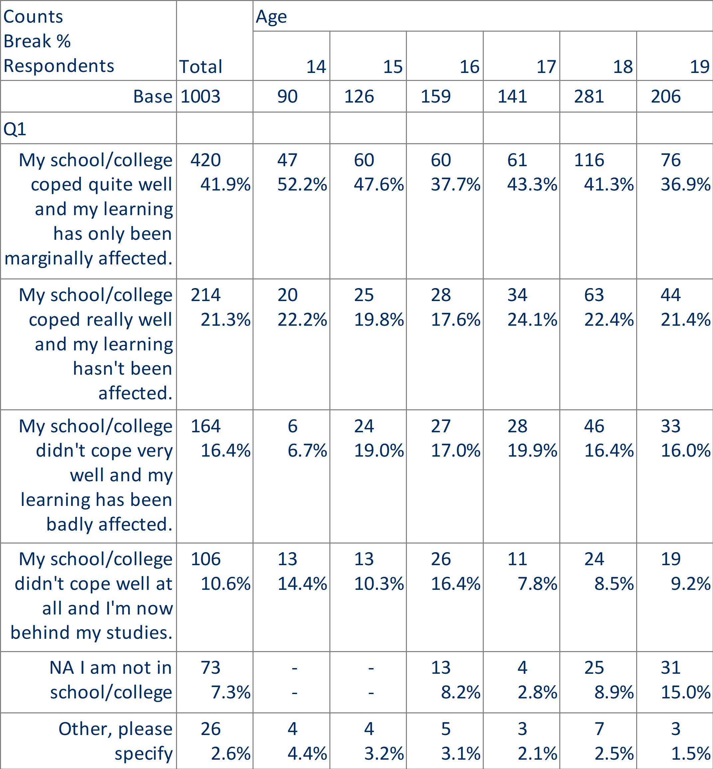
Question One Cross Tabulation with Age
How do you think your school or college coped with delivering teaching and learning during lockdown? (Please select best match)

Slide 5
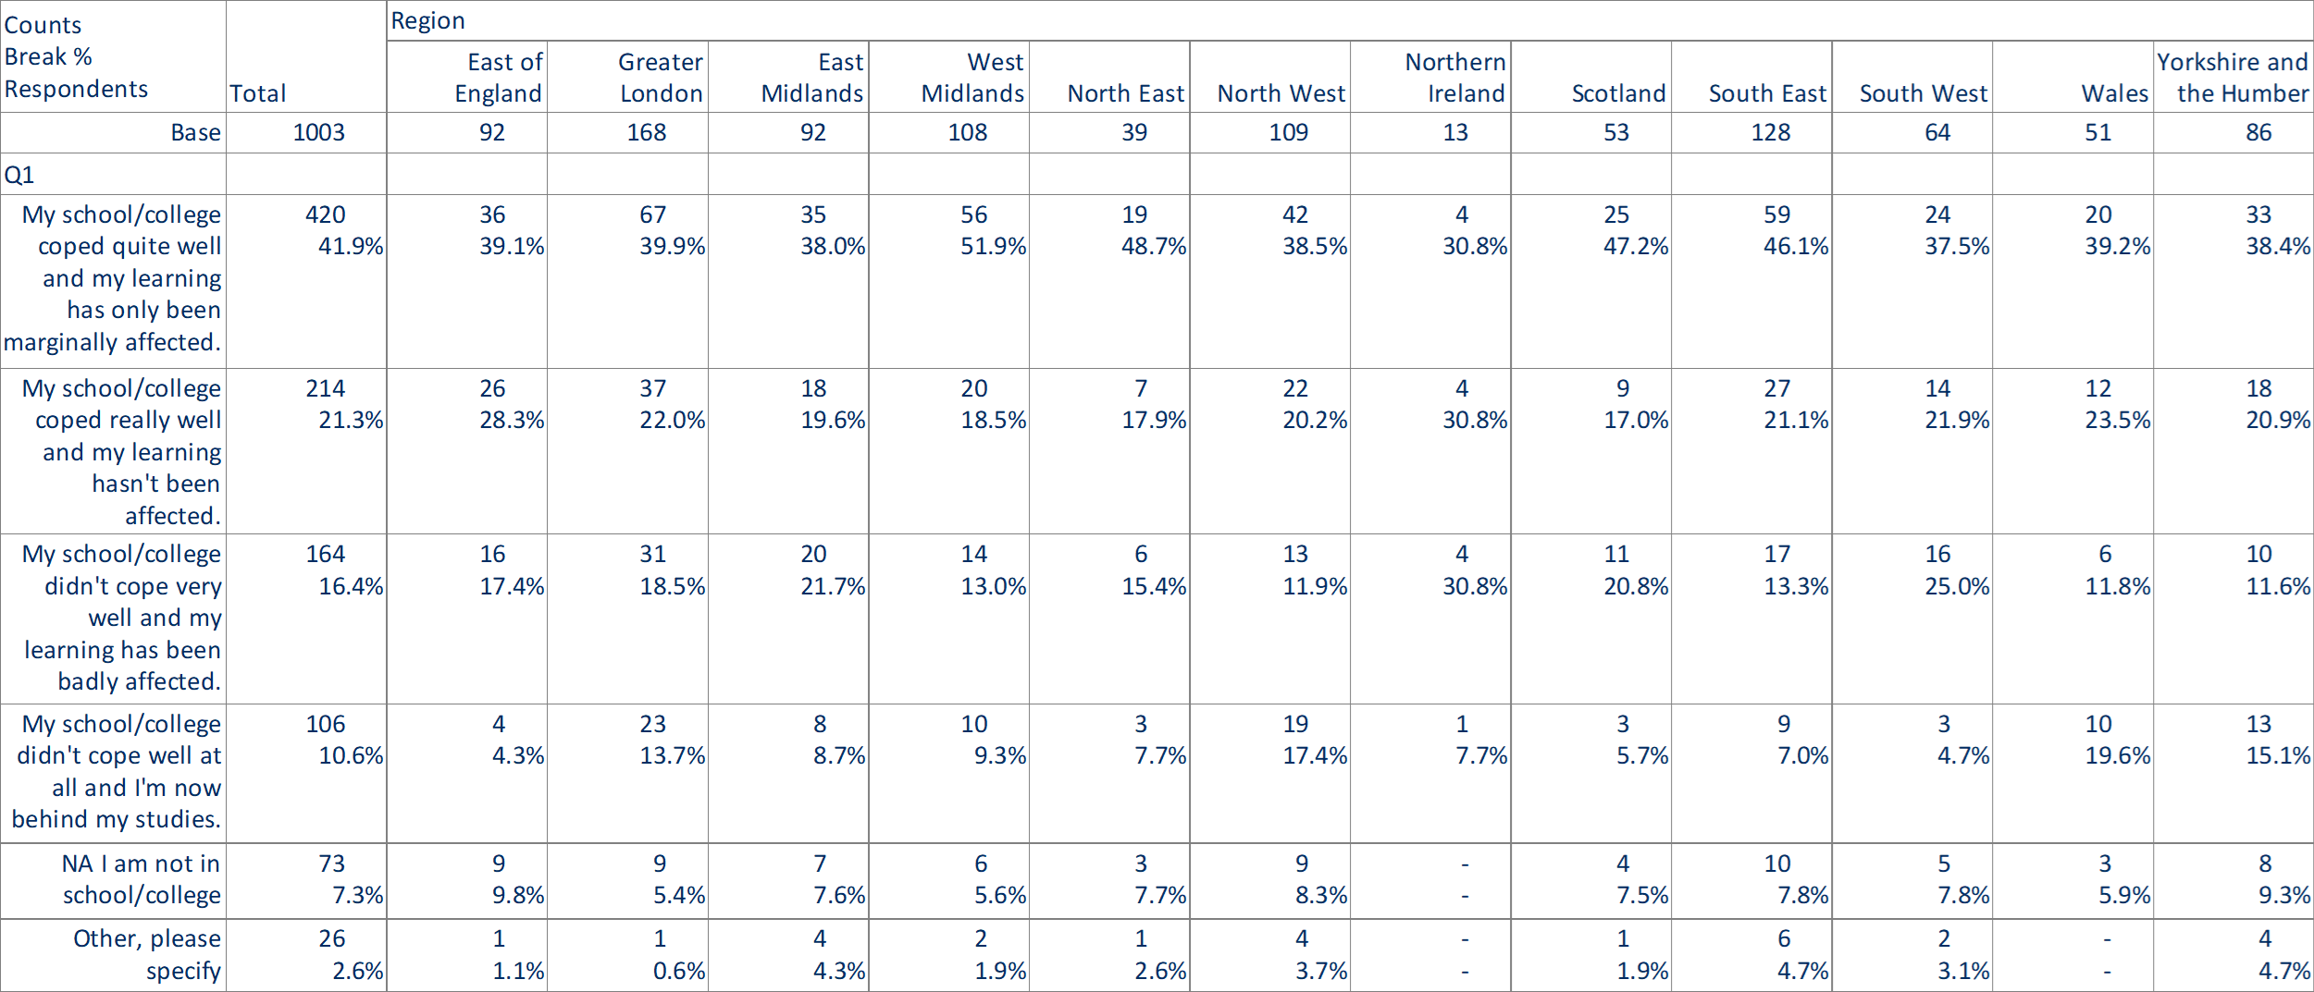
Question One Cross Tabulation with Region
How do you think your school or college coped with delivering teaching and learning during lockdown? (Please select best match)

Slide 6
Question One Cross Tabulation with City
How do you think your school or college coped with delivering teaching and learning during lockdown? (Please select best match)

Slide 7
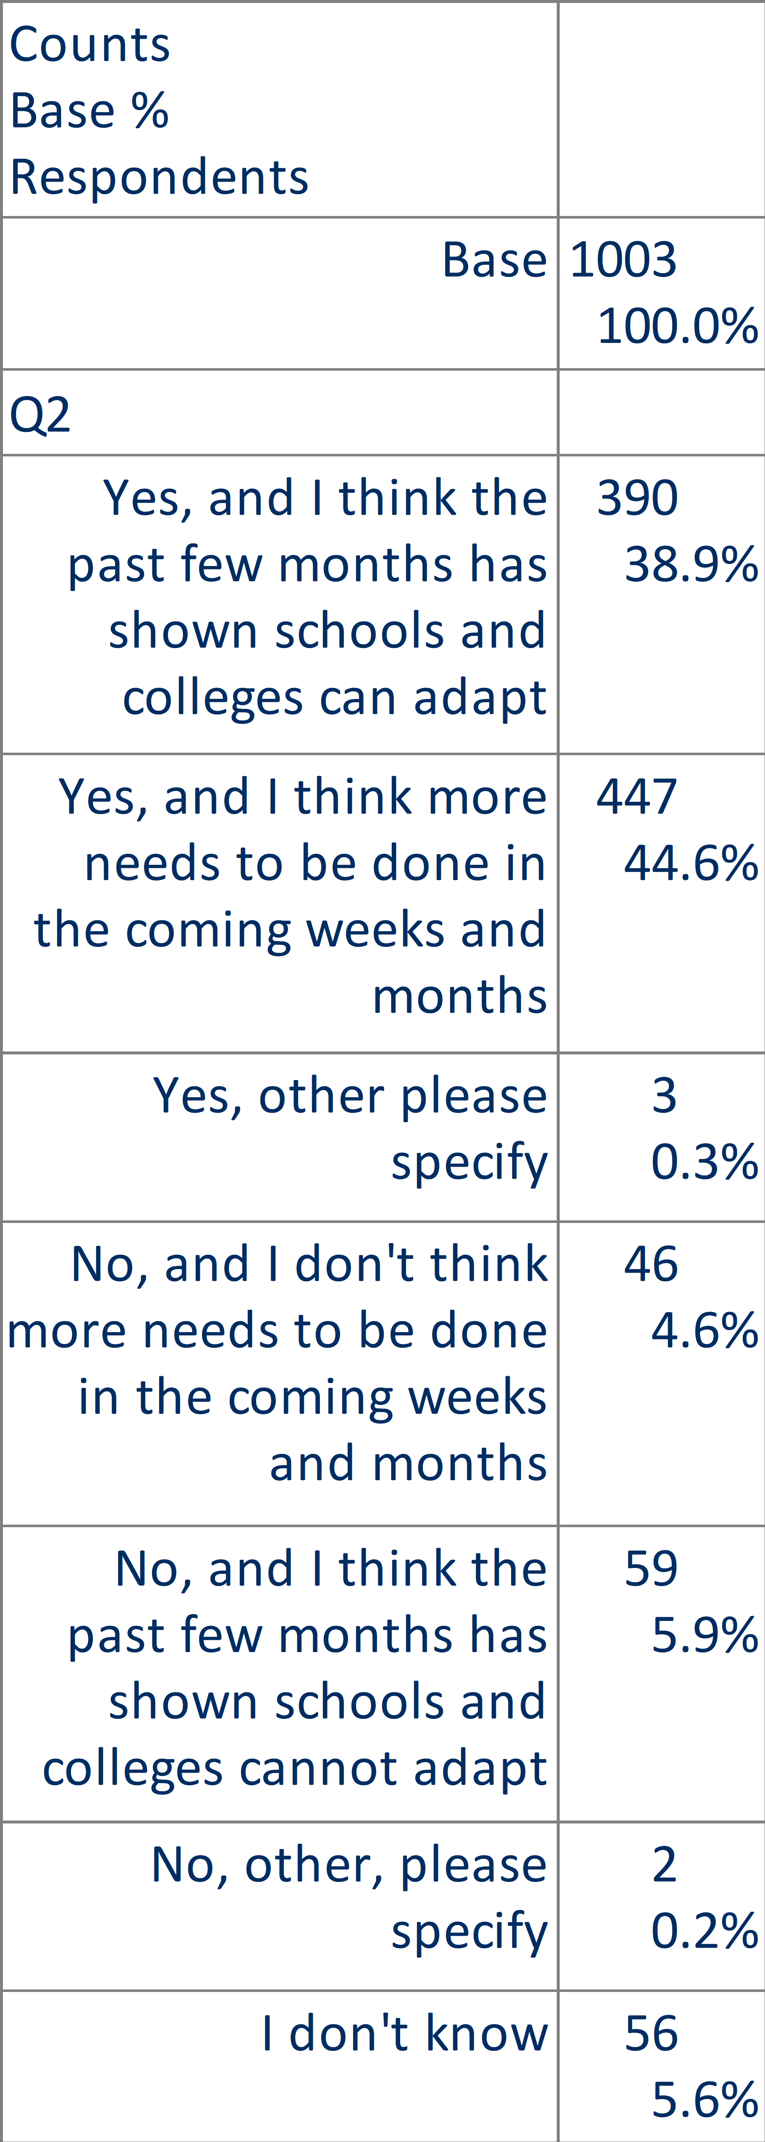
Question Two
Do you think that the future of schooling needs to be more flexible and adapt more quickly as a result of the Coronavirus pandemic? (Please select best match)

Slide 8
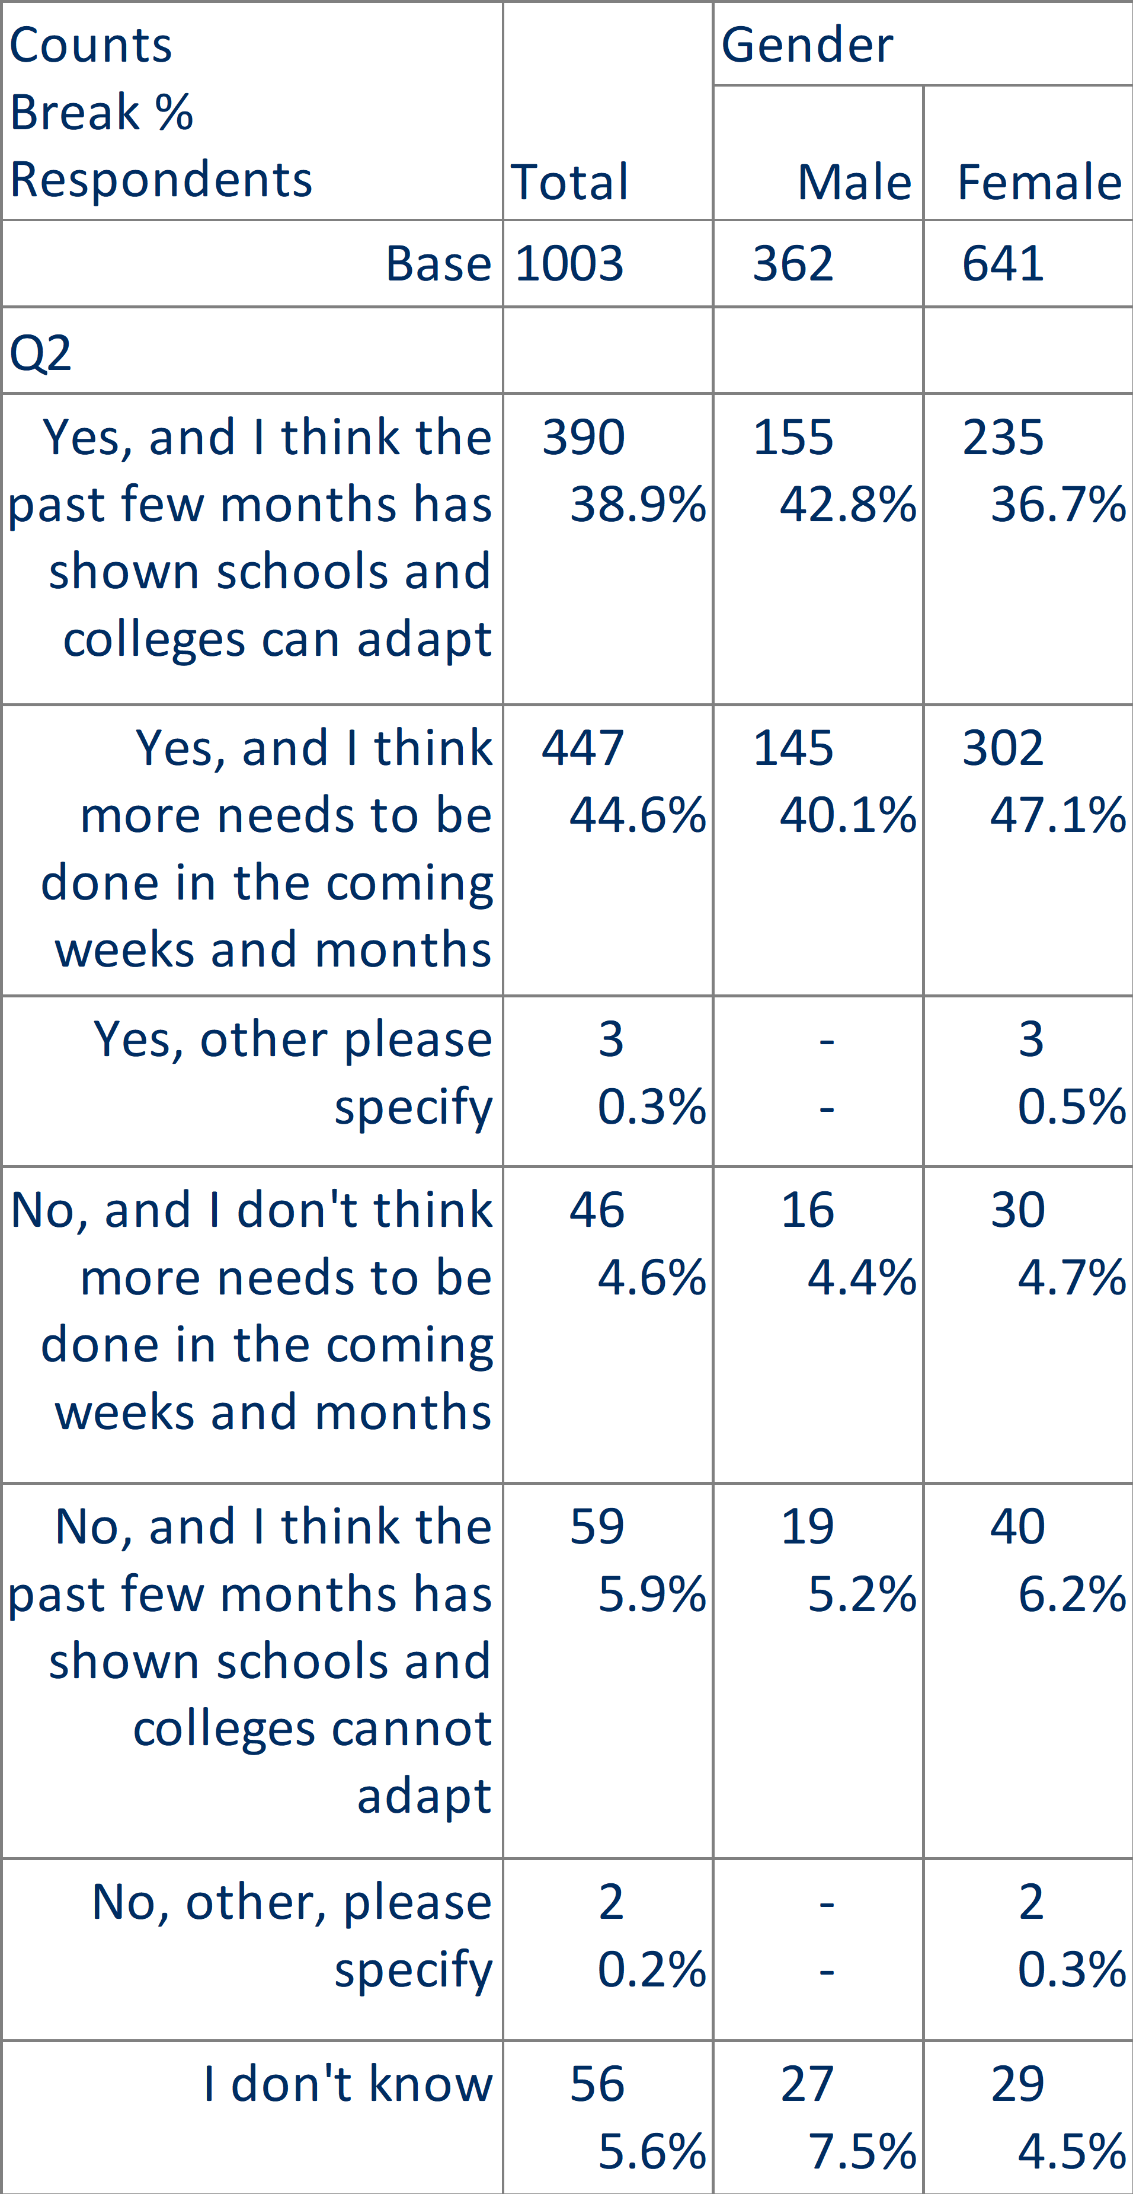
Question Two Cross Tabulation with Gender
Do you think that the future of schooling needs to be more flexible and adapt more quickly as a result of the Coronavirus pandemic? (Please select best match)

Slide 9
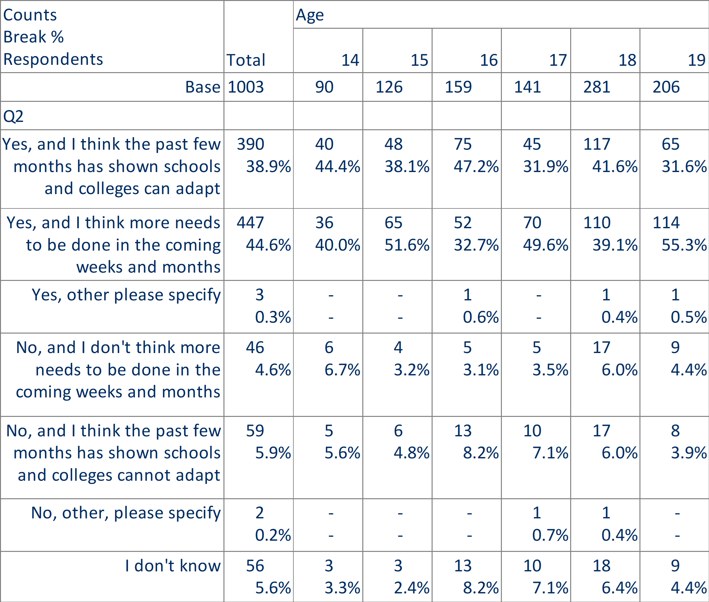
Question Two Cross Tabulation with Age
Do you think that the future of schooling needs to be more flexible and adapt more quickly as a result of the Coronavirus pandemic? (Please select best match)

Slide 10
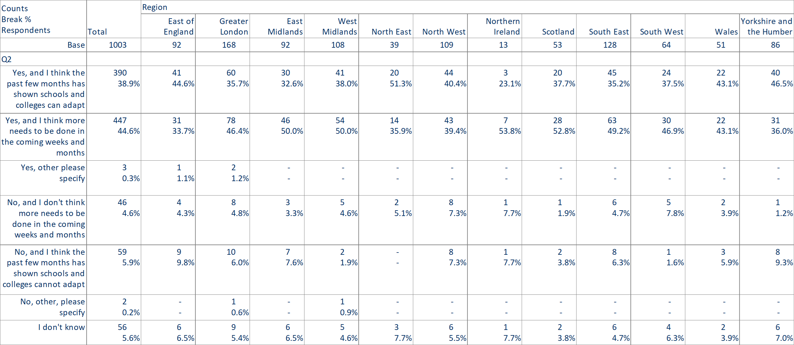
Question Two Cross Tabulation with Region
Do you think that the future of schooling needs to be more flexible and adapt more quickly as a result of the Coronavirus pandemic? (Please select best match)

Slide 11
Question Two Cross Tabulation with City
Do you think that the future of schooling needs to be more flexible and adapt more quickly as a result of the Coronavirus pandemic? (Please select best match)

