Slide 1

Rethinking Assessment
Challenge, Knowledge & Humanity Led Learning & Assessment
Dr Chris McLean: university of Manchester

Slide 2
Challenge, Knowledge & Humanity Led Learning & Assessment
What challenges do we face in education?
  How can education prepare young people for the future and enable individuals, society and the planet to grow, flourish and thrive?
How can we tackle these challenges through rethinking assessment, pedagogy and curriculum design?
  How can approaches such as Extended Project Qualifications and School Citizen Assemblies play a role?

Slide 3
What’s the Problem (Challenge)?
How can we develop all stages of education and assessment to ensure that all individuals, society, organisations and the planet can grow, flourish and thrive?
Create a better world – greater equity, inclusivity, diversity, sustainability & greener growth…..
Purpose of Education and Assessment – Who, what, why & how?
Rethinking Assessment, Pedagogy & Curriculum Design - beyond passing exams & absorbing abstract facts – mobilising knowledge, understanding and skills, empathy, real world learning, problem-solving, critical thinking, innovation, collaboration, creativity, resilience…..

Slide 4

Assessment
Curriculum
Pedagogy
Pupil Progression Routes
Society & Economics
School Leadership
Globalisation
Training & Development (CPD)
Sustainability, Biodiversity & Climate Change
Organisational Culture
Pandemics
Technological Innovations
Accountability

Slide 5
Future Ready: Assessment & Progression
“Employers frequently express the opinion that education needs to evolve in order to meet the challenge of preparing young people for a future that is being shaped by forces such as the march of technology, a changing political climate, the globalisation of the economy and concerns about the sustainability of our way of life.”
(Pearson, Future Ready 2021)
“Our Extended Project qualification (EPQ) can provide your students with the skills that universities and employers look for and will help them to stand out from the crowd in their future careers…. These key transferable skills are extremely valuable in supporting a learner’s progression to Higher or Further Education, vocational qualifications or directly into employment, as well as supporting their study in other subjects.”
(OCR EPQ Specification 2021)

Slide 6
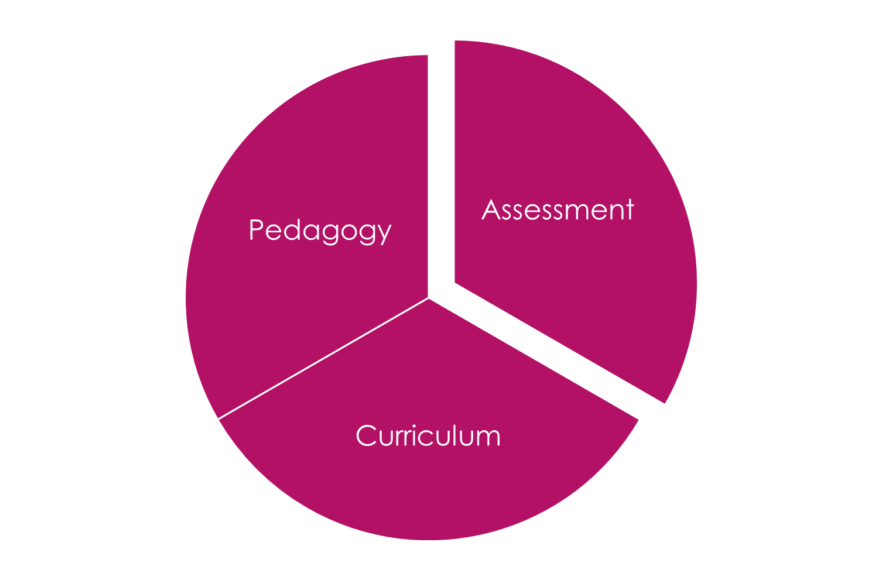
Assessment, Pedagogy & Curriculum: What do we need?
High Quality Assessment for Learning, Progression & Positive Outcomes - individuals, communities, organisations & wider society
Outcomes: Knowledge/understanding, mental/physical health, equity, diversity, citizenship, sustainability, biodiversity, climate action, inclusivity, innovation, creativity….
Progression: further & higher education & lifelong learning, careers, volunteering….
Making a Real Difference: local & global communities
Diverse Approaches & Techniques for Assessment, Pedagogies & Curriculum Design – Project Qualifications & SCAs.

Slide 7

Assessment: Project Qualifications & SCAs
Extended Project Qualifications (A Level); Foundational & Higher (GCSE)
  Assessment: report, dissertation, performance (art, dance, music), event, design, artefact – written element & presentation (Group?)
  Primary Qualification??
School Citizen Assemblies: Empower young people as changemakers by
Embedding SCA projects into curriculum design
Working with experts, stakeholders and local communities to tackle real world challenges
Generating knowledge, understanding, skills and actions connected to a specific design challenge or problem (also link to project qualifications)

Slide 8
Challenge Led Learning Outcomes
Extended Project Qualifications (EPQ) & School Citizen Assemblies (SCA)
Higher Order Thinking & Reflection
Real World/Challenge Based Learning - connecting with experts
Knowledge, Empathy & Understanding
Creativity, Diversity & Complexity
Collaboration, Communication & Citizenship
Agency, Independence & Resilience
Making a Real Difference – local &/or global communities

Slide 9
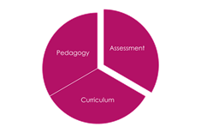
EPQ: Assessment, Learning & Engagement
Stephenson (AQA) & Issacs (UCL) 2019
“Prescription in the A-level curriculum has been attributed to ‘regulatory overkill’ which has resulted in an assessment system that fails to cater for learners’ specific needs or inspire teaching and learning (Bassett, 2014). Teachers claim that pressures to prepare students for tests and the narrowing of the curriculum to focus on academic subjects has reduced the time spent on creative teaching, investigative and practical work, limiting the depth of learning”
Such a strong emphasis on high-stakes testing could be damaging to learners…it can improve exam results (Hanushek & Raymond, 2005) but not knowledge and understanding (Amrein & Berliner, 2002). Furthermore, according to teachers, switching to linear examinations and reducing coursework in an attempt to raise standards has resulted in disaffection and demotivation amongst students (Hutchings, 2015)…The EPQ is perceived to facilitate freedom for students to study something they consider meaningful, in a way that suits them, which consequently empowers and motivates learners to engage in SRL.”

Slide 10
EPQ: University Admissions & Grades
Queen Mary University of London welcomes students taking the Extended Project Qualification (EPQ). The EPQ is an excellent opportunity for students to undertake a self-directed and self-motivated project which allows students to explore a topic of interest in depth through independent research….We recognise the EPQ as a qualification that provides students with a strong foundation in their transition to university.
We welcome the EPQ as adding value to a student’s academic profile and as an excellent preparation for the independent study necessary for students to succeed at University of Lancaster.
This additional offer reflects our confidence in the EPQ as an excellent preparation for the kinds of independent study necessary for students to succeed at a research intensive university such as Southampton.
The EPQ gives A-level students excellent preparation for university-level study and may help boost their UCAS application… Admissions tutors may wish to make an alternative offer to applicants, one of which involves successful completion of the EPQ. University of Manchester
Taking the EPQ to strengthen your application [and] can improve your chances of getting an undergraduate place at university. University of Bath

Slide 11
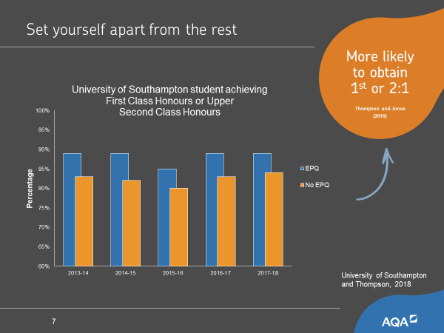
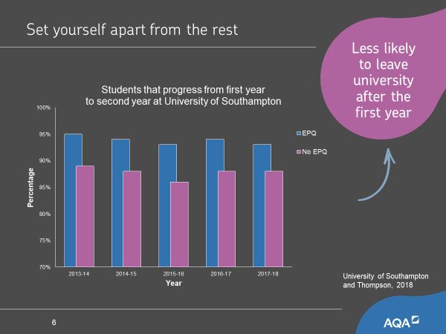

Slide 12

School Citizen Assemblies
Empowering young people to tackle real world issues by connecting experts and communities through broad, balanced and engaging curriculum design

Slide 13
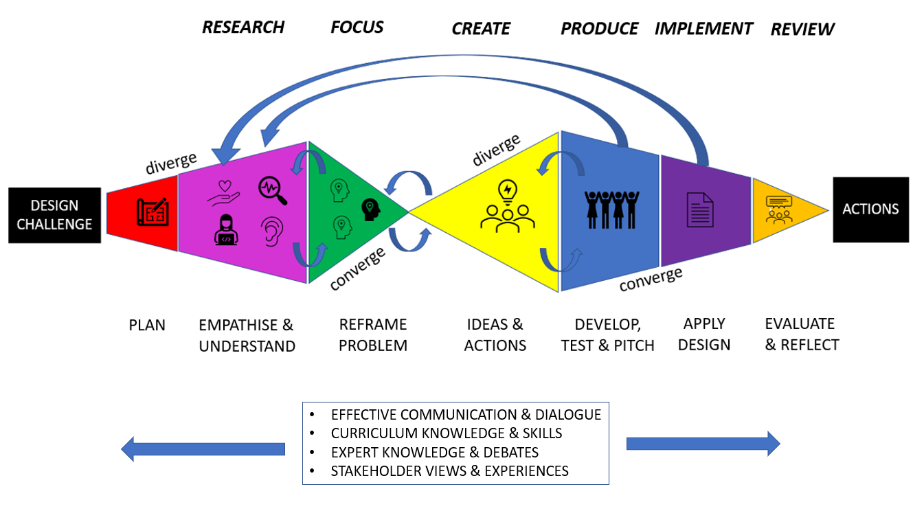

Slide 15
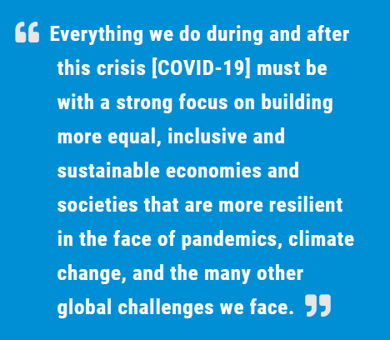
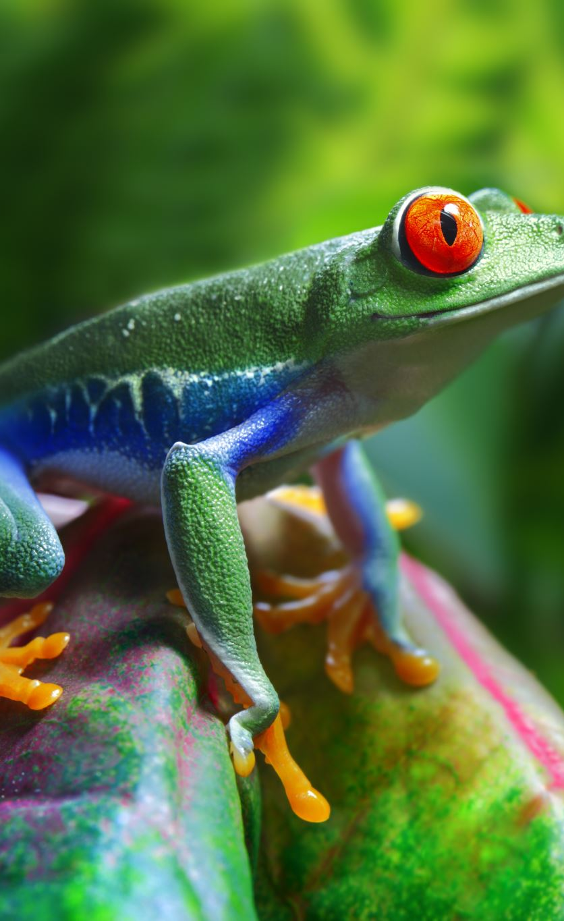
Antonio Guterres – UN Secretary General

Slide 16
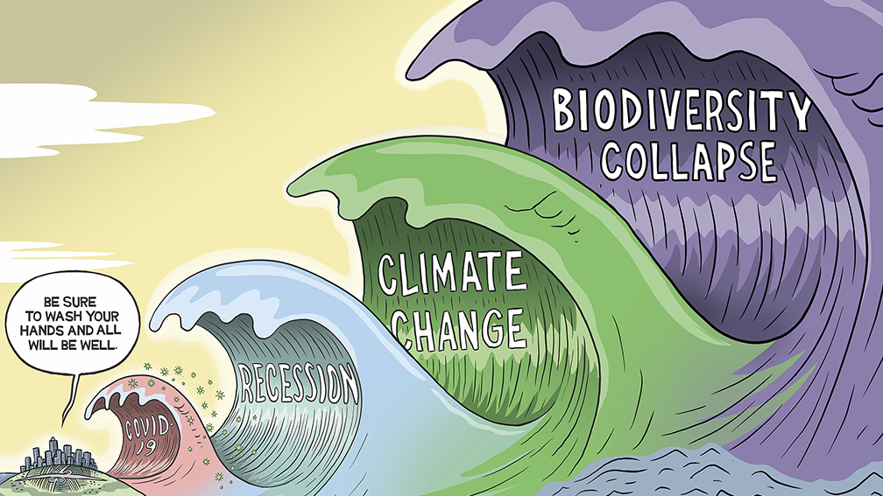

Slide 17
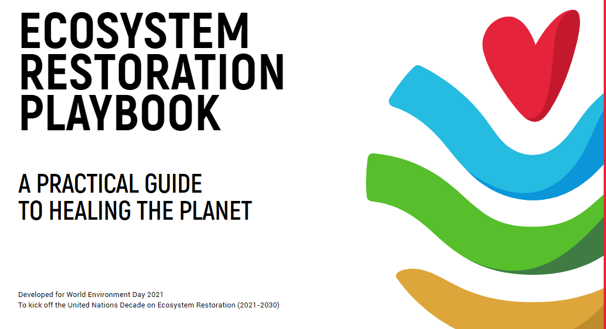
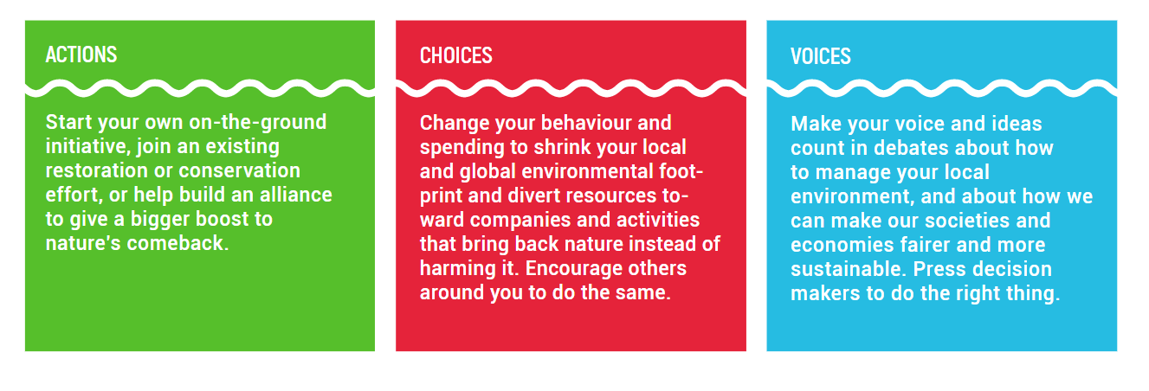

Slide 18
SCA Projects: Voice, Choices & Practical Actions
Secondary Whole School Climate Change and Sustainability Project: ~220 groups (~1250 pupils; all years) – Refuse, reduce, repair, reuse, repurpose, recycle, rethink
Biodiversity, Sustainable Palm Oil & Local Climate Change: primary whole school & year 6
Animals/Habitats in Crisis & local climate change actions - Whole Primary School
Shop Local & Buy Sustainable (SLBS): Farming trip (Farm to Fork) - school shop & advice
Making Sustainable Bird Feeders - advice for local community on biodiversity
Conservation, Animal Welfare & Grow Local: Grow & buy food locally – healthy eating
Tweak your Diet & Reducing Food Waste: Plant Based Recipe book & waste reduction
Sustainable Eco-tourism: advice on selecting & acting sustainably on holiday.
Designing Sustainable Futures: Buildings and Communities: energy reduction: design & use of buildings/grounds; sustainable careers.
Global & Local Citizens Sustainability Project - reducing litter, waste & recycling
Primary School Sustainability Artwork Project (MMU) – climate change & action
Year 7 English Summer Environmental Campaign Project: Reading, writing, oracy

Slide 19

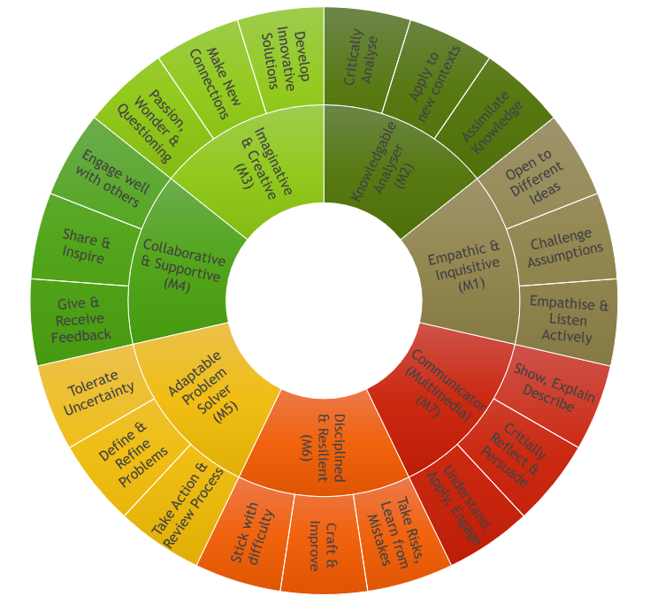
Assessment Circle
Emerging
Developing
Advanced
Outstanding
Inspirational

Slide 20
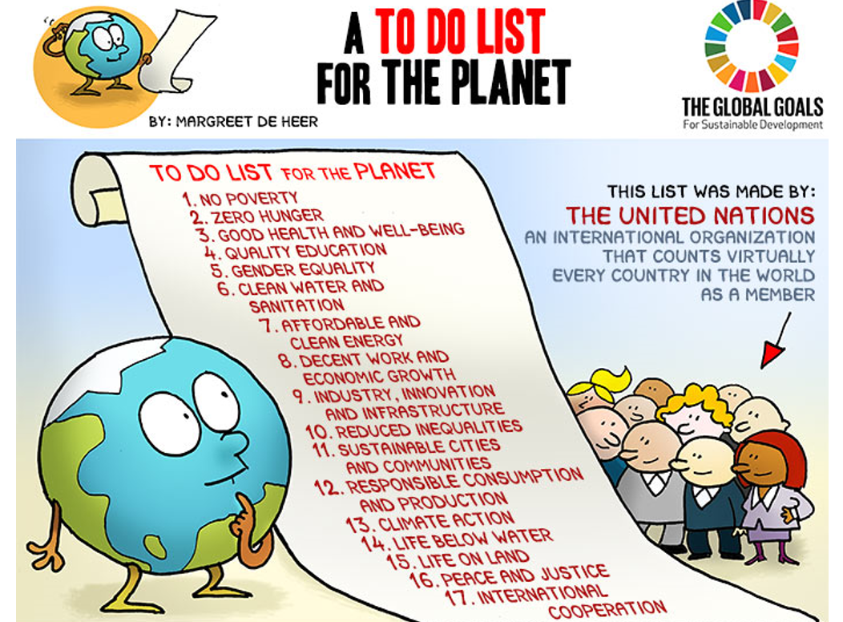

Slide 21

Contact: christine.mclean@manchester.ac.uk

