Slide 1
How learner profiles can recognise breadth of student learning and achievement
Rosie Clayton - Rethinking Assessment
Mike Flanagan - CEO, Mastery Transcript Consortium
Gavin O’Loughlin - DCF Lead & Teacher, Golftyn Primary School
Al McConville - Deputy Head, King Alfred School
Fran Wilby - Rethinking Assessment
Notes:
Welcome,

Slide 2
Session Aims:
To explore global trends in learner profiles and new transcripts
To understand what they are being used for and their core components
To look at workable models in UK schools and hear about RA pilot plans

Slide 4
Times Education Commission
The Commission proposes that this new qualification should also be supported by a Digital Learner Profile, a personal online portfolio for every student.
It would include academic qualifications alongside a record of other achievements: video footage of a pupil playing a musical instrument, photographs of projects they have worked on or details of expeditions, volunteering and work experience. A prototype of the digital profile already exists.

Slide 5
Networks & Global Movements
Brookings Institute
Welsh Goverment E-portfolios/Quals review
Mastery Transcript
Consortium
New Metrics for success
Independent Assessment Commission
ICAPE primary assessment
PISA creative thinking 2022
Rethinking Assessment
Education Scotland - profiles
APPGs
House of Lords report Dec 2021
Pearson Commission
Times Education Commission
HMC assessment reform group
FED 10 year plan for education
Coalition to Honour all Learning

Slide 6
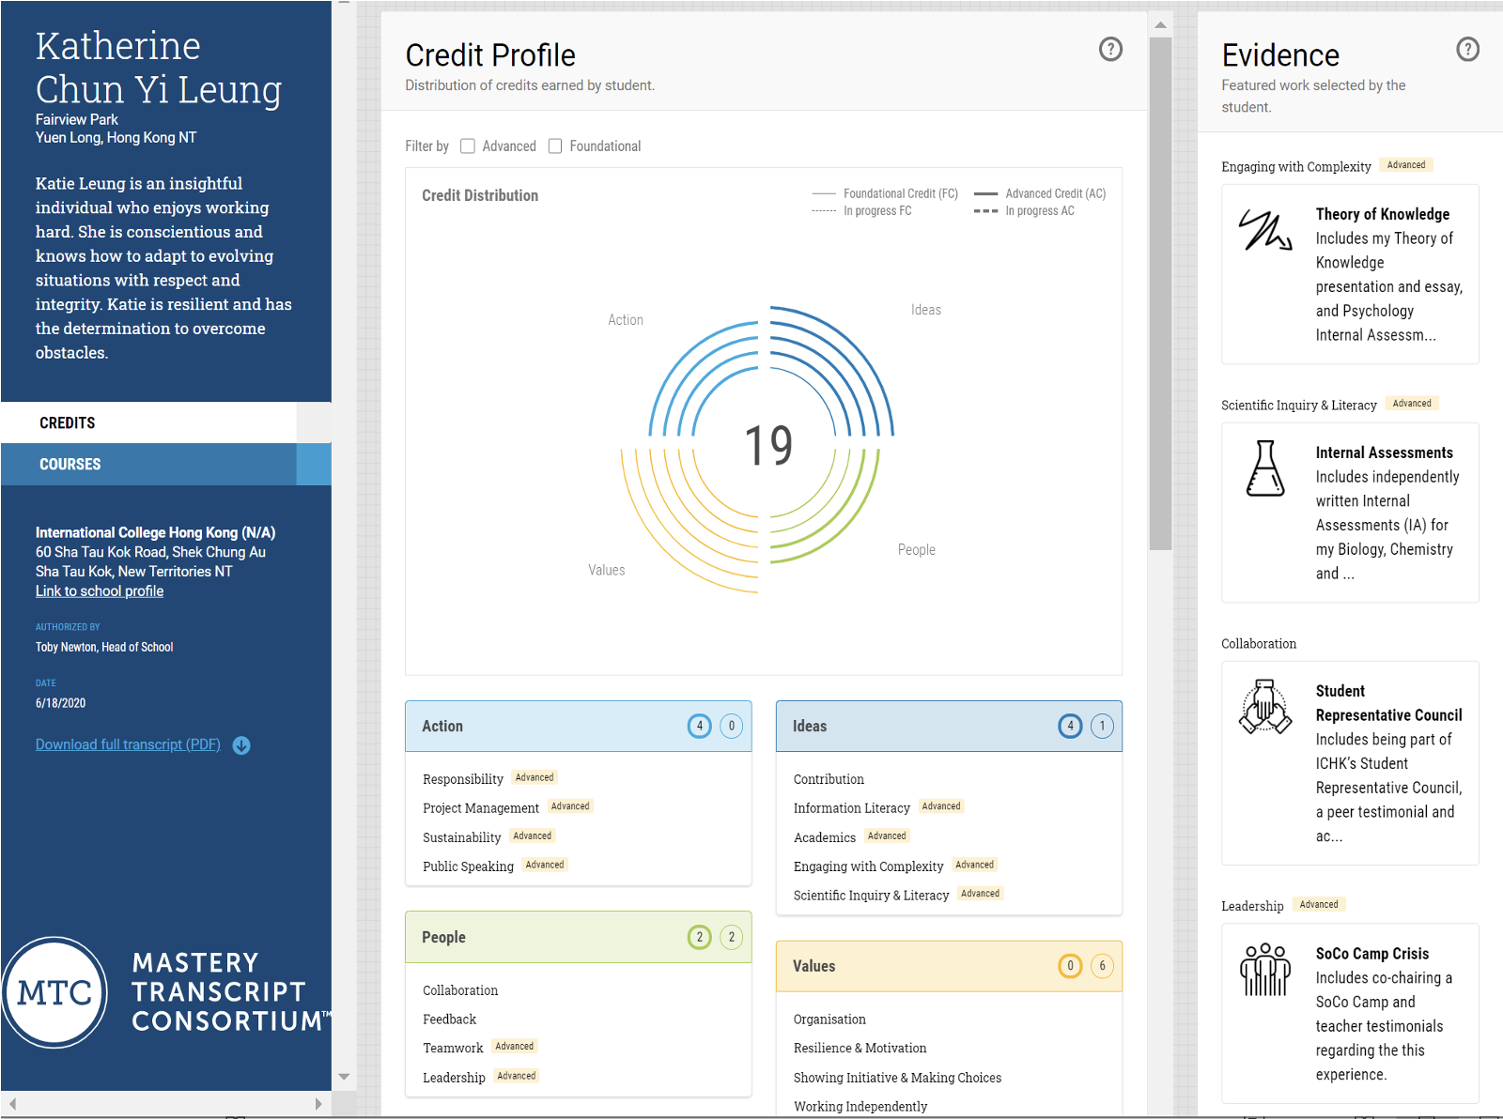

Slide 8
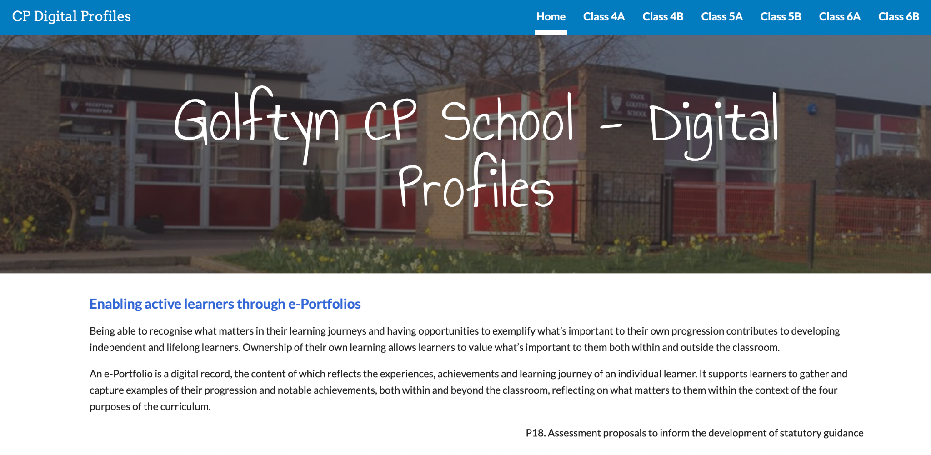

Slide 9
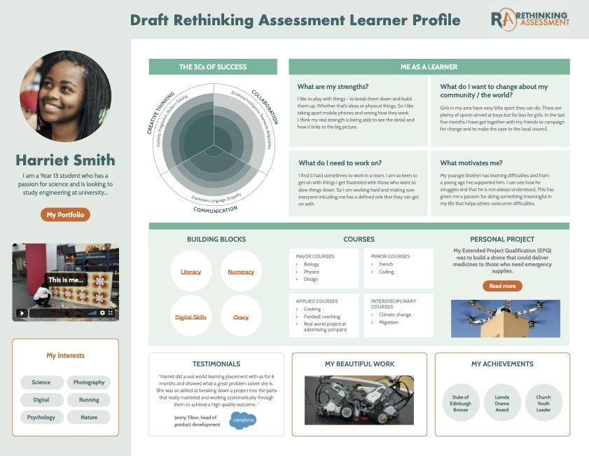

Slide 10
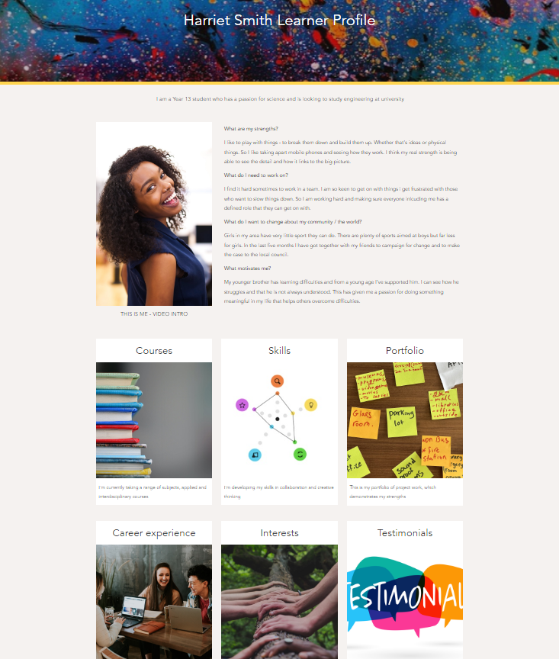
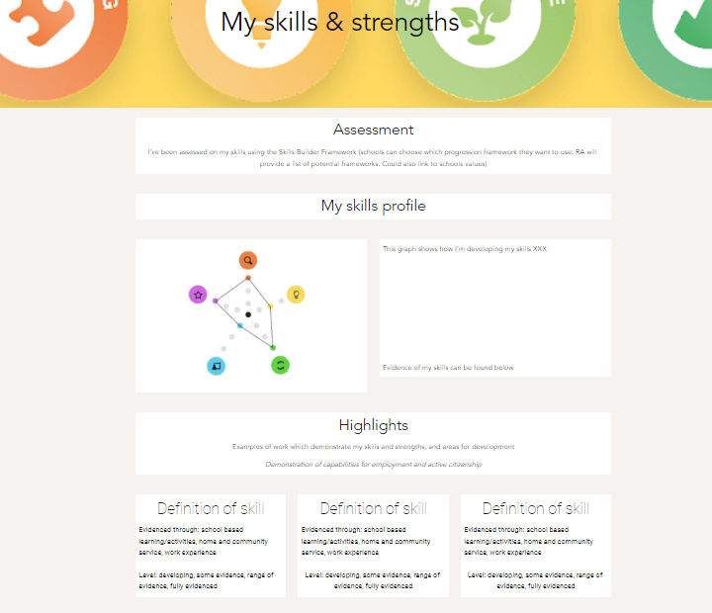
Notes:
https://sites.google.com/view/harriet-smith/home?authuser=0
https://sites.google.com/view/harrietsmithv3/snapshot?authuser=0

Slide 11
Learner Profile design principles
Strengths based
Captures and evidences breadth - head, heart, hand
Captures development over time/enables a learner to talk about and show their progress and development
Learner led, owned, customisable - inclusive
Accessible from tech perspective
Portable - between settings and beyond school

