Slide 1
The future of assessment: four trends
Sue Attewell & Paul Bailey Jisc

Slide 2
Outline
Intro & overview
Future trends:
Online & remote
Authentic
Capstone
Artificial intelligence
Activity
This Photo by Unknown Author is licensed under CC BY-SA-NC
Notes:
Intromeand paul
Explain – talk a bit then move to discusssion

Slide 3
Education and research improves lives, and technology improves education and research. That’s why we exist. Our vision is for the UK to be world leaders in technology for education and research.
Notes:
At Jisc we power world-class education and research because we believe education and research improve lives, and technology improves education and research.
That’s why we exist. It’s what drives us every day – unlocking our collective expertise, fostering communities and powering members with world-class services and products, including our superb Janet network, which connects 18 million people.
But we’re much more than a secure network. Our value-added activities set us apart. We’re focused on enabling UK education’s excellence – whether that’s by optimising digital transformation, and unlocking opportunities to save costs through licensing and cloud partnerships, or our work on data analytics and open research.
Our goal is to improve collaboration, digital infrastructure and secure connectivity in a way that powers better teaching, learning and research.

Slide 4
Help the sector save time and money Through our sector wide deals and shared services alone we save the sector around:
£192m (2020-2021)
We provide the Janet Network - the UK’s National research and education network (NREN) It is used by 18 million people
It has built in, world class cyber security protection, utilising sector specific intelligence
We provide trusted expert advice and practical assistance
Providing insight, guidance and thought leadership​
Delivering training and events​
Building communities

Slide 5
How do Jisc now support schools?
Helping schools meet DfE digital and technology standard requirements
https://www.gov.uk/guidance/meeting-digital-and-technology-standards-in-schools-and-colleges
Connection to our private education network (Janet), cyber security, cloud, trust and identity, procurement frameworks, and benefiting from our advice and guidance
A catalogue of services https://www.jisc.ac.uk/customers/our-catalogue-of-services-for-customers
Leicester Grammar School Trust Connectivity
https://repository.jisc.ac.uk/8388/1/leicester-grammar-school-trust-case-study.pdf
E-ACT: “a trust-wide approach to connectivity is making us more resilient”
https://repository.jisc.ac.uk/8656/1/e-act-a-trust-wide-approach-to-connectivity-is-making-us-more-resilient-case-study.pdf

Slide 6
Future trends
Notes:
Im going to talk through 4 trends
Then we’ll ask you tochoose one of them todiscuss in moredepth

Slide 7
Digital and remote assessments
Sitting down for three hours and handwriting on a piece of paper is medieval. It does not sit well with the capabilities that we have already or could have. Exams have to go digital. Klaus-Dieter Rossade, director of assessment programme, the Open University
Timed and scheduled
Open/closed book
E-Proctoring often seen as the response
Balance student impact
Increase inclusion
Minimise staff workload
Notes:
staff are very conscious of the need to rethink practice but not necessarily confident in their ability to do so.
UCL now moved to "Digital as default mode for delivering Controlled Condition Written Exams" https://www.ucl.ac.uk/teaching-learning/education-planning-2022-23/education-operating-model-2022-23

Slide 8
Authentic assessment
Industry relevant
Complex real-world problems
Focus on higher order thinking skills rather than recall
How to communicate findings
Employability skills
This Photo by Unknown Author is licensed under CC BY-SA-NC
Notes:
Stirling university economics students – tested on complex real-world problems in place of 2-hour exams
Promote learner employability by assessing authentic tasks and promoting ethical conduct

Slide 9
Capstone or endpoint assessments
Increased continuous/formative assessment
Greater importance of formative feedback on assignments
Portfolios
Single final assessment
Apprenticeship model
Notes:
Brunel University (Environmental science department) ripped up the rulebook on what constitutes an assessment, making it more relevant The usual three-hour exam was replaced with a task that asked the students to address a complex question, drawing on a wide range of information from across the course, ‘showing their working’ and uploading references with highlighted annotations – and they had seven hours to tackle the problem.
S

Slide 10
How technology is disrupting assessment
AI now has the potential to disrupt student assessment. Rapid rise of transformers such as Chat GPT-3
AI assistive writing
AI driven tools to help teachers
Access to digital information challenges the value of learning facts
Data analytics, immersive technologies are creating new ways to assess expertise and skills
This Photo by Unknown Author is licensed under CC BY-SA-NC
Notes:
Need to adapt, to respond
No point in starting an arms race

Slide 11
Which trend would you like to discuss?
ⓘ Start presenting to display the poll results on this slide.

Slide 12
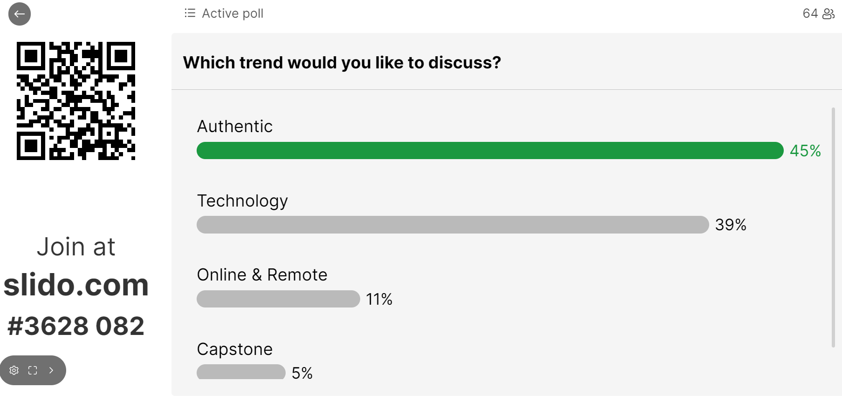

Slide 13
What are the challenges/implications for schools, students and/or staff?
ⓘ Start presenting to display the poll results on this slide.

Slide 14
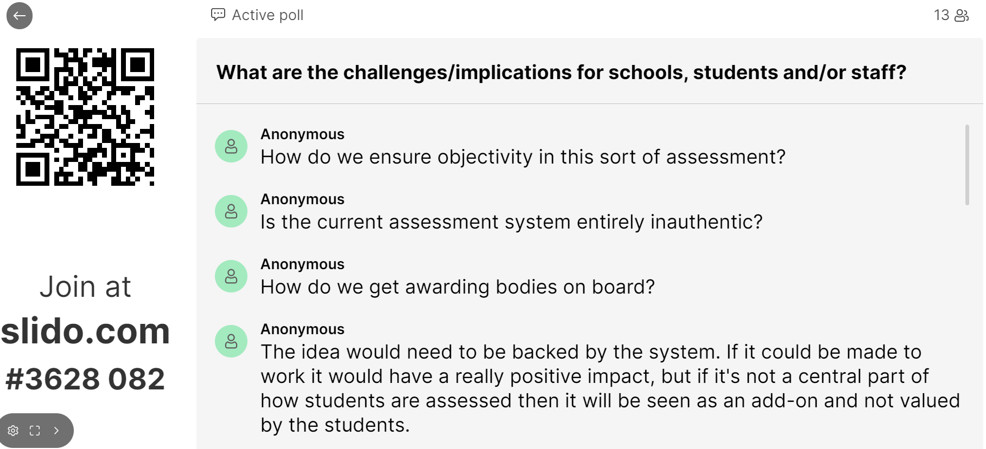

Slide 15
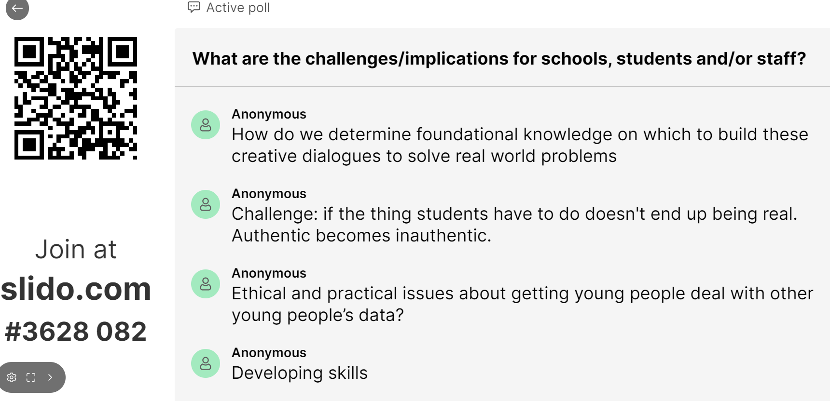

Slide 16
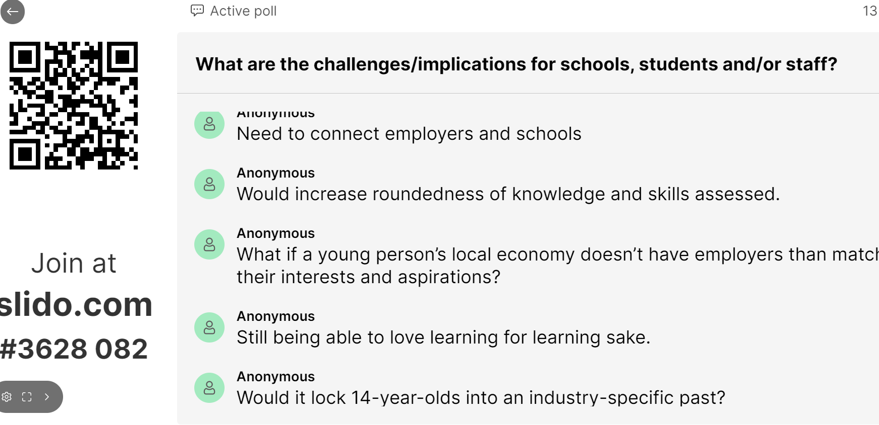

Slide 17
Where are the opportunities and priorities?
ⓘ Start presenting to display the poll results on this slide.

Slide 18
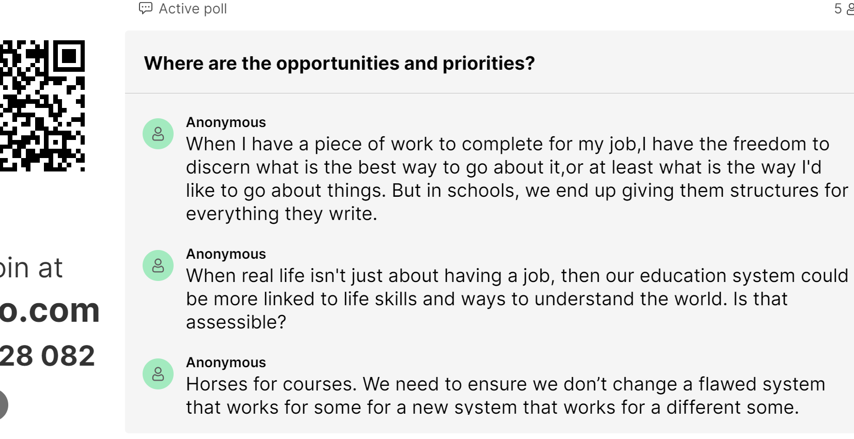

Slide 19
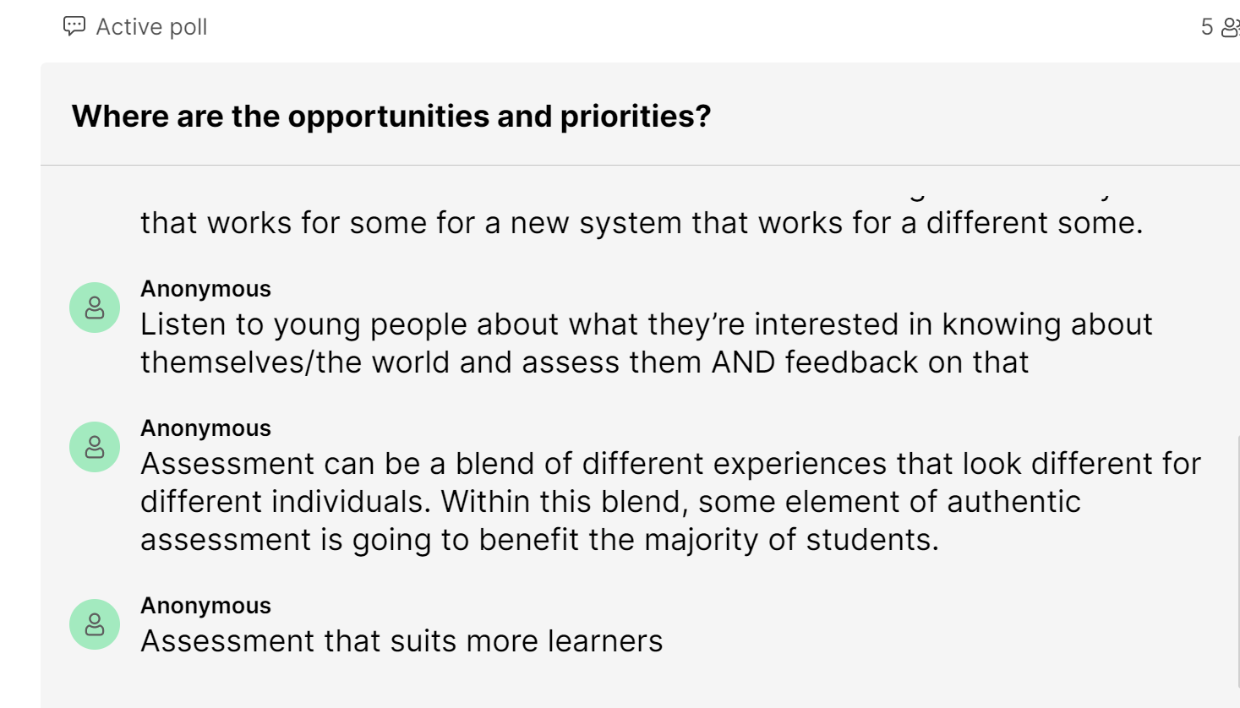

Slide 20
Further information and contact details:
https://www.jisc.ac.uk/guides/principles-of-good-assessment-and-feedback
https://www.jisc.ac.uk/reports/rethinking-assessment
https://codesign.jiscinvolve.org/wp/2022/06/assessment-futures-2035/
https://nationalcentreforai.jiscinvolve.org/wp/2022/10/06/how-might-ai-tools-such-as-gpt-3-impact-education-and-assessment/
Sue.attewell@jisc.ac.uk Paul.bailey@jisc.ac.uk

