Slide 1

Uncovering the harsh realities
for Britain’s young people in today’s jobs market
#YouthMisspent

Slide 2

City & Guilds | Youth Misspent
Background to this research
High youth unemployment vs 1.3m open job vacancies – why?
A decade of austerity – impacting education and
the wider public sector
A fifth (18%) of young people leaving education annually without 5 grade A* - C GCSEs annually (37% of those who received free school meals)
45% of young people in insecure work vs the
UK just entered a recession
12 December 2022
What has been
the impact?
01

Slide 3

City & Guilds | Youth Misspent
What did the research tell us?
We polled 5,000 18–24-year-olds about their lives. What did we find?
Staggering levels of disadvantage:
19%
had been a young carer
10%
had been in care system themselves
9%
of young men had been in prison
12 December 2022
38%
of young people in receipt of free school meals
14%
significant physical and mental health issues
28%
had achieved a Level 2 or below as their highest level of qualification
Disadvantaged YP the most likely to feel locked out of the labour market, to be unemployed and to have lower educational attainment. Disadvantage is being baked in.
02

Slide 4
City & Guilds | Youth Misspent
Low in confidence and feeling left behind
We found low levels confidence in their skills and their ability to get a good job. Also many felt unsupported in their endeavours to enter the workplace:
16%
Currently out of work Economically inactive or unemployed = Approx 859k YP)
26%
Felt Government was doing enough to support YP into work
33%
Felt employers were doing enough to support YP into work
12 December 2022
30%
Believe they’ll never meet their career ambitions
43%
Believe their education has not equppied them with the right skills
23%
Felt they had the right skills to progress in their career
02

Slide 5

City & Guilds | Youth Misspent
What else did the research tell us?
64% believe it’s not easy for young people to get a good job these days
Just 17% are currently in a job they want
to be doing
29% have struggled to even get an interview
9% young people believe they will never be able to start working
Disadvantaged young people significantly more likely to aspire to careers in lower
paid sectors and more ‘humble’ jobs
Women more likely to be working in
and aspire to work in careers in lower
paid sectors - and already earning significantly less than men
Young women significantly more likely
to believe they were not being sufficiently supported into the workplace by employers and Government
12 December 2022
03

Slide 6
Mismatches between the jobs available and career aspirations
15%
Young people surveyed want to work in the Arts, Entertainment and Recreation industry
2%
Share of jobs the Arts, Entertainment and Recreation industry accounts for in the labour market
2%
8%
Young people surveyed want to work in Manufacturing
Share of jobs the manufacturing industry accounts for in the labour market

Slide 7
More advantaged vs less advantaged young people – career choices
ABC1
C2DE
6%
4%
Information and communication
10%
6%
Financial services
Professional services
7%
4%

Slide 8
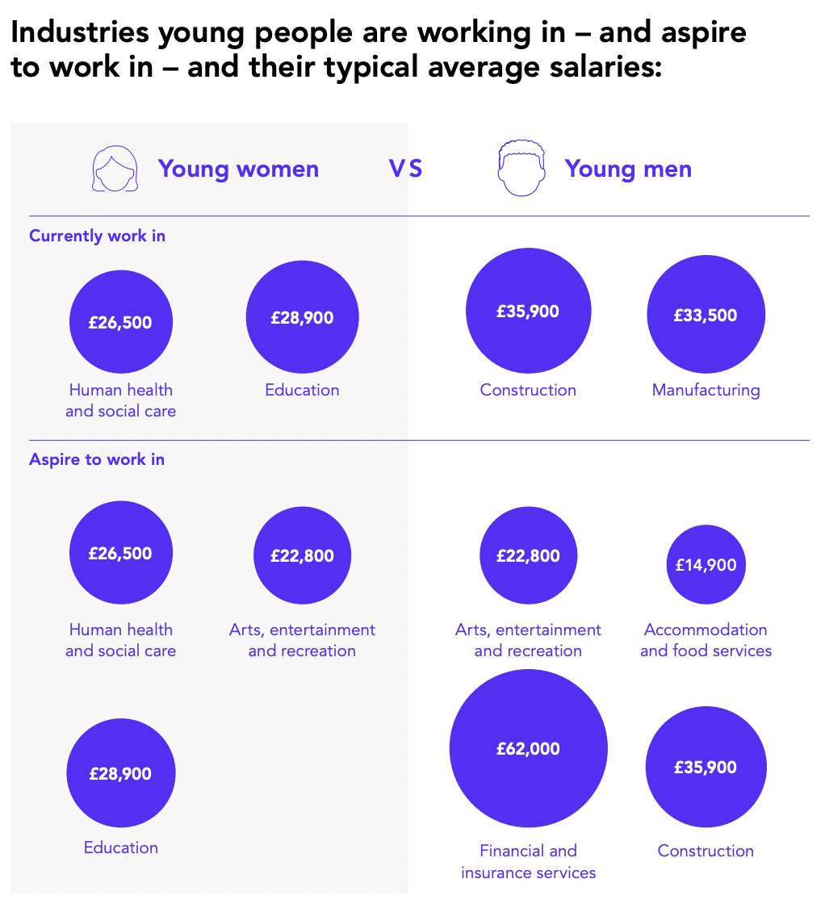
Gender matters when it comes to aspirations

Slide 9
Young people’s salary aspirations in next 5 years - earning £30k plus
50%
YP earn above the UK median salary (£28,000) within 5 years
79%
Of all working adults earn less than £30,000 a year
55%
49%
Young men
Young women
57%
47%
ABC1
C2DE

Slide 10
City & Guilds | Youth Misspent
Our recommendations
Employers
Engage with the skills system and existing Government skills initiatives to provide better opportunities and progression for young people – and fill critical skills shortages. And campaign for change where the system isn’t working.
Make it easier for young people to access, then progress in their careers – especially the most disadvantaged / under represented groups.
Provide more work experience, paid internships or training opportunities and work with education providers to support better careers advice and guidance in schools, to raise awareness of careers on offer.
Government
Work with educators and employers to optimise existing skills interventions and fully utilise funding pots.
Improve careers guidance and education from early years through to adulthood.
12 December 2022
Educators
Help young people of all ages to be more aware of the broader education and career opportunities available to them.
Ensure that curricula are inclusive, allowing people with different abilities to achieve their best.
03

Slide 11

City & Guilds | Youth Misspent
THANK YOU
12 December 2022
Support this campaign by:
Reading and sharing the report
Raising awareness of the campaign on social media using the hashtag #YouthMisspent ​
Being part of the ongoing campaigning on this issue throughout 2023
12

