Slide 1
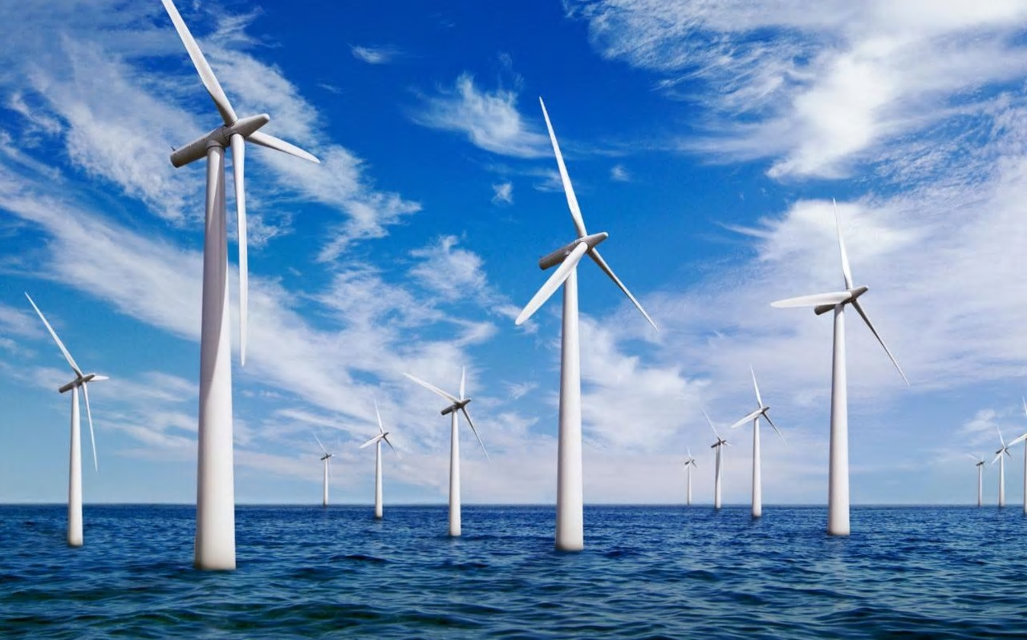
How can you build an offshore windfarm?
in partnership with

Slide 2
Introduction to project
Show video to introduce project
Our Future- Morgan Freeman
https://www.youtube.com/watch?v=8YQIaOldDU8
Why green energy
https://www.youtube.com/watch?v=56MhjXTcSCg
Or annotate anchor text – reading age 12.5
https://www.theguardian.com/environment/2019/mar/07/government-throws-its-weight-behind-offshore-wind-power-expansion

Slide 3
Project briefing
Globally there is increasing investment in renewable energy.
The UK is building the biggest offshore windfarm in the world in the North Sea.
This is leading to a significant increase in the number of job opportunities in the renewable energy sector in a number of areas in the UK.
You are going to work in teams on a project to answer the question
“How can you build an offshore windfarm?”
This project has been developed by The Edge Foundation in partnership with Tekmar Energy, funded by the EU European Social Fund.

Slide 4
Project briefing
Tekmar are an important engineering business in the offshore energy sector.
They need your help as associate project engineers to deliver a protection system for cables to a new offshore wind farm off the coast of North East England.
You need to produce a presentation as part of the bid team to explain why the offshore wind farm should be built and how Tekmar can help.

Slide 5
Who are Tekmar? https://www.tekmar.co.uk/
Who are Tekmar?
Work individually to answer the following questions using the links provided:
What do Tekmar do?
How can Tekmar help to build an offshore windfarm?
What job roles exist in the renewable energy industry? Which interest you the most?
Here are some links which you may find useful.
https://www.tekmar.co.uk/
https://www.renewableuk.com/page/Careers
https://ourfuture.energy/category/day-in-the-life/
https://orsted.co.uk/en/Careers

Slide 6
Who are Tekmar? https://www.tekmar.co.uk/
Careers in renewable energy
Use the information you have gathered to create a job profile for the opportunity which interested you most.
It should include:
Description of roles and responsibilities
Details of the skills and qualifications required.
For guidance on how to write a job profile and real world examples check out the link below:
https://www.indeed.com/hire/how-to-write-a-job-description?from=hire-jobdes-breadcrumb-index
Challenge task
Produce an advert to recruit for the job. Where might you advertise the vacancy, how could candidates find out about the role?

Slide 7
Project briefing
You are going to work in teams of four on a project to answer the question
“How can you build an offshore windfarm?”
Your presentation will be split into two parts and must include the following information:
Why do we need offshore windfarms?
climate change and greenhouse gases, reduce carbon footprint and air pollution.
How can Tekmar help to build an offshore wind farm?
What materials are needed? How are they manufactured? Produce Life Cycle Assessment of materials
How can corrosion be prevented? What are the structure and properties of polymers
In our lessons you will first find out why we need windfarms, then focus on the science it takes to build them, linking to the engineering business Tekmar.

Slide 8
Review
In industry teamwork is really important and each team member has different strengths.
Reflect on the job profile you have written.
Which relevant skills and experience do you currently have?
Which skills may you have to develop?
What could you do both in and outside of school to develop those skills?
Discuss your skills and strengths with your team and how you can contribute to the success of your project.

