Slide 1
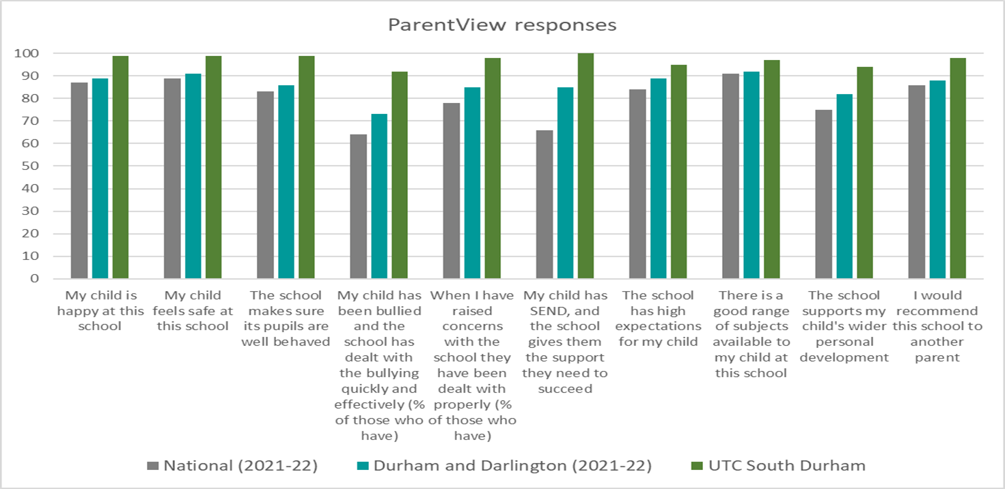
Parent Engagement - outcomes

Slide 2
‘He is very aware of who to go to if there are any problems or issues that he needs assistance with and this is a view echoed by us as parents’.
‘The communication within UTC is very clear and even prior to him starting in September this has always been hugely positive.’
‘You have not only transformed my sons life, but our family life. He wants to go to school each day. We cant thank you enough.’
‘Family and friends have commented about the huge change in our son and we are certain that this is down to the fact that he is at UTC and is now enjoying going to school, this can only be a result of the wonderful things that UTC have in place to support their students.’
‘We all felt very supported by the school.’
‘As a family we cannot recommend this school enough and are very excited to see what the next couple of years hold for our son. He is already talking about plans for college and university, words that we never thought we would hear.’
‘I know how busy the teaching day is, and how much everyone has to get through, so the time your staff take to go the extra mile is very much appreciated.’

Slide 3
‘She is more motivated than she has been in a long time and that is down to UTC . I'm incredibly proud of her and just want you to know how grateful I am.’
‘Whenever I contact school things are addressed straight away.
Two weeks ago my son turned to me and said ‘Mum I never ever thought I would like school’
That in its self is absolutely overwhelming and brought me to tears.
I asked him what he loved about the school he said
‘The teachers mum .. they are so nice and they speak to me differently.. not like my old school’
‘I have been impressed with the way that UTC communicates with us parents and with the development of our daughter both academically and socially.’
‘You treat pupils as individuals, care about what is happening with them and you don’t treat their problems as a bit of a nuisance.’

Slide 4
Parent Engagement - outcomes
90% attendance at Student-Led Conferences/Parents Evenings
General parent feedback (emails, social media etc.) – word of mouth.
Parent Ambassadors
Candidates for role of parent trustee and engagement of parents in voting process
Student attendance improves
Easier to work together for the best interests of every student (become the village)

Slide 5
Post September start
Post place offer
Application process
First visit
Pre-application/pre-visit
The Parent journey
Notes:
We love a road map! Taking out parents on a journey, recognising that they hold a lot of the decision making power in young people’s decision to change schools and that, even when the decision is made, it’s still a big step. It’s important that our parents feel supported along the way. Students can be applying/exploring us as an option up to or sometimes over a year in advance; by the time students join us each September, we want them and their parents to feel like their part of our community and it becomes their UTC (they become part of our village and we become part of theirs) The approach we take has very intentional touch points along the way to build that outcome.

Slide 6
Pre Application/Pre visit
Positive reputation
Word of mouth
Parent centred social media and marketing

Slide 7
First Visit
Parent Ambassadors
Open and honest
Key messages
Happy students and happy staff

Slide 8
Application Process
Online application
Regular contact – keep in touch (valentines, Christmas etc.)
Meeting every student and parent

Slide 9
Post place offer
Keep in touch
Family STEM events
Clarity of communications and expectations

Slide 10
Post September
On boarding
Community agreement
Weekly Communication
Student-led conferences
Crew leader communications/ building relationships
Positive contact home
Listening to and demonstrating action against feedback

