Slide 1

Parental Engagement
Thursday 7th December 2023
Catherine.Purvis-Mawson@utcsouthdurham.org
Deputy Principal (Business Engagement, Careers and Marketing)
Laura.McAllister@utcsouthdurham.org
Vice Principal (Teaching and Learning, Crew)

Slide 2

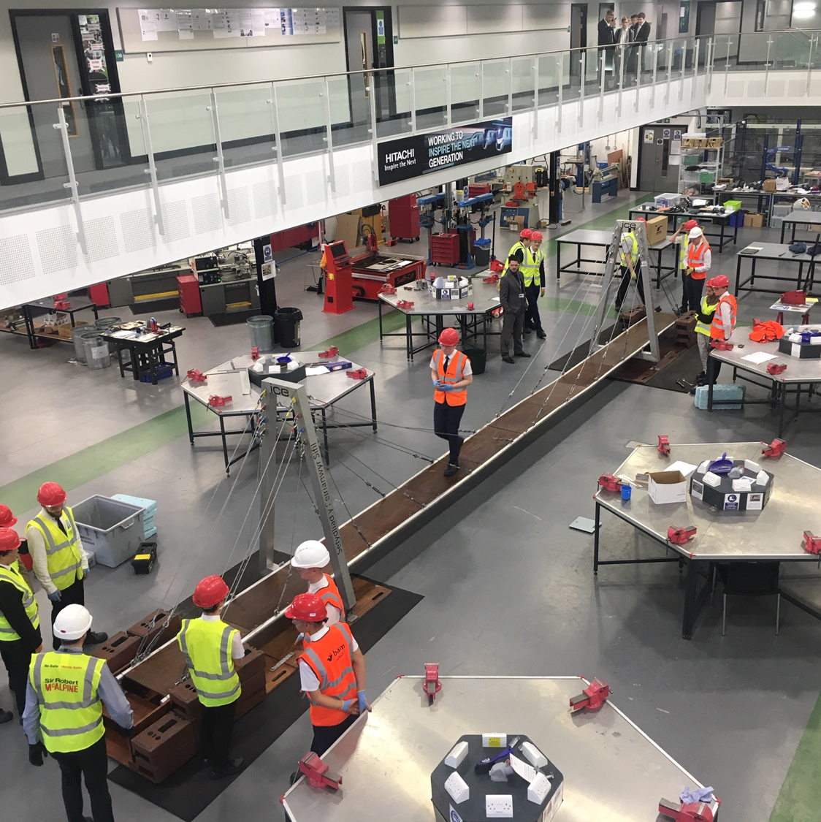
Structure of the session
Context of UTC South Durham
Sharing moment
Our approach to parental engagement
Sharing moment
Key takeaways and pitfalls
Notes:
We’ve got some success from our approach to parental engagement but we’re not perfect and don’t have all of the answers. There will be lots of things you’re doing that have a huge impact so let’s take the opportunity to share!

Slide 3

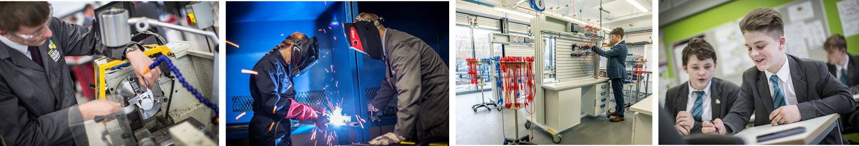
WHAT IS A UTC?
Technical school for 14-19 year olds from across a region
46 around the country, each with its own specialism
Prepare young people for the world of work
Removing career barriers for all

Slide 4
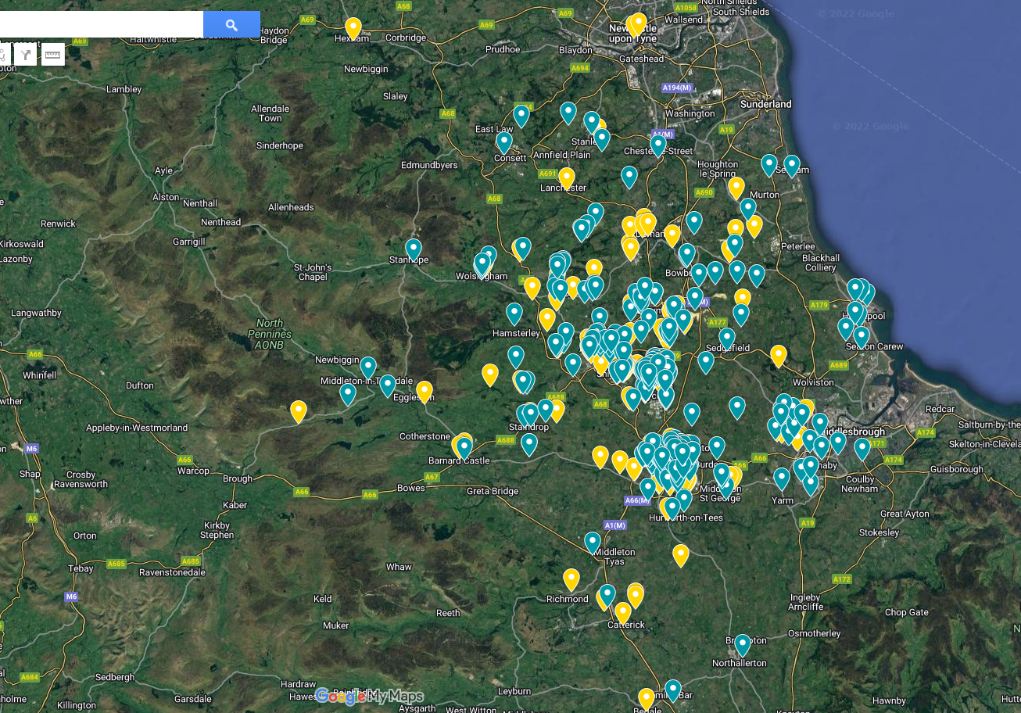
440 students
47 schools
8 counties
14 constituencies

Slide 5
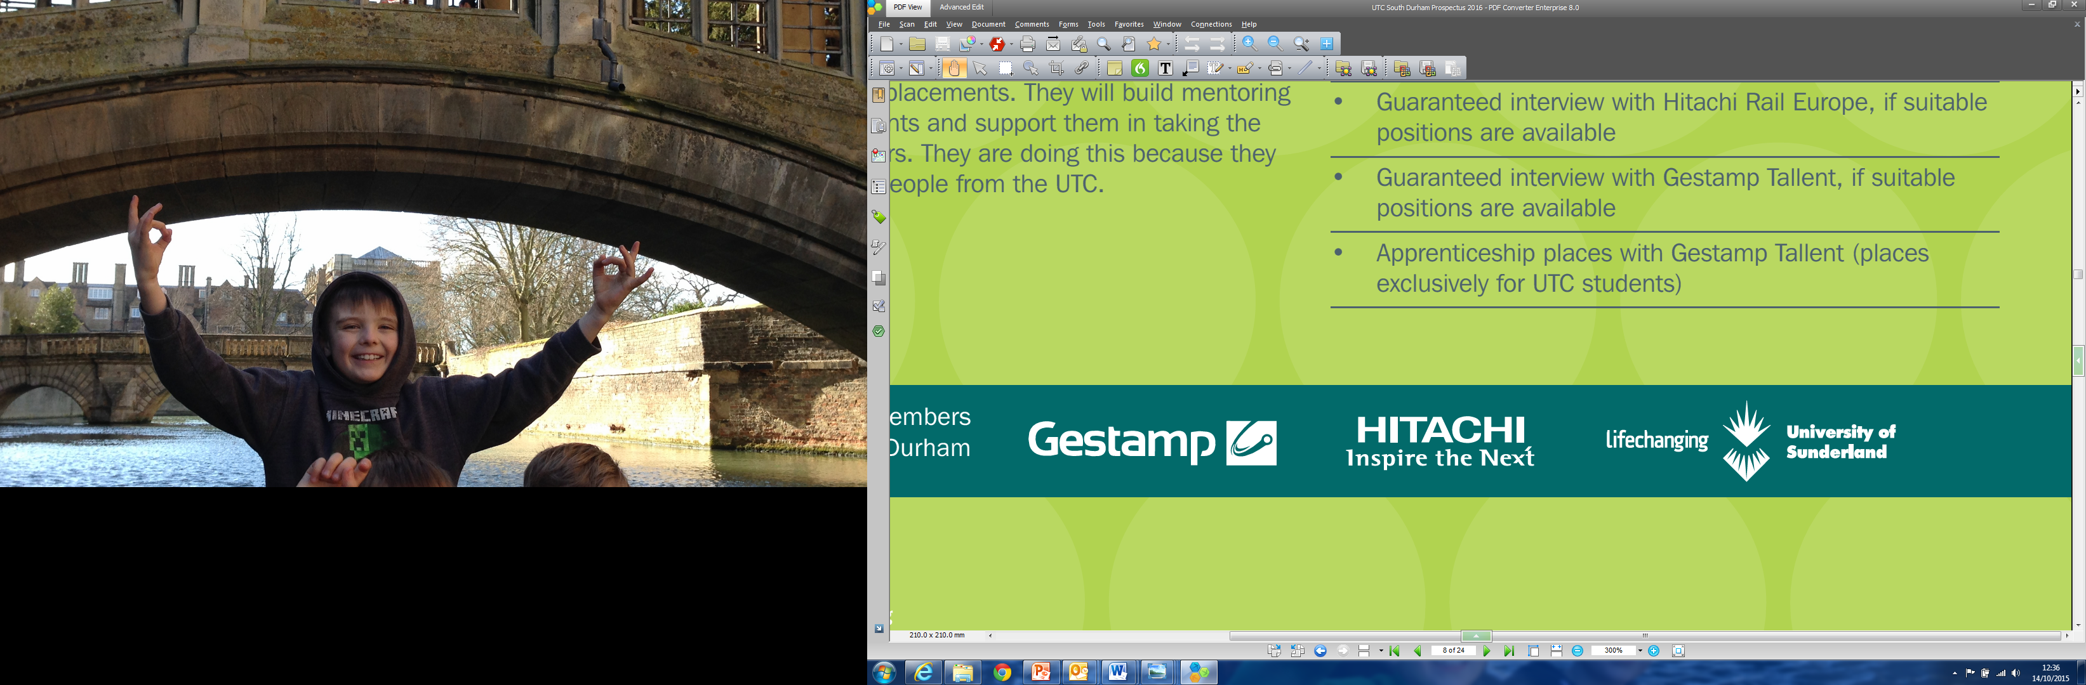
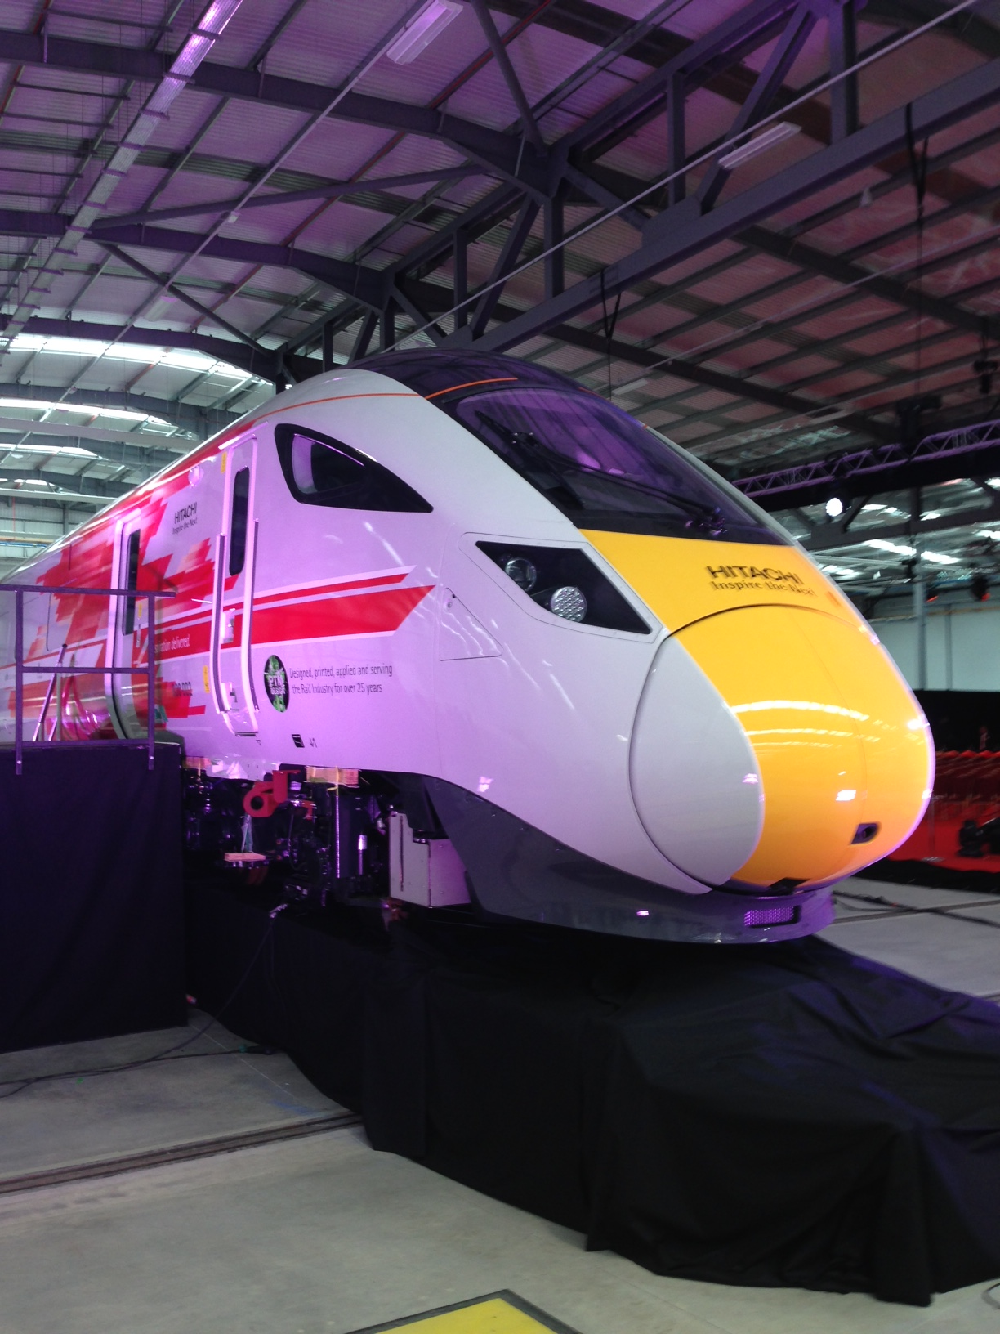

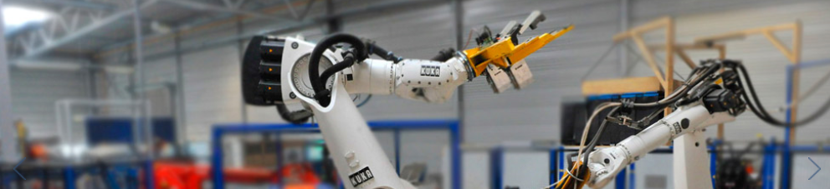

Slide 6















































OVER 150 EMPLOYER PARTNERS

Slide 7

DESTINATIONS OVER 6 YEARS
2018 TO 2023
100%
39%
97%
of students who wanted to go to university did so – 98% study STEM degrees
of Year 13 leavers landed a paid apprenticeship (many at higher or degree level) – 7 x the national average for that age group
of students who left the UTC have gone on to a positive destination
7th in the country out of 2300 post-16 providers for Apprenticeship starts from L3 (latest DfE tracking from 2020)

Slide 8

STUDENT LEAVER PROFILE
Young professionals, first names with staff
Like-minded colleagues
Working week of 30 hours
GCSEs or A-A-levels/T-levels/PEO
Range of technical STEM qualifications
Visits, work experience, mock interviews
Industry Projects
Meeting regional industry needs
Notes:
Culture and ethos – everything through the lens, everyone comes on the journey!

Slide 9


Slide 10
