Slide 2
Week 4 Changing perspectives of apprenticeships
By the end of this lesson, you will be able to
understand different perspectives of/ viewpoints about apprenticeships
compare writers’ ideas and perspectives, as well as how these are conveyed, across two or more texts (AO3)

Slide 3
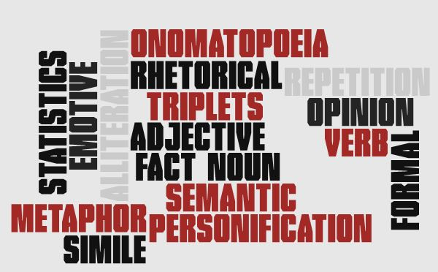
Starter BINGO Choose 9 words from the word cloud. Write each into a separate box on your grid.
Can you remember what these language features are?
Notes:
Resource 1- bingo grid. Students choose 9 words to write into separate boxes in their grid. Teacher gives definition, student crosses out the word being described. Either do 1st to a line or 1st to full house. Some were looked at last lesson, others you will have used in lessons prior to this unit. Choose those most appropriate to your group.

Slide 4
Question 4 Comparing viewpoints
You’ll be able to answer this question at the end of the lesson.
For this question, you need to refer to the whole of Source A, together with Source B.
Compare how the two writers convey their different attitudes to apprenticeships.
In your answer, you could:
compare their different attitudes
compare the methods they use to convey their attitudes
support your ideas with references to both texts.
[16 marks]
compare writers’ ideas and perspectives, as well as how these are conveyed, across two or more texts (AO3)
Notes:
Explain the AO and that the skills are similar to AO2. Mark scheme on next slide if wish to introduce at this stage.

Slide 5
Level 2 Some understanding and comment 5-8 marks | Level 3 Clear, relevant explanation 9-12marks | Level 4 Detailed, perceptive analysis 13-16 marks
Attempts to compare ideas and perspectives Makes some comment on how writers’ methods are used Selects some appropriate textual detail/references, not always supporting from one or both texts Identifies some different ideas and perspectives | Compares ideas and perspectives in a clear and relevant way Explains clearly how writers’ methods are used Selects relevant detail to support from both texts Shows a clear understanding of the different ideas and perspectives in both texts | Compares ideas and perspectives in a perceptive way Analyses how writers’ methods are used Selects a range of judicious supporting detail from both texts Shows a detailed understanding of the different ideas and perspectives in both texts

Slide 6
Before we look at the whole texts, let’s see if you can work out the viewpoints in the quotations!
Marketplace challenge 1 Step 1- find your match
Step 2- fill in just the 1st 2 columns of the table using your joint info
Step 3- now swap your Person A or Person B sheets with other students
Extension challenge- try to find all 10 viewpoints and quotations!
Person A- viewpoint/ perspective
MATCH!
Person B- quotation
Notes:
Resource 2A (quotation) and 2B (viewpoint)- 1 per student. Copy extras for 20+ groups. See Resource 2 teacher answers- quotations used are highlighted in bold with the accompanying view next to them in italics. Resource 3- table (double-sided with same table copied on each side)

Slide 7
What is the viewpoint in this quotation?
Challenge 2
Read the sources to find out which one your quotation is from.
Analyse the quotation, thinking about the perspective shown and how the writer conveys their view.
Write your ideas around the quotation. Use the thought bubbles to help.
Be ready to share your ideas with the class.
ZOOMING IN
Which word(s) is/are the key word(s) in proving this view?
Is there a particular language feature being used?
How do the words used make the reader aware of the view?
Notes:
https://www.tes.com/news/why-schools-must-do-better-apprenticeships
Resource 4 (19th century text) and Resource 5 (21st century text- link above if copyright is an issue). Students analyse their own quotation- could swap with another pair who annotate in a different colour to show their extra ideas. During feedback to the class, the audience listen and fill in ideas on their table (resource 3- completing the remaining 2 columns of the table as they listen). Teacher answers regarding language features are on Resource 2 (teacher answers ones)

Slide 8
Structuring Question 4 (16 marks- 20 minutes)
How do we put all this together in an answer?
Both writers have different attitudes towards… (choose something shown by 2 linked quotations, e.g. personal attitudes towards apprenticeships, perspectives of employers, views on outcomes of apprenticeships, etc.)
The phrase/word… (quote) … shows/ reinforces/ suggests/ indicates… (explain how it shows the view)
The use of… (language technique) … creates/ suggests/ conveys the effect of/ suggest to the reader that… (explain the effect on the reader- how it really makes the reader realise what their view is)
It might also symbolise/ connote/ further imply that… (always try to give a second effect to reach the higher levels)
Modelling
Let’s write an answer together first.
Notes:
Use 1 pair of linked quotations (1 from Source A and 1 from Source B).

Slide 9
Activity
Answer the question on your own now.
Level 2 Some understanding and comment 5-8 marks | Level 3 Clear, relevant explanation 9-12marks | Level 4 Detailed, perceptive analysis 13-16 marks
Attempts to compare ideas and perspectives Makes some comment on how writers’ methods are used Selects some appropriate textual detail/references, not always supporting from one or both texts Identifies some different ideas and perspectives | Compares ideas and perspectives in a clear and relevant way Explains clearly how writers’ methods are used Selects relevant detail to support from both texts Shows a clear understanding of the different ideas and perspectives in both texts | Compares ideas and perspectives in a perceptive way Analyses how writers’ methods are used Selects a range of judicious supporting detail from both texts Shows a detailed understanding of the different ideas and perspectives in both texts
Notes:
Question on slide 4. Students to write, then peer assess and improve.

