Slide 1
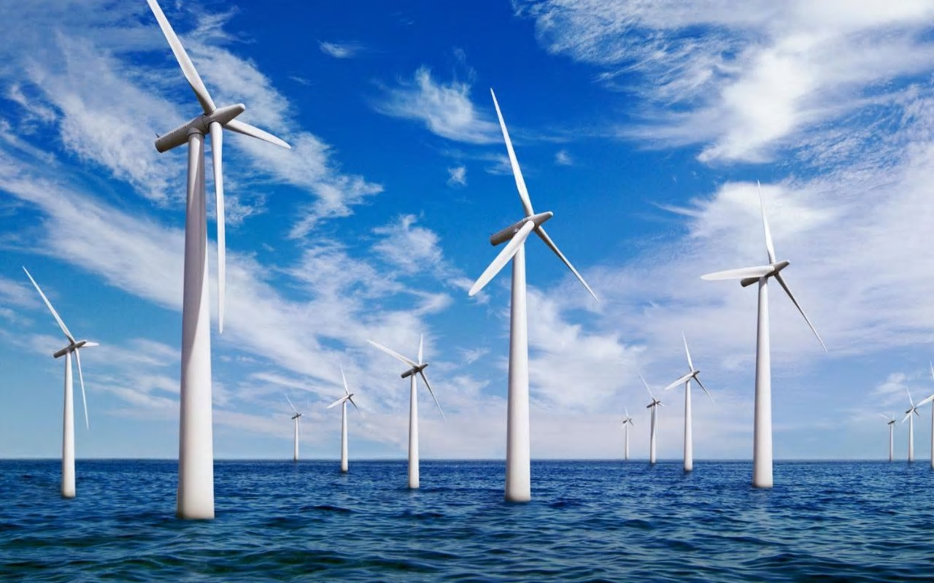
How can you build an offshore windfarm?
in partnership with

Slide 2
Connect
Why do we need offshore windfarms?
An inconvenient truth trailer
https://www.youtube.com/watch?v=1u9meHJFGNA
National Geographic – Climate change
https://www.youtube.com/watch?v=Ok8rMT2KCy0

Slide 3
Project briefing
You are going to work in teams on a project to answer the question
“How can you build an offshore windfarm?”
Your presentation must include the following information:
Why do we need offshore windfarms?
climate change and greenhouse gases, reduce carbon footprint and air pollution.
How can Tekmar contribute to success of the offshore wind farm?
What materials are needed? How are they manufactured? Produce LCA of materials
How can corrosion be prevented? What are the structure and properties of polymers

Slide 4
Learning Outcomes
Learning Outcomes
By the end of this lesson you should be able to:
Describe four potential effects of global climate change
Discuss the scale, risk and environmental implications of global climate change
Evaluate the quality of evidence in a report about global climate change, given appropriate information.

Slide 5
Research Activity
Use the links provided and your textbooks to answer the questions below in full sentences. Create a glossary of any words which are new to you and the definitions
Name four potential consequences of global climate change
Describe why the consequences of climate change are difficult to predict
How might climate change affect the area where you live?
What do scientists believe causes climate change?
Notes:
AQA Chemistry textbook (3rd edition) has good summary of this information on page 200 in addition to the links on the next slide.

Slide 6
Research Activity
Useful links:
Climate change cause and effects
https://www.nationalgeographic.com/environment/global-warming/global-warming-effects/
Effects of climate change
https://www.wwf.org.uk/effectsofclimatechange
Climate change modelling experiment
http://www.bbc.co.uk/sn/hottopics/climatechange/moreaboutexperiment.shtml
Article on effects of climate change on Britain
https://www.greenpeace.org.uk/what-we-do/climate/climate-change-how-it-affects-britain/
Reduce carbon?
https://ourfuture.energy/debate/electric-everything/

Slide 7
Evaluate the evidence
Each person in group choose one of the pieces of text to read.
Read it in silence, making notes or highlighting key points if necessary.
Produce a review of the text to cover the following points:
What is the text about?
Who has written it?
What are your thoughts on the the article? Do you trust the author? Is the information credible? Explain your thinking.
Notes:
Text are varying in reading age and challenge, teacher may choose to allocate texts to each student in group depending on ability.

Slide 8
Evaluate the evidence
Take turns to present your review to your group. Remember to include the following points:
What is the text about?
Who has written it?
What are your thoughts on the the article? Do you trust the author? Is the information credible? Explain your thinking.
Now as a group discuss the texts you have reviewed and decide which one is the most credible.
Be prepared to explain your reasoning to the class.

Slide 9
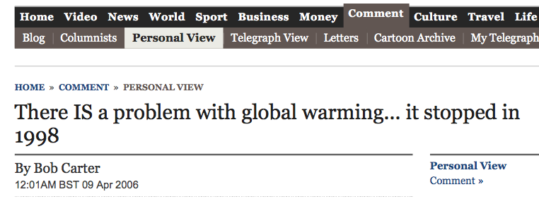
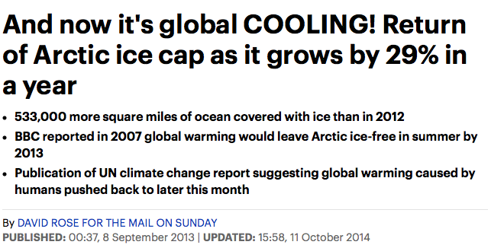
Evaluate the evidence
Despite this article, global temperature records from the UK Met Office, (NOAA National Oceanic and Atmospheric Administration) and NASA all show that 2005, 2010, 2014, 2015 and 2016 have all been warmer than 1998!
The evidence here is crucial – similar trend have been recorded by three sets of scientists (PEER REVIEW)
Although the BBC website did feature an article in December 2007 which suggested that the Arctic sea ice in the summer may disappear by 2013, BUT the BBC also published a later article in April 2011 where this prediction was updated based on further evidence.
This article has used out of date information – It is essential that scientists and journalists continually communicate with one another in order to ensure that correct information is reported!
It is important to note that although huge advances in science have allowed scientists to make prediction about the future, you cannot predict with total certainty the effects of climate change.
Notes:
Based on peer-reviewed evidence, many scientists believe that human activities will cause the temperature of the Earth’s atmosphere to increase at the surface and that this will result in global climate change.
However, it is difficult to model such complex systems as global climate change. This leads to simplified models, speculation and opinions presented in the media that may be based on only parts of the evidence and which may be biased.
Students should be able to:
• evaluate the quality of evidence in a report about global climate change given appropriate information
• describe uncertainties in the evidence base
• recognise the importance of peer review of results and of communicating results to a wide range of audiences.

Slide 10
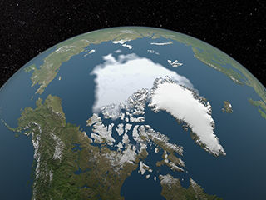
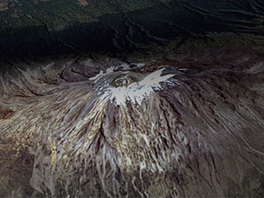
Review
Why might increasing awareness of climate change lead to increased global investment in wind power?
Notes:
Pictures from Nasa website

