Slide 1
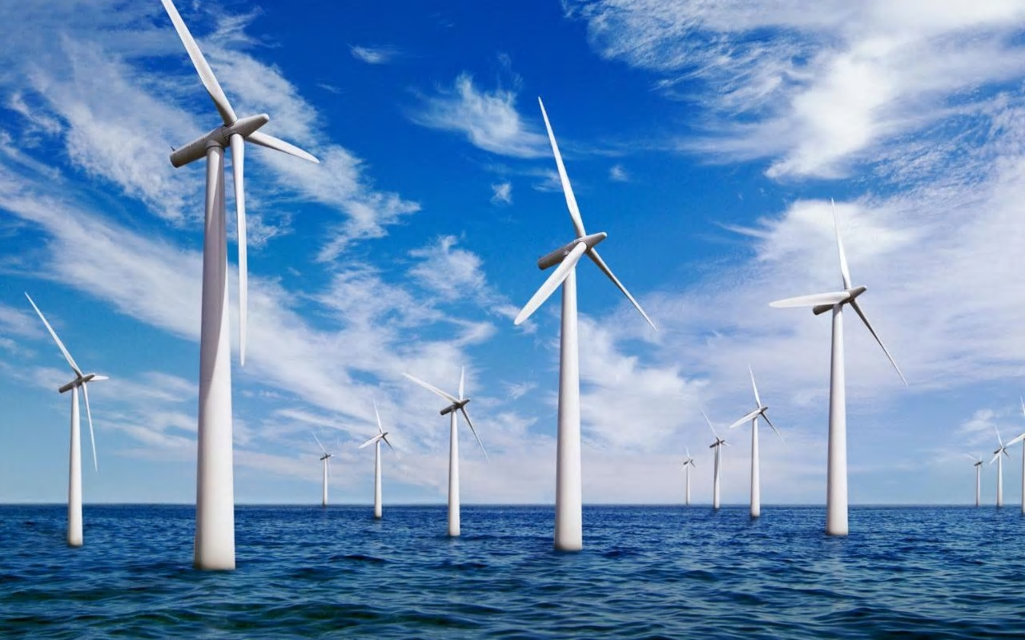
How can you build an offshore windfarm?
in partnership with

Slide 2
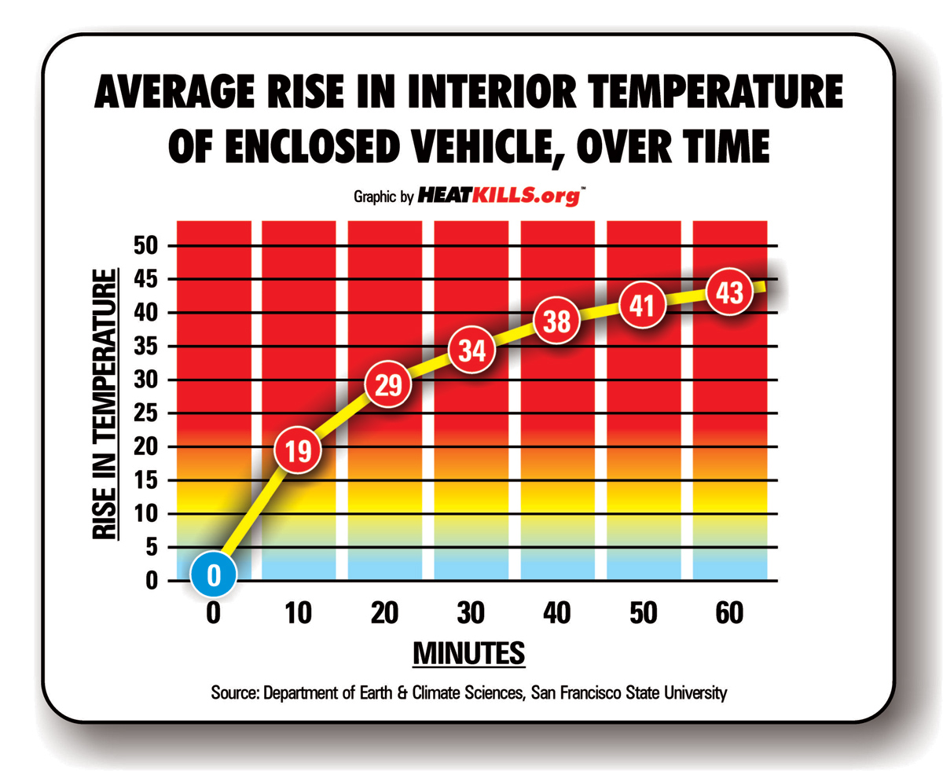
Connect
Why do cars get hot in the summer?

Slide 3
Learning Outcomes
Learning Outcomes
Why do we need offshore wind farms?
By the end of this lesson you should be able to:
Describe the greenhouse effect.
Recall two human activities which produce greenhouse gases.

Slide 4
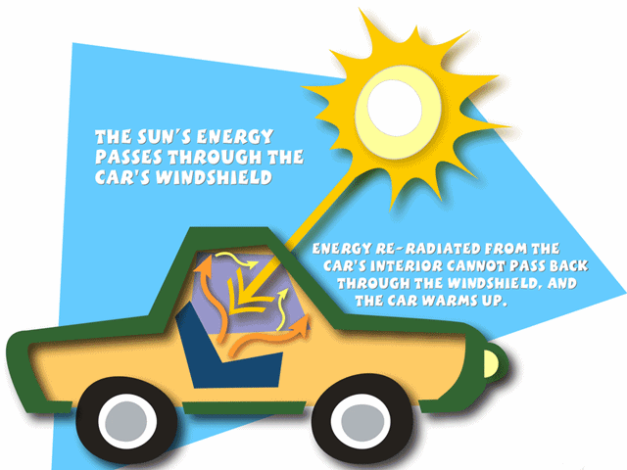
Why do cars get hot in the summer?
Sunlight (heat) passes through the windscreen of a car.
The heat cannot pass back through the car windscreen.
Therefore, the heat is trapped inside the car.
The car heats up.

Slide 5
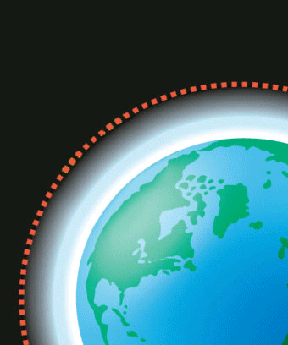
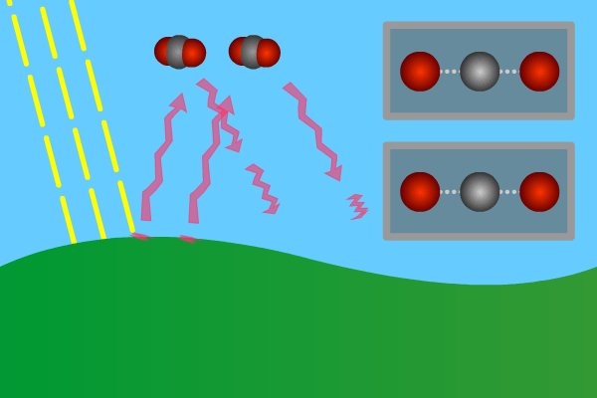
What is the greenhouse effect?
Electromagnetic radiation (at most wavelengths) from the Sun passes through the Earth’s atmosphere.
The Earth absorbs electromagnetic radiation with short wavelengths and so warms up.
Heat is radiated from the Earth as longer wavelength infrared radiation.
Some of this infrared radiation is absorbed by greenhouse gases in the atmosphere.
Therefore the atmosphere warms up.
Create a story board to describe the greenhouse effect using the information above.
Notes:
Greenhouse gases in the atmosphere maintain temperatures on Earth high enough to support life. Water vapour, carbon dioxide and methane are greenhouse gases.
Students should be able to describe the greenhouse effect in terms of the interaction of short and long wavelength radiation with matter.

Slide 6
Create a story board to describe the greenhouse effect using the template below.
Electromagnetic radiation (at most wavelengths) from the Sun passes through the Earth’s atmosphere. | The Earth absorbs electromagnetic radiation with short wavelengths and so warms up. | Heat is radiated from the Earth as longer wavelength infrared radiation.
 |  | Challenge: Give examples of greenhouse gases. Which human activities may cause greenhouse gases to increase?
Some of this infrared radiation is absorbed by greenhouse gases in the atmosphere. | The atmosphere warms up.
Notes:
Optional storyboard template to scaffold activity

Slide 7
What is the greenhouse effect?
Carbon dioxide, methane and water are the main ‘greenhouse’ gases on earth
If we did not have the NATURAL greenhouse effect, due to a lack of carbon dioxide in our atmosphere….
The average temperature on earth would be -19°C
Remember the first life forms evolved in liquid water.
There would be no life (at least not as we know it!) without the NATURAL greenhouse effect!
Give examples of greenhouse gases.
Which human activities may cause greenhouse gases to increase?
Notes:
Greenhouse gases in the atmosphere maintain temperatures on Earth high enough to support life. Water vapour, carbon dioxide and methane are greenhouse gases.
Students should be able to describe the greenhouse effect in terms of the interaction of short and long wavelength radiation with matter.

Slide 8
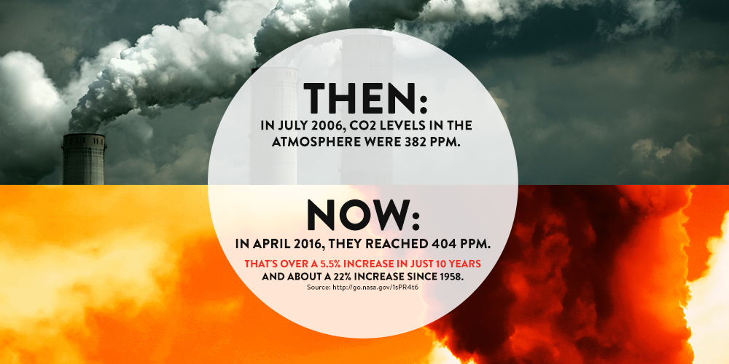

Slide 9
Greenhouse gases
Over the past century the amount of carbon dioxide released into the atmosphere has greatly increased. Fossil fuels such as coal and oil are burned to generate electricity and run cars.
As more trees are cut down for timber and to
clear land the carbon dioxide removed from the air
through photosynthesis decreases.
The graph opposite shows changes in temperature
and concentration of carbon dioxide.
What patterns can you see?

Slide 10
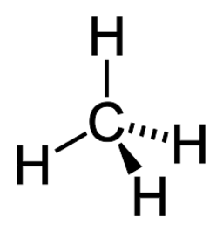
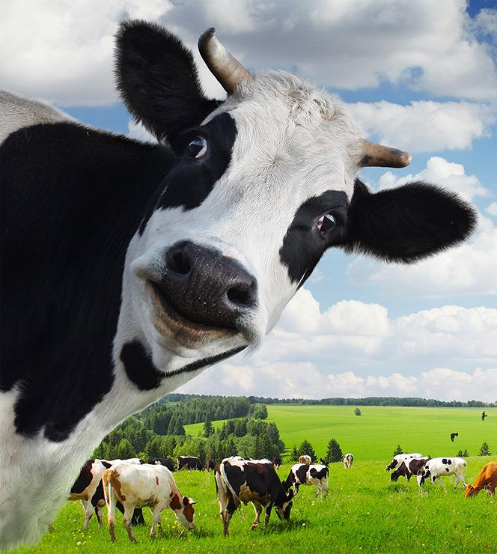
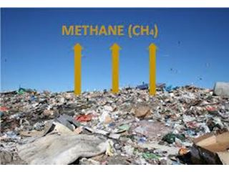
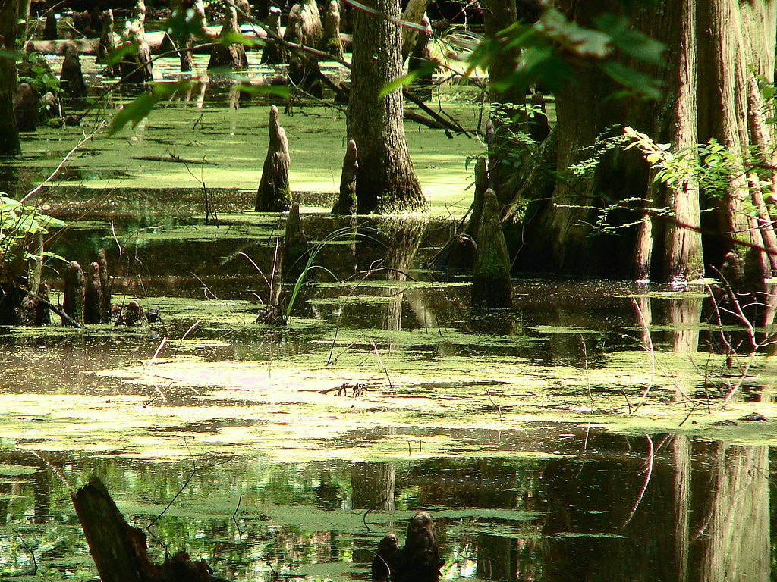
Greenhouse gases
Methane is also a greenhouse gas!
Methane is a product of anaerobic respiration which takes place in swamps and rice fields, as well as in the gut of cattle.
Microorganisms on landfill sites also contribute to methane emissions.
https://www.independent.co.uk/news/uk/home-news/food-waste-households-recycling-caddy-greenhouse-gas-fossil-fuels-collections-defra-a8684921.html
Notes:
Article on food waste collections to reduce greenhouse gas emissions.
https://www.independent.co.uk/news/uk/home-news/food-waste-households-recycling-caddy-greenhouse-gas-fossil-fuels-collections-defra-a8684921.html

Slide 11
Activity
To control the levels of greenhouse gases and help tackle climate change, it is widely agreed the levels of greenhouse gases must be controlled.
One idea is to work to ‘reduce your carbon footprint.’
Definition:
The carbon footprint of a product, service, or event is the total amount of carbon dioxide and other greenhouse gases emitted over it’s full life-cycle.
You have 9 cards with ways individuals and organisations can reduce their carbon footprint. As a group decide which you think are the 3 most important and explain why.
Notes:
This can be completed as a “diamond 9 activity” if desired.

Slide 12
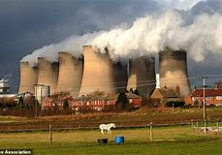
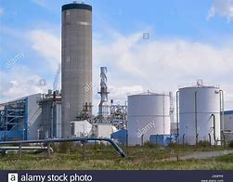
Whiteboard Review
Which of following electricity generation methods has the smallest carbon footprint?
Write your answer on your whiteboard – be prepared to explain your choice!
Coal Wind Gas

Slide 13
Optional further reading
Article on how to reduce your carbon footprint
https://www.bbc.co.uk/news/science-environment-46459714
Article on how to reduce your carbon footprint
https://www.theguardian.com/environment/2017/jan/19/how-to-reduce-carbon-footprint

Slide 14
Resources
Carbon footprint card sort to print.

Slide 15
9 strategies to reduce carbon footprint
Eat a plant based diet | Use renewable energy sources | Drive less
Don’t travel by airplane | Switch off devices when not in use. | Drive electric cars
Buy less clothes | Insulate your home | Use energy saving lightbulbs
Notes:
Card sort to be cut for carbon footprint activity.

