Slide 1
How can you build an offshore windfarm?
in partnership with

Slide 2
Think-Pair-Share
Apart from reducing “greenhouse gases” how might building an offshore windfarm be beneficial?
Think about this question in silence for 1 minute.
Now discuss your ideas with your partner and write down what you would like to share with the class.
During the class discussion add to your list of ideas in a different colour pen.

Slide 3
Project briefing
You are going to work in teams of four on a project to answer the question
“How can you build an offshore windfarm?”
Your presentation will be split into two parts and must include the following information:
Why do we need offshore windfarms?
climate change and greenhouse gases, reduce carbon footprint and air pollution.
How can Tekmar help to build an offshore wind farm?
What materials are needed? How are they manufactured? Produce Life Cycle Assessment of materials
How can corrosion be prevented? What are the structure and properties of polymers
Today we will learn about air pollution and why we need offshore windfarms.

Slide 4
Learning Outcomes
By the end of this lesson you should be able to:
Describe how atmospheric pollutants are produced by burning fuels
Describe and explain the problems caused by increased amounts of pollutants in the air
Explain why we need offshore windfarms and plan part one of the presentation for the Tekmar bid.

Slide 5
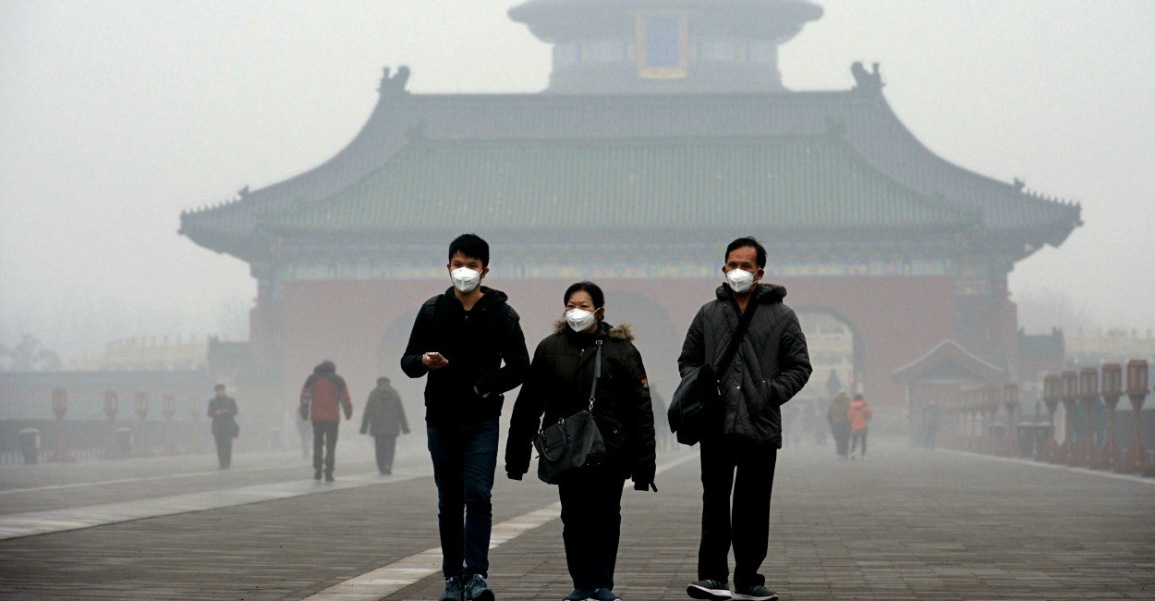
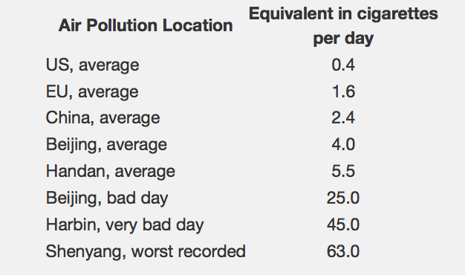
Air pollution
On a particularly bad day in Beijing, breathing in the air around you is the same as smoking 1.5 cigarettes every hour!
What causes air pollution?

Slide 6
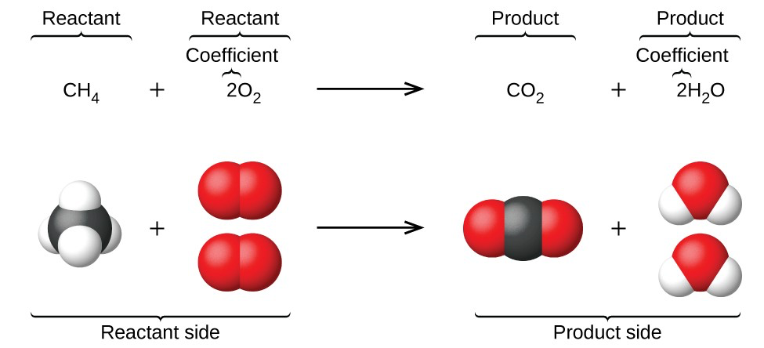
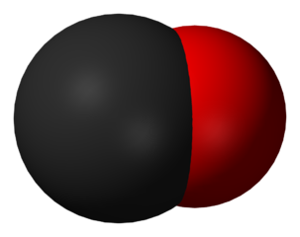
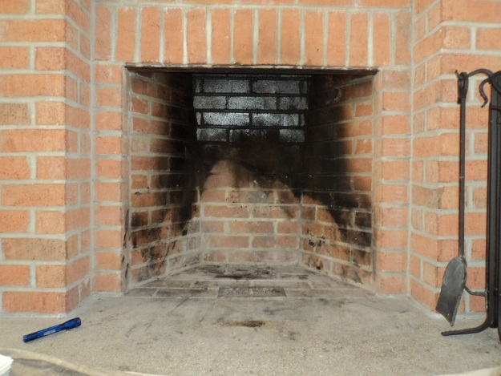
Combustion of fuels
When a fuel (a hydrocarbon) is burnt in oxygen it produces carbon dioxide and water.
If there is not enough oxygen inside the engine, incomplete combustion occurs.
This reaction produces carbon monoxide gas instead of carbon dioxide
How are carbon monoxide and carbon dioxide different?
Carbon monoxide is an toxic, odourless and colourless gas.
It binds to your red blood cells meaning oxygen cannot be carried around the body.
Why is this dangerous?
What else is produced in incomplete combustion?
Notes:
Highlight that both carbon monoxide and soot (carbon particulates) are produced through incomplete combustion.

Slide 7
Air pollution
Nitrogen oxides (NO_{X}):
78% of the earth’s atmosphere is made up of nitrogen. Ordinarily nitrogen is unreactive.
However, under the high temperatures inside a car engine it can be oxidised to nitrogen oxides.
Nitrogen oxides are toxic and can trigger people’s Asthma.
Nitrogen oxides also contribute to acid rain
Carbon Particulates (Soot):
Diesel contains larger hydrocarbons than petrol.
When diesel burns combustion is often incomplete.
This leads to the emission of unburnt hydrocarbons or particulates in the atmosphere.
Particulates contribute towards global dimming
Particulates are also thought to cause cancer.
Sulphur dioxide (SO₂):
Fossil fuels contain impurities such as sulphur.
When fuel are burnt sulphur combines with oxygen to produce sulphur dioxide.
SO₂ is toxic and is a cause of acid rain.
Sulphur can be removed from fuels to prevent these problems.

Slide 8
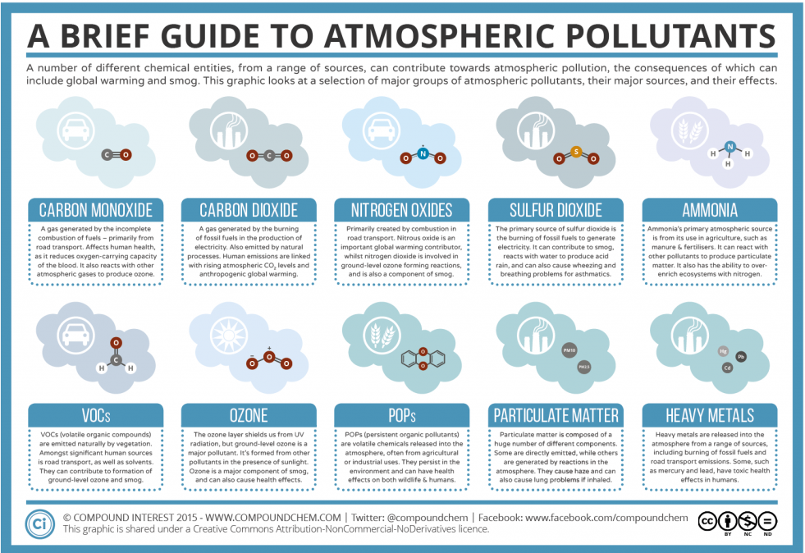
1 October, 2017

Slide 9
Problems caused by air pollution
Copy and complete the table to summarise the effects of atmospheric pollutants.
Pollutant | How pollutant is formed. | Environmental/health issues linked to pollutant
Carbon dioxide
Carbon monoxide
Nitrogen oxides
Sulphur dioxide
Carbon particulates (soot)
How can windfarms reduce air pollution? What other measures could be taken to reduce air pollution?

Slide 10
Concept Map
Work in your group make as many connections as you can. Remember you must write down a reason for every connection that you make!
Global warming
Sulphur dioxide
Acid Rain
Climate change
Carbon dioxide
Carbon monoxide
Fossil Fuels
Incomplete combustion
Soot
Global dimming
Nitrogen oxides
Greenhouse Gases
Complete combustion
Cattle and rice farming
Car engines
Methane
Asthma
Notes:
Each student should use a different colour pen with expectation that everybody writes.

Slide 11
Review
Use the information you have learned over the past few lessons and your own knowledge, to begin to plan the first part of your presentation to answer the question:
Why do we need offshore wind farms?
Complete the consensus placemat.
Why do we need offshore windfarms?
Notes:
Consensus placemat – each student writes their thought in the box in front of them within a given amount of time e.g. 3minutes
They then discuss as a group what each person has written and agree which key points are most relevant and write them into the centre box. Again set a time limit for this.

Slide 12
Why do we need offshore windfarms?
Notes:
Consensus placemat

Slide 13
Project briefing
You are going to work in teams of four on a project to answer the question
“How can you build an offshore windfarm?”
Next lesson you will need to work in your group to produce your first draft of part one of your presentation to be reviewed by your classmates. Remember it must include the following information:
Why do we need offshore windfarms?
climate change and greenhouse gases, reduce carbon footprint and reduce air pollution.
Make a list of all the jobs which need to be done to complete this part of the presentation, this will help you plan your presentation.
Notes:
Students may need support to develop plan with question to prompt thinking such as

Slide 14
Project Planning
You presentation must include the following information:
Why do we need offshore windfarms?
climate change and greenhouse gases, reduce carbon footprint and reduce air pollution.
Make a list of all the jobs which need to be done to complete this part of the presentation, this will help you plan your presentation.
You might like to think about the following questions to help your plan:
What do we want the presentation to include?
What information do we already have?
What do we need to know?
What resources may we need?
What additional support may we need?
When do we need this?

Slide 15
Project Team
Remember the work you did at the beginning of the project where you answered the questions:
Which relevant skills and experience do you currently have?
Which skills may you need to develop?
What could you do both in and outside of school to develop those skills?
Reflect on how your skills may have developed as you have worked on your project so far.
Use this information to decide as a group who will complete each of the jobs on your project plan. Write down who is responsible for each job and set a deadline.

Slide 16
Project Review
As a group write a list of resources and support you need before the end of next lesson to produce the first part of your presentation.
Hand it in to your teacher before you leave the lesson today.
(Don’t forget to put your names on it!☺)

