Slide 1
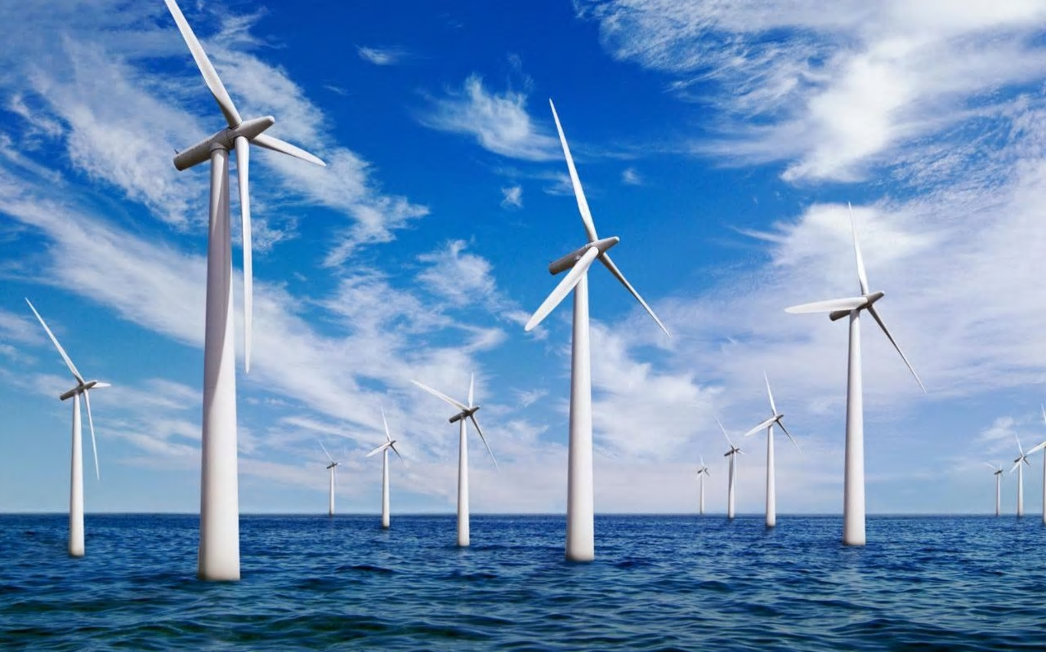
How can you build an offshore windfarm?
in partnership with

Slide 2
True or False
Scientists predict the average temperature on Earth could rise by 5.8C by 2100
Climate change could lead to rising sea levels, extreme weather events and the extinction of wildlife
Carbon dioxide levels in the atmosphere have risen by 11% since the industrial revolution
The leading source of human-produced carbon dioxide is cattle farming
Shutting down all fossil fuel power stations would have the biggest impact on reducing carbon dioxide emissions
Air pollution causes 40,000 premature deaths in the UK each year
Notes:
Source data nasa.gov

Slide 3
True or False
Scientists predict the average temperature on Earth could rise by 5.8C by 2100
Climate change could lead to rising sea levels, extreme weather events and the extinction of wildlife
Carbon dioxide levels in the atmosphere have risen by 11% since the industrial revolution
The leading source of human-produced carbon dioxide is cattle farming
Shutting down all fossil fuel power stations would have the biggest impact on reducing carbon dioxide emissions
Air pollution causes 40,000 premature deaths in the UK each year
True
True
False – levels have risen by 43%
False – burning fossil fuels is the leading source
True
True

Slide 4
Project briefing -Recap
Tekmar are an important engineering business in the offshore energy sector.
They need your help as associate project engineers to deliver a protection system for cables to a new offshore wind farm off the coast of North East England.
You need to produce a presentation as part of the bid team to explain why the offshore wind farm should be built and how Tekmar can help.

Slide 5
Project presentation – Recap
You are going to work in teams of four on a project to answer the question
“How can you build an offshore windfarm?”
Your group needs to work together to produce your first draft of part one of your presentation to be reviewed by your classmates. Remember it must include the following information:
Why do we need offshore windfarms?
Climate change and greenhouse gases, reduce carbon footprint and reduce air pollution.

Slide 6
Project presentation – Part 1
Last lesson you allocated job roles to each team member and set timelines. Use this to ensure you use your time effectively during this lesson. You must have a first draft of part one of your presentation to share with your peers by the beginning of next lesson.

Slide 7
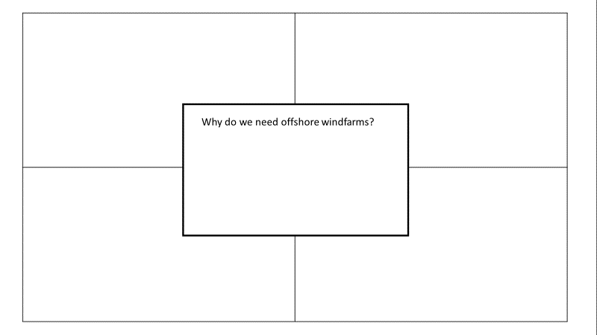
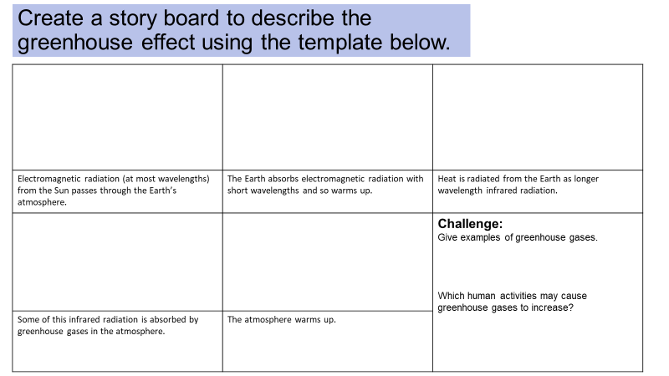
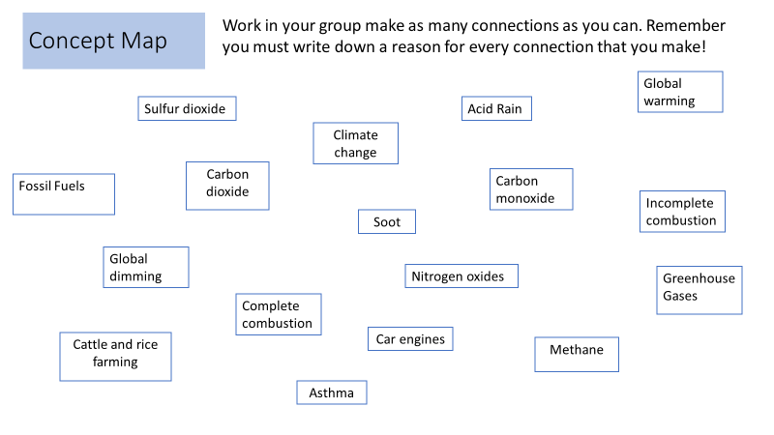
Project presentation – Resources
Use the resources you have already produced to help you put together your presentation.

Slide 8
Further research – useful links
Review your presentation plan, what further research and information do you need to produce part 1 of your presentation? You may find the links below useful.
Information on UK Wind Energy
https://www.renewableuk.com/page/WindEnergy
Energy challenge – why we need offshore windfarms
https://ourfuture.energy/in-focus/3-energy-issues/
World wind- why north sea windfarms.
https://ourfuture.energy/bright-idea/world-wind/
Air pollution
https://ourfuture.energy/in-focus/air-pollution/

Slide 9
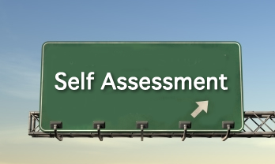
Project presentation – Self assessment
Review the work you have produced so far against the success criteria below:
Does it answer the question “Why do we need offshore windfarms?”
Does it include information on:
climate change and greenhouse gases
carbon footprint
air pollution.
Have you checked the spelling and grammar?
Are the slides clear and easy to read?
Does the presentation look professional and engaging?
E.g. have you included pictures and do all links work correctly?
Have you referenced any data, quotes you have included?
Write down what you have done well (www) and what you can do to improve your presentation (ebi)

Slide 10
Project presentation – Self assessment
Review your notes on what you have done well (www) and what you can do to improve your presentation (ebi)
Next steps:
Agree what further work you need to do as a team to complete and improve part one of your presentation.
Identify what further information, support or resources you need.
Agree who is responsible for completing any further work needed.
Homework
Complete your draft presentation to be reviewed by another team by the beginning of next lesson.

