Slide 1
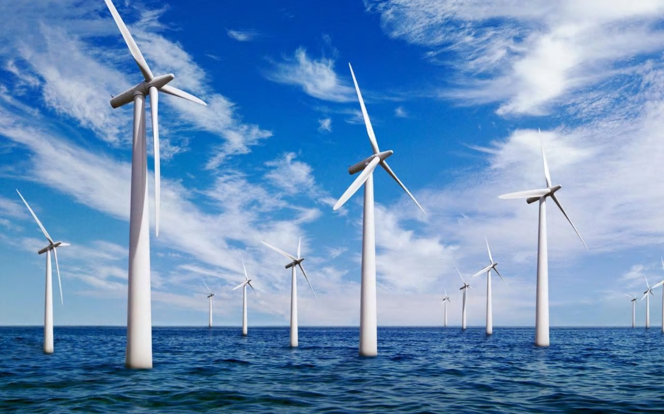
How can you build an offshore windfarm?
in partnership with

Slide 2
What makes good feedback?
On a pink post-it note write down what you think good feedback is not and again stick it to the board.
On a yellow post-it note write down your thoughts on what makes good feedback and stick it to the board.
Notes:
Agree a class contract on how feedback will be given during peer review.

Slide 3
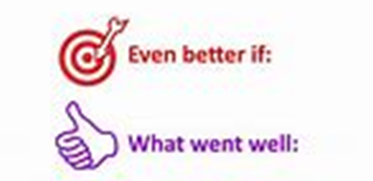
Project presentation part one Peer assessment
Review the work you have been given against the success criteria below:
Does it answer the question “Why do we need offshore windfarms?”
Does it include information on:
climate change and greenhouse gases
carbon footprint
air pollution.
Have you checked the spelling and grammar?
Are the slides clear and easy to read?
Does the presentation look professional and engaging?
E.g. have you included pictures and do all links work correctly?
Have you referenced any data, quotes you have included?
Write down what has been done well (www) and what would make the presentation even better (ebi)

Slide 4
Project presentation part one Peer assessment
Review the feedback you have been given.
Next steps:
Agree what further work you need to do as a team to complete and improve part one of your presentation.
Identify what further information, support or resources you need.
Agree who is responsible for completing any further work needed and set a deadline for this to be completed.

Slide 5
Project briefing- Recap
Tekmar are an important engineering business in the offshore energy sector.
They need your help as associate project engineers to deliver a protection system for cables to a new offshore wind farm off the coast of North East England.
You need to produce a presentation as part of the bid team to explain why the offshore wind farm should be built and how Tekmar can help.

Slide 6
Project briefing - recap
You are going to work in teams of four on a project to answer the question
“How can you build an offshore windfarm?”
Your presentation must include the following information:
Why do we need offshore windfarms?
climate change and greenhouse gases, reduce carbon footprint and air pollution.
How can Tekmar contribute to success of the offshore wind farm?
What materials are needed? How are they manufactured? Produce LCA of materials
How can corrosion be prevented? What are the structure and properties of polymers

Slide 7
Who are Tekmar? https://www.tekmar.co.uk/
How can Tekmar help?
Review your answers to the questions from the project launch lesson:
What do Tekmar do?
How can Tekmar help to build an offshore windfarm?
Use this information and the project brief to help you identify what information you still need to help you complete your presentation to support a successful bid for the windfarm contract.

Slide 8
Who are Tekmar? https://www.tekmar.co.uk/
Exit ticket review
Complete your exit ticket with the information you have identified you need to know for the second part of your presentation. Then hand it in to your teacher.
Exit Ticket

Slide 9
assessment
Quizzes resource
https://ourfuture.energy/category/quiz/

