Slide 1
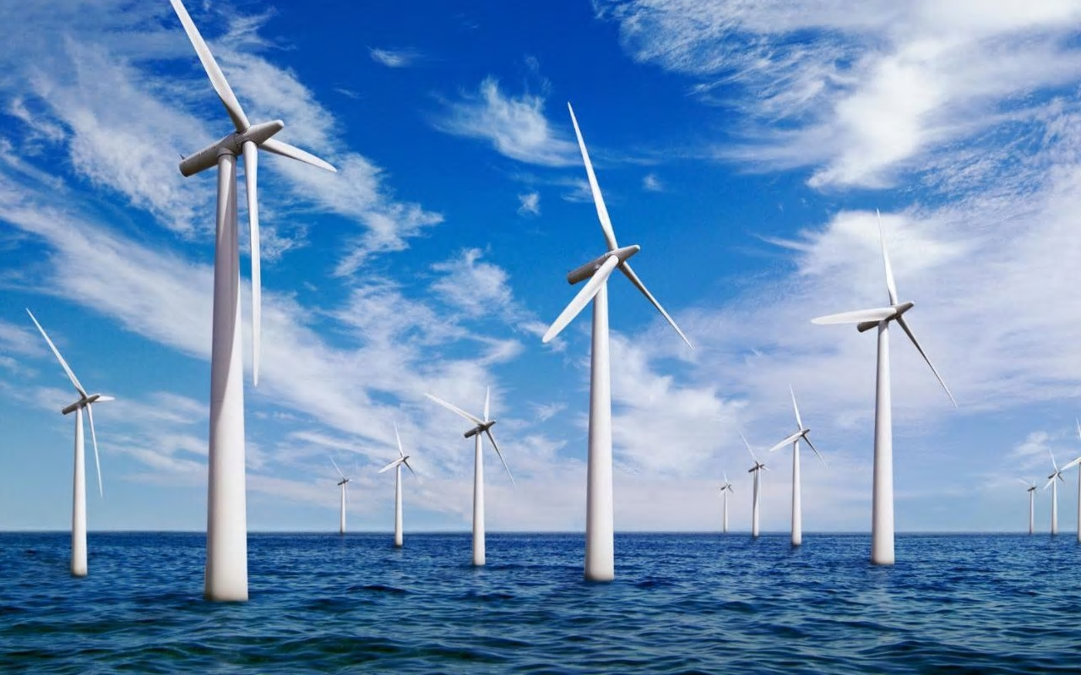
How can you build an offshore windfarm?
in partnership with

Slide 2
Connect
On a whiteboard classify these resources as finite or renewable:
natural gas
solar power
nuclear fuels
metals e.g. copper
wood
cotton
leather
coal
oil
ethanol made from fermentation
Challenge:
Are these resources natural or synthetic?

Slide 3
Learning Outcomes
By the end of today’s lesson you should be able to:
Distinguish between finite and renewable resources
Extract and interpret information about resources from charts, graphs and tables.
Explain how this might affect the build of an offshore windfarm,

Slide 4
Key definitions
Finite: Finite resources are those that are being using up at a faster rate than they can be replaced
Renewable: Renewable resources can be replaced at the same rate as they are being using up.
Natural Resources: These come from the earth, the sea or the air. They have been formed without human impact.
Synthetic Resources: Synthetic materials have been designed to either replace or improve upon natural products.
What are the advantages and disadvantages of building an offshore windfarm in terms of finite and renewable resources?

Slide 5
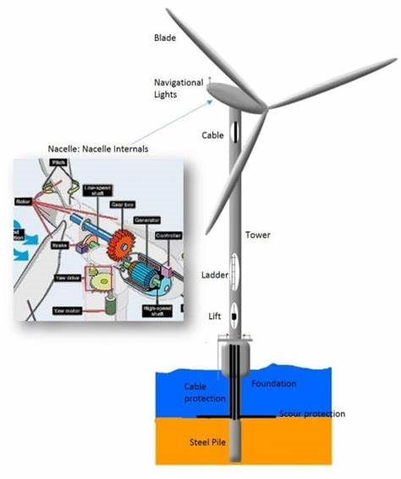
How can we build an offshore windfarm?
1. Make a list of all the materials you might need to build an offshore windfarm. You may find the links below useful:
http://www.madehow.com/Volume-1/Wind-Turbine.html
https://www.azocleantech.com/article.aspx?ArticleID=379
https://www.windpowerengineering.com/business-news-projects/blade-materials-manufacturing-changing-keep-larger-turbines/
2. Now categorise the materials as finite or renewable.
Challenge: Which materials are synthetic and which are natural?
How might wind power be a more sustainable method of generating electricity than some other traditional methods?
Notes:
Students can work in teams or pairs to complete this task

Slide 6
Ask the expert
There are a wealth of careers in developing the materials used to build wind turbines and in other industries. Here are some examples of some of the jobs available:
https://www.prospects.ac.uk/job-profiles/materials-engineer
https://www.careerexplorer.com/careers/materials-scientist/
https://work.chron.com/job-description-polymer-chemist-16922.html
https://www.tomorrowsengineers.org.uk/articles/3839
Each member of your team must choose one job to research and become an expert on. You will then take turns to share what you have learned with your group.

Slide 7
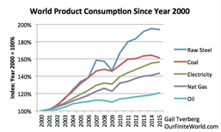
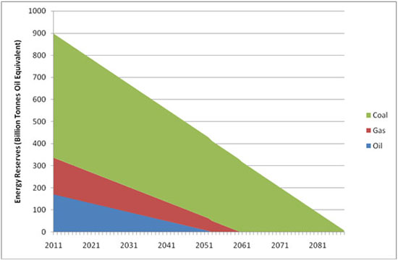
Think-Pair-Share
What do the graphs and charts below show?
Notes:
https://www.ecotricity.co.uk/our-green-energy/energy-independence/the-end-of-fossil-fuels
Students can be given copies of the graphs to interpret the data
Aim to highlight trend in finite fossil fuels, increasing energy demand therefore increased demand for renewable energy.
Additional off shore wind statistics if needed.
https://www.renewableuk.com/page/UKWEDhome

Slide 8
3-2-1 Review
Write down:
3 things you have learned
2 key words and definitions
1 question you still have.

