Slide 1
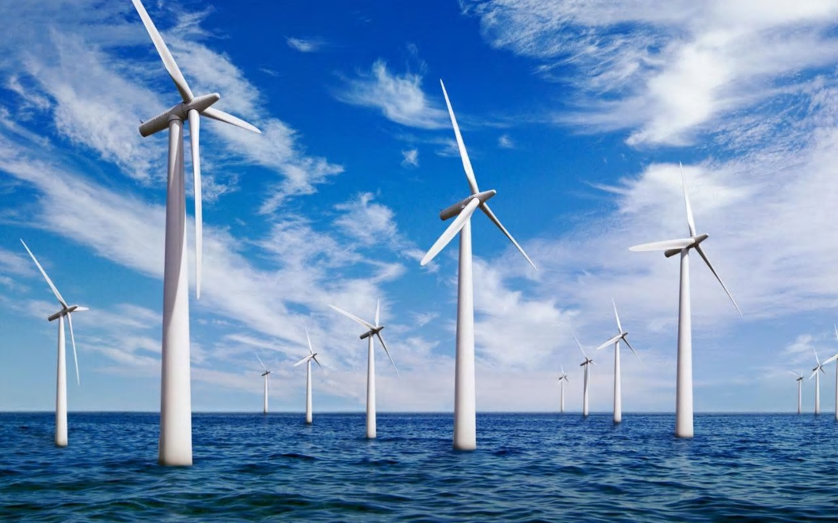
How can you build an offshore windfarm?
in partnership with

Slide 2
All write round robin
Why are offshore wind turbines not made of pure iron?
Think about the question in silence
In your groups take turns to share your answers.
As each person gives their answer, everyone write it down on their piece of paper.
Keep going until your teacher says stop!

Slide 3
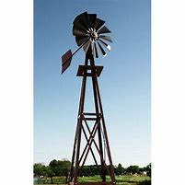
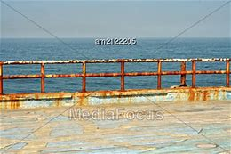
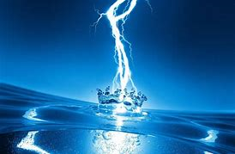
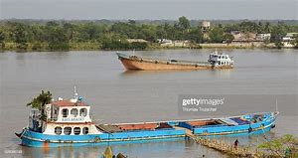
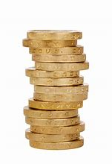
How can you build an offshore wind farm?
Why are offshore wind turbines not made of pure iron?
Notes:
Students should hopefully make links to rusting and conductivity of electricity. May also link to costs of materials and density and mass?

Slide 4
Learning Outcomes
By the end of today’s lesson you should be able to:
Describe conditions which cause rusting and prevention methods
Name examples of common alloys
Explain how the properties of materials are related to their uses and how to select appropriate materials.

Slide 5
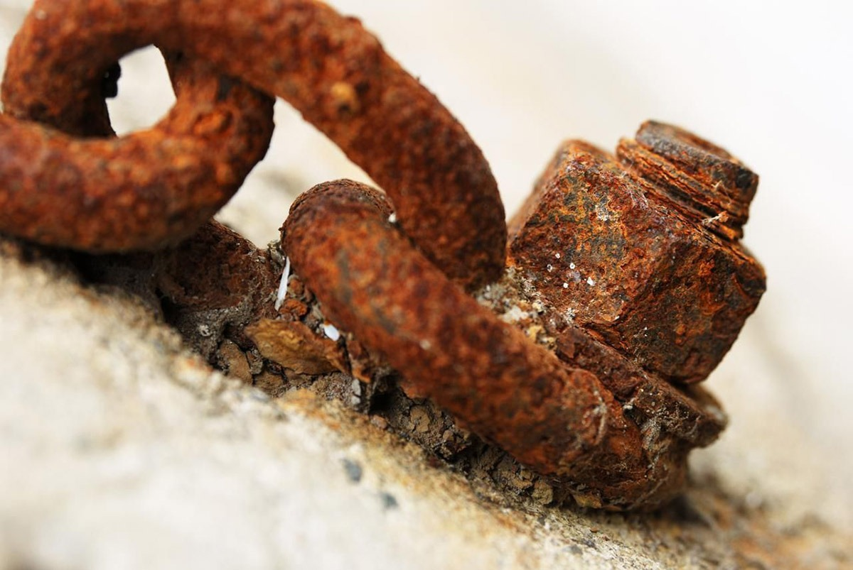
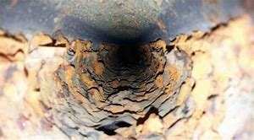
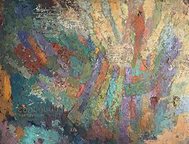
How can you build an offshore wind farm?
Offshore wind turbines can be difficult to install and maintain, so it is important they last a long time.
The materials needed to build an offshore wind farm have been carefully selected by engineers and developed by scientists.
The materials are chosen to suit the purpose of the wind turbine and conditions.
Corrosion can be a problem with some materials but can be prevented.
Corrosion – the destruction of materials by chemical reactions with substances.

Slide 6
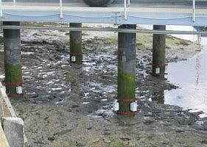
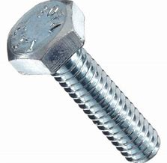
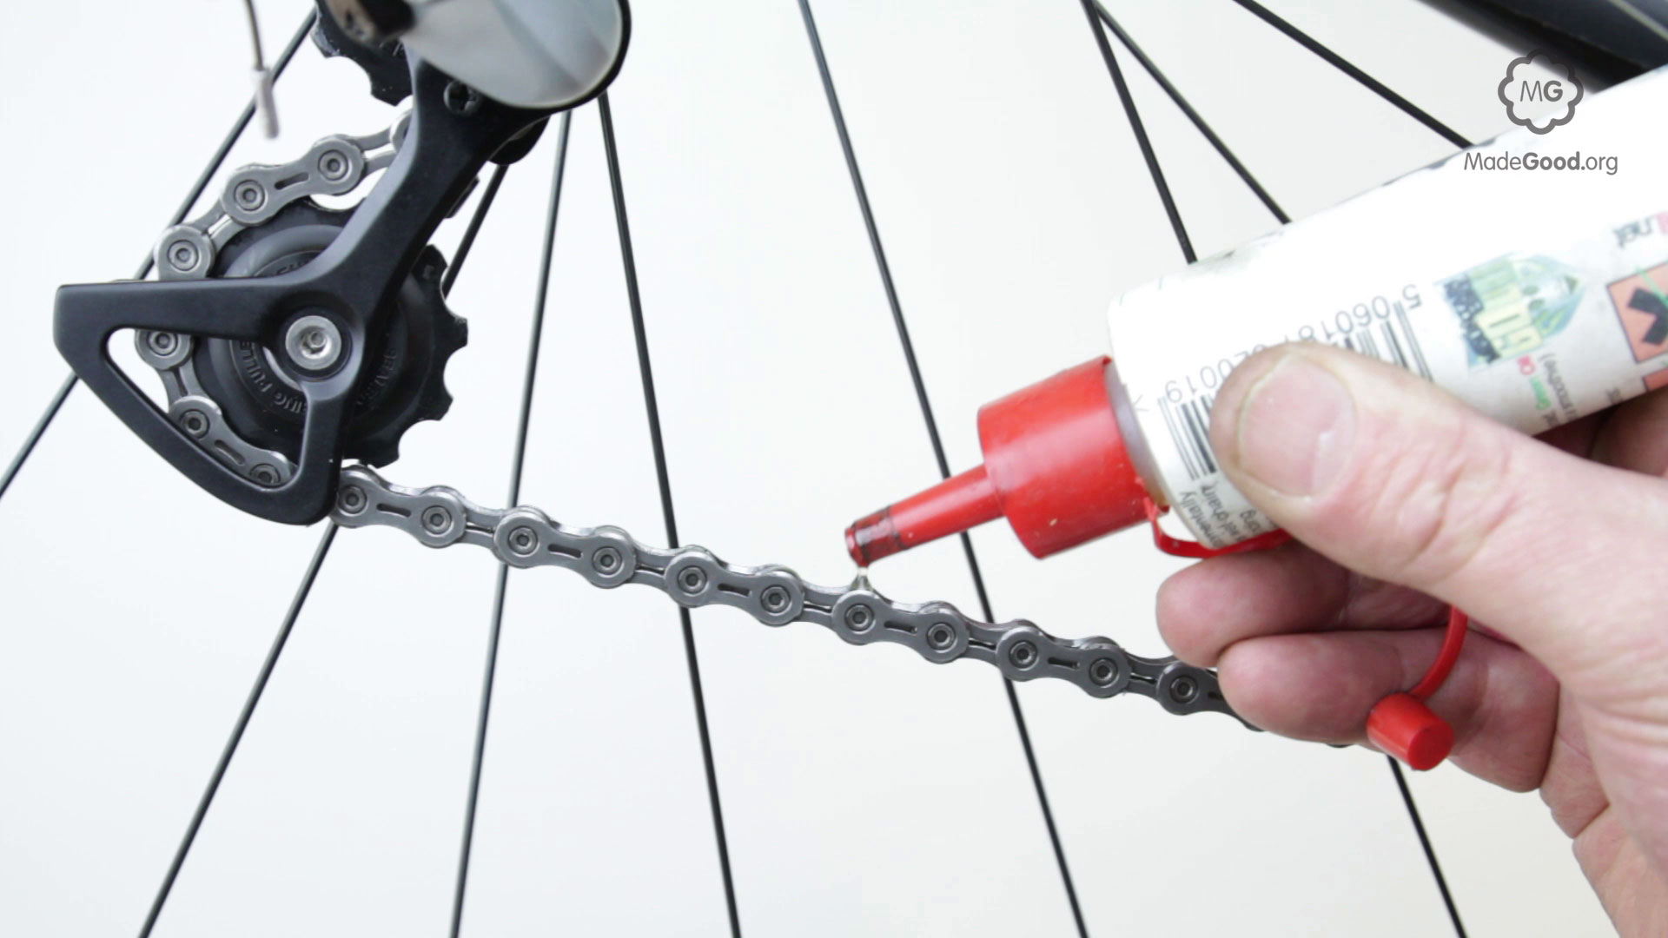
Why aren’t wind turbines made of pure iron?
If air and water are present then iron will rust. Rusting is a form of corrosion.
Rusting can be prevented by coating iron or steel with:
Paint
Oil or grease
Plastic
A less reactive metal
A more reactive metal (sacrificial protection)
Notes:
Images clockwise from top right – paint, sacrificial protection, oil, galvanised bolt.

Slide 7
Why aren’t wind turbines made of pure iron?
Apart from corrosion the materials need to be able to withstand the forces of the wind and sea.
They need to be cost effective and fit for purpose. Can you remember which materials can be used to build offshore wind farms?
The properties of a material depends on it’s structure. Often one material or element does not have the exact properties needed on it’s own, so scientists and engineers produce mixtures.
Some examples of these mixtures are alloys or composites.
Notes:
Link to learning from lesson 7 using earths resources. Should have examples such as steel, composites, polymers.

Slide 8
Selecting materials research task.
Use your text book and online resources to research each of the following materials and complete the table.
Finished?
Which of these materials would be useful when building an offshore wind farm? Why?
Material type | How is it made? | Properties | Uses
Glass
Ceramics
Composites
Carbon Steel
Stainless Steel
Aluminium alloys
Notes:
Pages 222-226 of AQA Chemistry textbook has useful information to complete this task.

Slide 9
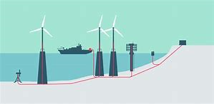
How can we build an offshore windfarm?
The offshore wind turbines needs to be connected to a cable to carry the electricity back to shore.
Giant cables lie under the sea and link the wind farms to transformers on land

Slide 10
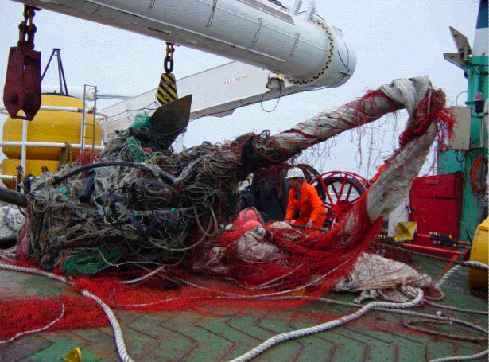
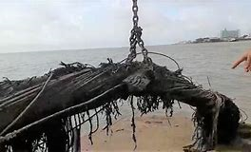
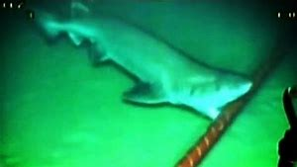
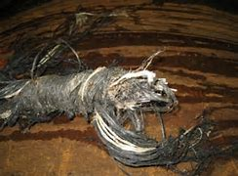
How can we build an offshore windfarm?
The subsea cables which carry the electricity back to land need to be protected from the elements and other hazards.
How can Tekmar help overcome these problems?

Slide 11
Why aren’t wind turbines made of pure iron - homework
How do scientists know that air and water are need for rusting? Design an experiment to investigate this using the equipment below

Slide 12
Why aren’t wind turbines made of pure iron - homework
How do scientists know that air and water are need for rusting? Design an experiment to investigate this using the equipment below
Notes:
Students can complete this optional practical using AQA sheet provided

