Slide 1
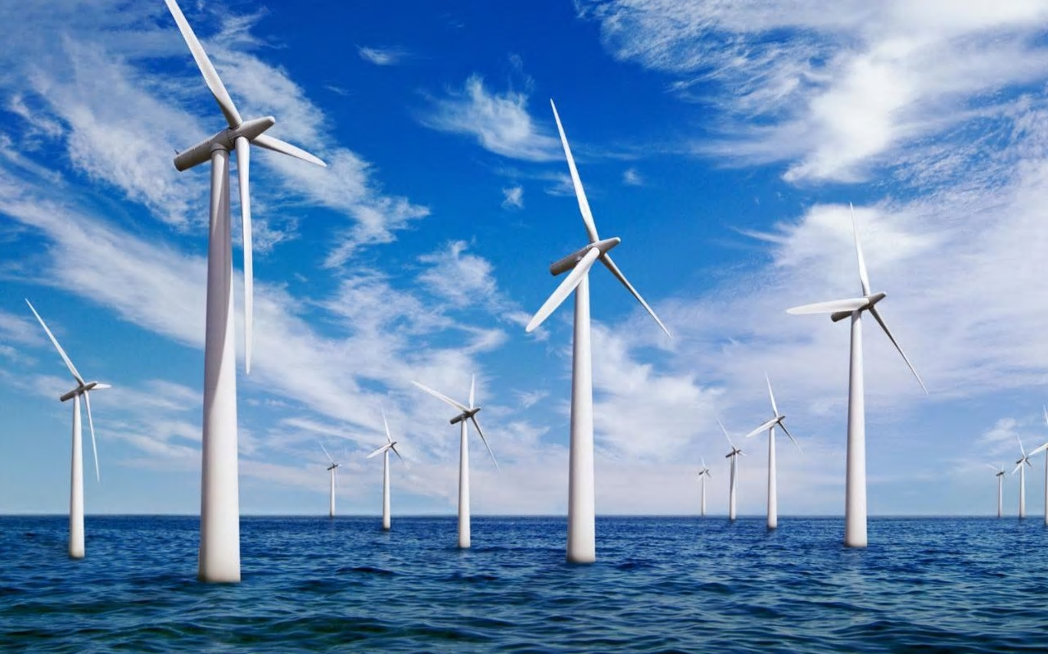
How can you build an offshore windfarm?
in partnership with

Slide 2
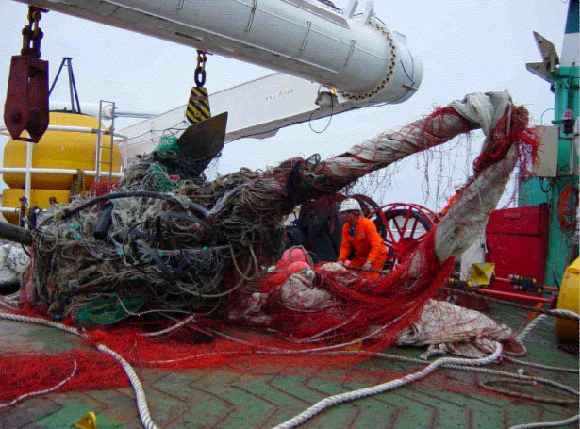
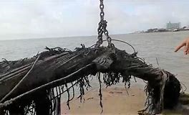
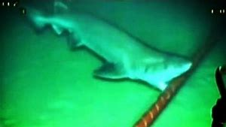
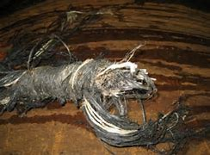
How can we build an offshore windfarm?
How can Tekmar help overcome these problems?
https://www.tekmar.co.uk/
Notes:
Link to project launch lesson what do Tekmar do. Link to site included if further research is needed.

Slide 3
Learning Outcomes
By the end of this lesson you should be able to:
Explain how low density and high density polythene are produced from ethene
Explain the difference between thermosoftening and thermosetting polymers in terms of the their structures.
Notes:
Video is a bit technical but gives visuals of Tekmar’s products ad services and how they market their products.

Slide 4
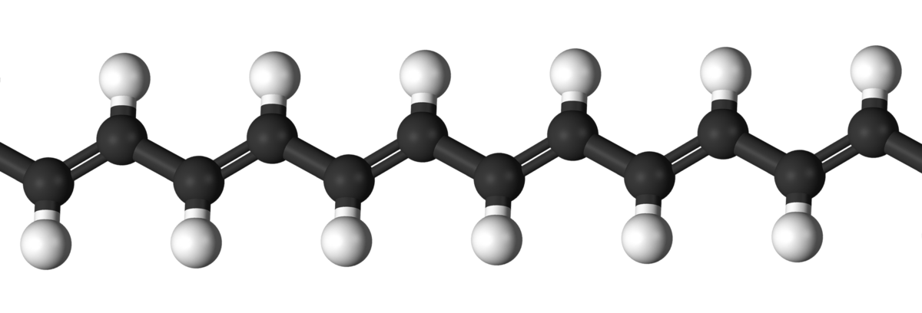
How can Tekmar help build an offshore windfarm?
Tekmar produce systems to protect the subsea cables which connect the wind turbines to land.
This is important as it is very difficult to repair and replace cables if they become damaged.
Opposite are pictures of Tekmar products:
They are all made from polymers.
Notes:
Video is a bit technical but gives visuals of Tekmar’s products ad services and how they market their products.

Slide 5
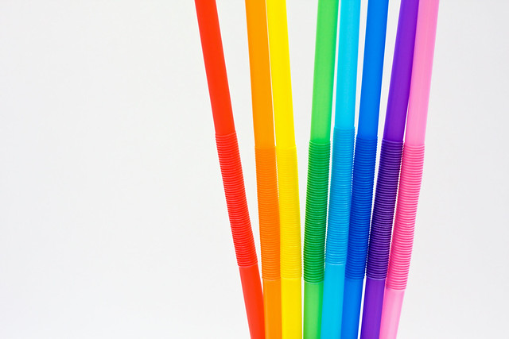
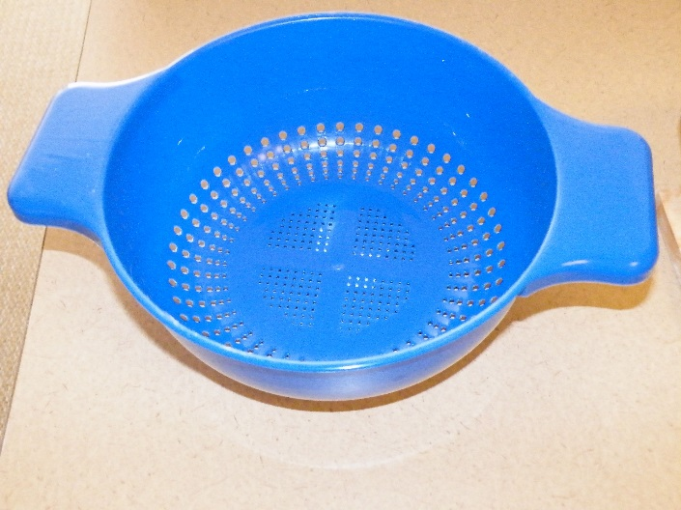
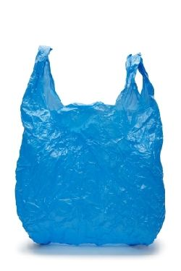
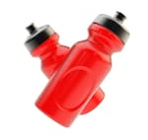
Properties of Polymers
These products are also made from polymers.
Do they have the same properties?
Notes:
Video is a bit technical but gives visuals of Tekmar’s products ad services and how they market their products.

Slide 6
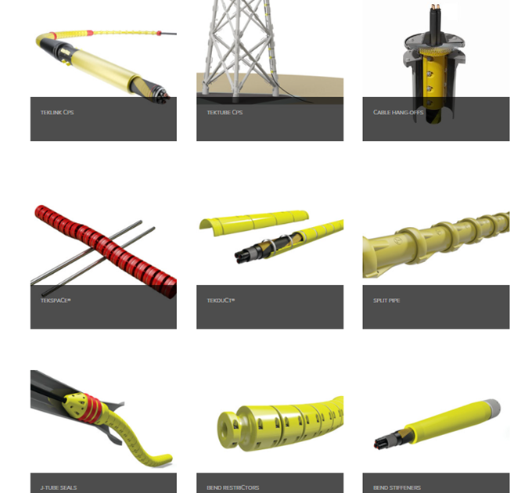
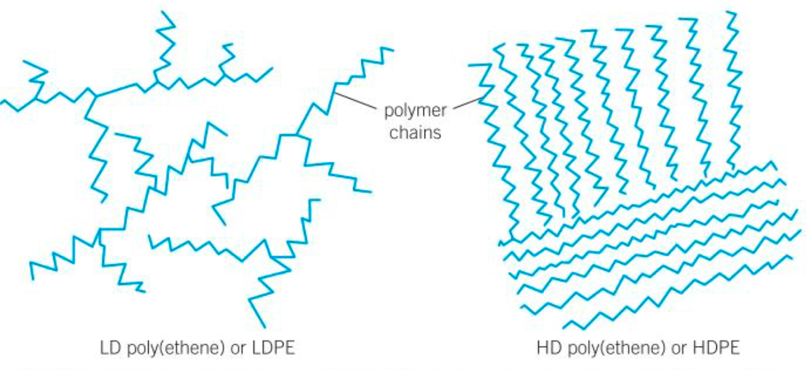
Properties of Polymers
The diagrams below show how hydrocarbon chains are arranged in two polymers. Which of the two do you think will have a higher melting point? (Consider the forces between the chains).
Write a couple of sentences to explain your answer and be prepared to explain your choice to the class.
Low density poly(ethene)
LDPE
High density poly(ethene)
HDPE
Notes:
Video is a bit technical but gives visuals of Tekmar’s products ad services and how they market their products.

Slide 7
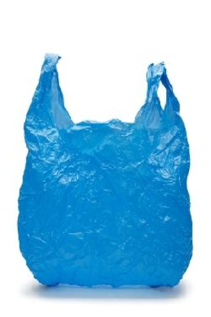
Properties of Polymers
The diagrams below show how hydrocarbon chains are arranged in two polymers. Which of the two do you think will have a higher melting point? (Consider the forces between the chains).
Write a couple of sentences to explain your answer and be prepared to explain your choice to the class.
Low density poly(ethene)
LDPE
High density poly(ethene)
HDPE
Notes:
Video is a bit technical but gives visuals of Tekmar’s products ad services and how they market their products.

Slide 8
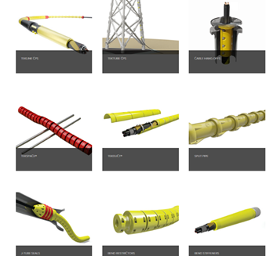
Properties of Polymers
The properties of polymers can depend on two things:
The monomers used to make it
The conditions chosen to carry out the reaction
Notes:
Video is a bit technical but gives visuals of Tekmar’s products ad services and how they market their products.

Slide 9
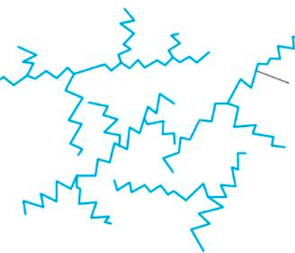
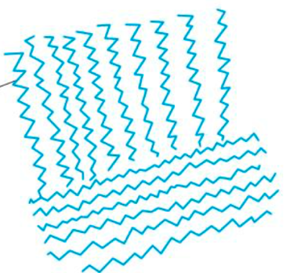
Properties of polymers and reaction conditions.
LD Poly(ethene)
Formed under very high pressures and a trace of oxygen
Randomly branched chains do not pack well
Weaker forces between chains mean lower melting point and more flexible polymer.
HD Poly(ethene)
Made using a catalyst at 50 °C and slightly raised pressure
Straighter polymer chains form which pack closely together (more crystalline)
Results in stronger forces between molecules which leads to higher melting points and a stronger polymer.
Notes:
Video is a bit technical but gives visuals of Tekmar’s products ad services and how they market their products.

Slide 10
How can Tekmar help build an offshore windfarm?
The properties of polymers can depend on two things:
The monomers used to make it
The conditions chosen to carry out the reaction
How might this information be useful to
Tekmar when they are manufacturing their products?
Notes:
Video is a bit technical but gives visuals of Tekmar’s products ad services and how they market their products.

Slide 11
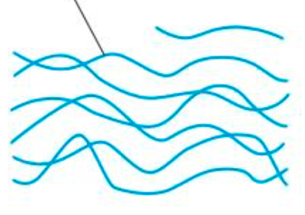
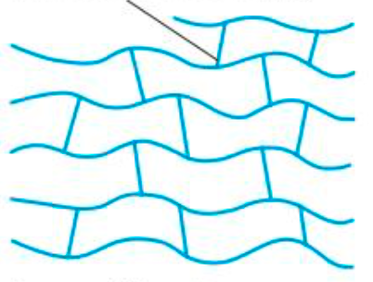
Types of polymer Thermosetting and Thermosoftening polymers
Thermosetting polymers do not melt when heat is applied to them – they remain rigid.
Thermosoftening polymers will soften and melt when heated but will re-set when cooled down.
But which of the diagrams shows each type?
Covalent bonds link chains together

Slide 12
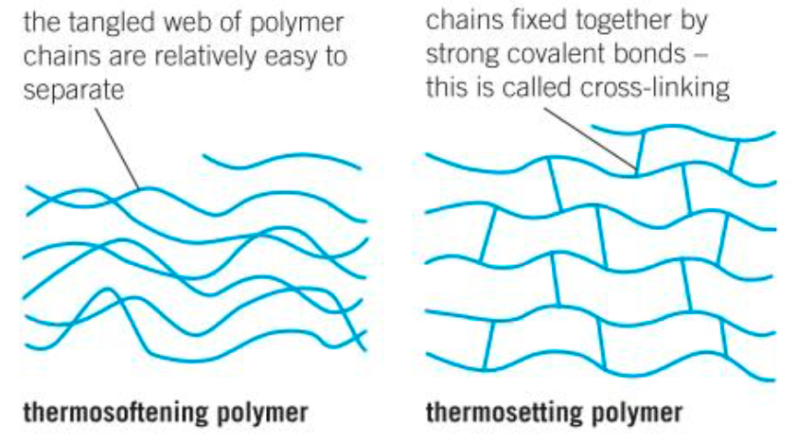
Types of polymer Thermosetting and Thermosoftening polymers

Slide 13
How can Tekmar help build an offshore windfarm?
Work in your groups to answer the following questions:
What properties might Tekmar want from the polymers they use in manufacturing their products?
Which of the polymers discussed might be the most suitable?
What other factors might they need to consider when choosing which polymers to use?

Slide 14
How can Tekmar help build an offshore windfarm?
Review your notes from today’s lesson. Consider how they may link to the second part of your presentation :
How can Tekmar help build an offshore wind farm?
Then work in groups to complete the consensus placement to answer the question: How do the polymers used in Tekmar’s products contribute to their success?
HINT: Consider the structure and properties, impact of manufacturing and durability of products when under the sea.

Slide 15
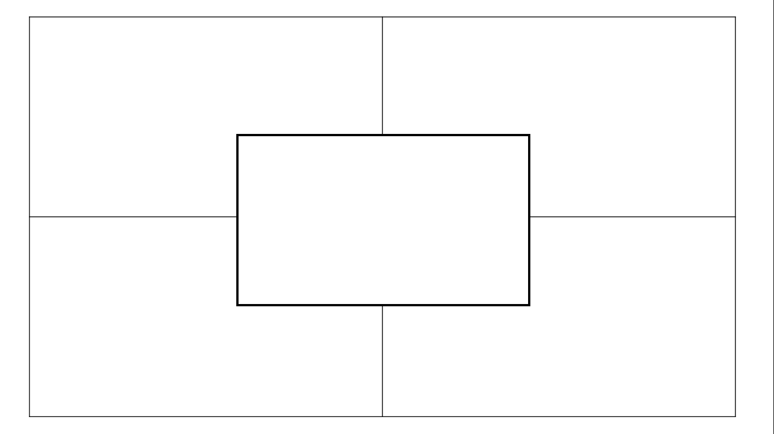
How do the polymers used in Tekmar’s products contribute to their success?
Notes:
Consensus placemat

