Slide 1
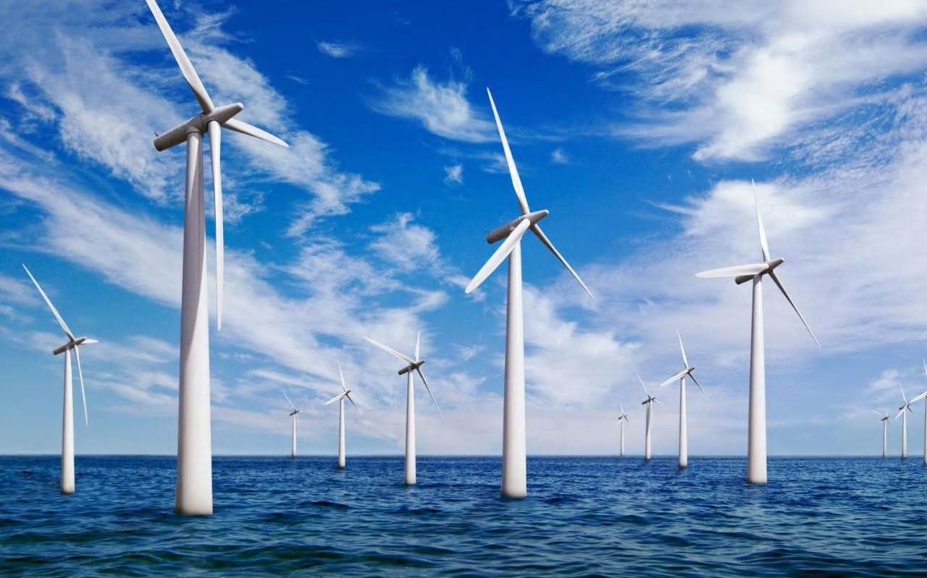



How can you build an offshore windfarm?
in partnership with

Slide 2



Project briefing
Globally there is increasing investment in renewable energy.
The UK is building the biggest offshore windfarm in the world in the North Sea.
This is leading to a significant increase in the number of job opportunities in the renewable energy sector in a number of areas in the UK.
You are going to work in teams on a project to answer the question
“How can you build an offshore windfarm?”
This project has been developed by The Edge Foundation in partnership with Tekmar Energy, funded by the EU European Social Fund.

Slide 3
Project briefing - Recap
Tekmar are an important engineering business in the offshore energy sector.
They need your help as associate project engineers to deliver a protection system for cables to a new offshore wind farm off the coast of North East England.
You need to produce a presentation as part of the bid team to explain why the offshore wind farm should be built and how Tekmar can help.

Slide 4
Project briefing - Recap
You are going to work in teams of four on a project to answer the question
“How can you build an offshore windfarm?”
This lesson you will need to work in your group to produce your first draft of part two of your presentation to be reviewed by your classmates. Remember it must include the following information:
How can Tekmar help to build an offshore windfarm
What materials are needed? How are they manufactured? Produce Life Cycle Assessment of materials
How can corrosion be prevented? What are the structure and properties of polymers
Make a list of all the jobs which need to be done to complete this part of the presentation, this will help you plan your presentation.
Notes:
Students may need support to develop plan with question to prompt thinking such as

Slide 5
Project Planning
You presentation must include the following information:
How can Tekmar help to build an offshore windfarm?
What materials are needed? How are they manufactured? Produce LCA of materials
How can corrosion be prevented? What are the structure and properties of polymers
Make a list of all the jobs which need to be done to complete this part of the presentation, this will help you plan your presentation.
You might like to think about the following questions to help your plan:
What do we want the presentation to include?
What information do we already have?
What do we need to know?
What resources may we need?
What additional support may we need?
When do we need this?

Slide 6

Project presentation part two Peer assessment
Review the work you have been given against the success criteria below:
Does it answer the question How can Tekmar help to build an offshore windfarm?
Does it include information on:
What materials are needed?
How are they manufactured?
A LCA of materials
How can corrosion be prevented?
What are the structure and properties of polymers (Chemistry only)
Have you checked the spelling and grammar?
Are the slides clear and easy to read?
Does the presentation look professional and engaging?
E.g. have you included pictures and do all links work correctly?
Have you referenced any data, quotes you have included?
Write down what has been done well (www) and what would make the presentation even better (ebi)

Slide 7

Project presentation
Review the feedback you have been given.
Next steps:
Agree what further work you need to do as a team to complete and improve part one of your presentation.
Identify what further information, support or resources you need.
Agree who is responsible for completing any further work needed and set a deadline for this to be completed.
Next lesson you must be ready to present your bid to explain why the offshore wind farm should be built and how Tekmar can help.

