Slide 1
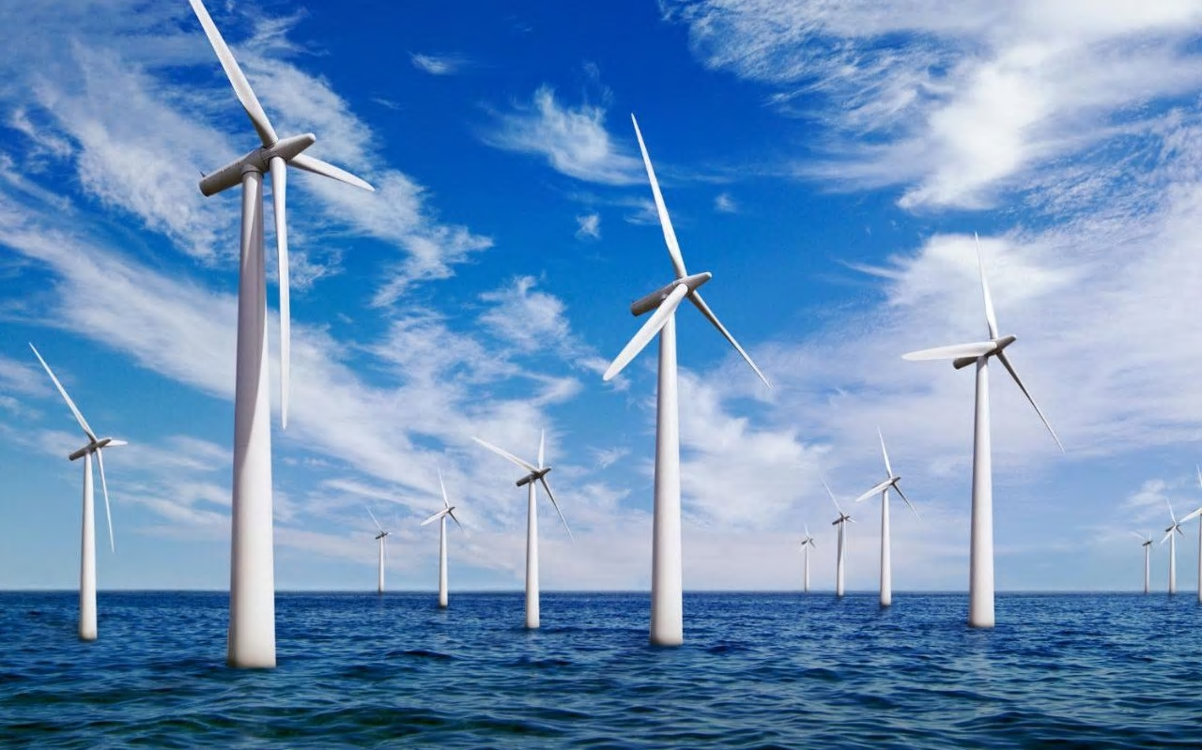
How can you build an offshore windfarm?
in partnership with

Slide 2
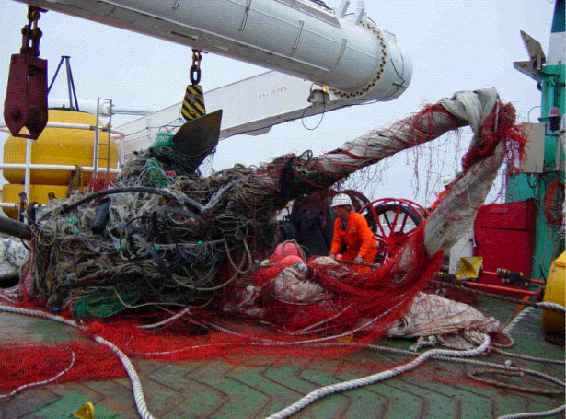
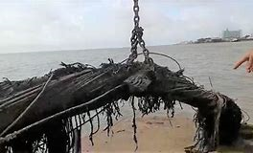
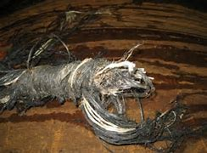
How can we build an offshore windfarm?
How can Tekmar help overcome these problems?
https://www.tekmar.co.uk/
Notes:
Link to project launch lesson what do Tekmar do. Link to site included if further research is needed.

Slide 3
Learning Outcomes
By the end of this lesson you should be able to:
Describe the products Tekmar produce.
Explain how Tekmar products are manufactured and which jobs are involved in this.
Evaluate the environmental impact of products using Life Cycle Assessment.

Slide 4
Project briefing -Recap
Tekmar are an important engineering business in the offshore energy sector.
They need your help as associate project engineers to deliver a protection system for cables to a new offshore wind farm off the coast of North East England.
You need to produce a presentation as part of the bid team to explain why the offshore wind farm should be built and how Tekmar can help.

Slide 5
Project briefing -recap
You are going to work in teams of four on a project to answer the question
“How can you build an offshore windfarm?”
Your presentation must include the following information:
Why do we need offshore windfarms?
climate change and greenhouse gases, reduce carbon footprint and air pollution.
How can Tekmar contribute to success of the offshore wind farm?
What materials are needed? How are they manufactured? Produce LCA of materials
How can corrosion be prevented? What are the structure and properties of polymers

Slide 6
How can Tekmar help build an offshore windfarm?
Tekmar produce systems to protect the subsea cables which connect the wind turbines to land.
This is important as it is very difficult to repair and replace cables if they become damaged.
Opposite are pictures of Tekmar products:
Here is a video showing one of the ways Tekmar
promote their products and services, when
putting a bid in to help build an
offshore windfarm.
https://www.youtube.com/watch?time_continue=112&v=GcfnOb7YgPM
Notes:
Video is a bit technical but gives visuals of Tekmar’s products ad services and how they market their products.

Slide 7
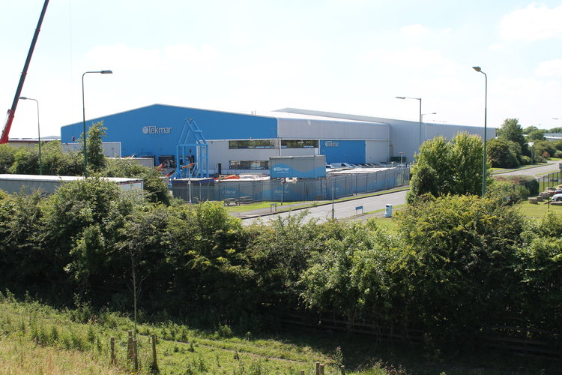
How can Tekmar help build an offshore windfarm?
Tekmar employ over 100 staff at their site in Newton Aycliffe. There are lots of different jobs involved in manufacturing their products and their client services.
You have been given some pictures and
examples of how Tekmar staff produce their
cable protection systems for offshore wind
farms.
Work as teams to sort the cards into the correct order.

Slide 8
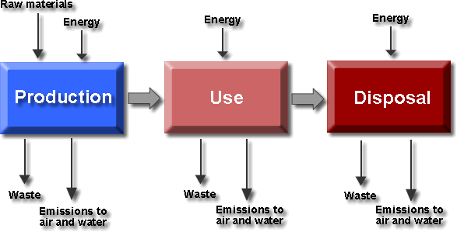
Sustainability in advanced manufacturing
Manufacturers such as Tekmar must assess the impact of their products on the environment, using a technique called Life Cycle Assessment(LCA).
A life cycle assessment includes the impact of:
Sourcing and processing the raw materials
Making the product and packaging
Using, reusing and maintaining the product
Disposing of the product at the end of its useful life.

Slide 9
Sustainability in advanced manufacturing
A Life Cycle Assessment (LCA) is carried out by:
Listing all energy and material inputs and the outputs on the environment.
Evaluating the potential environmental impacts of these.
Interpreting results to help make decisions about using one product, material or service over another.

Slide 10
Life Cycle Assessment
Here is an example of what a LCA might look like for a Tekmar cable protection system:
Life cycle assessment stage | Environmental impacts
Raw materials | Chemicals to make polymer extracted from crude oil which is a finite resource and carbon emissions produced in transporting the materials to the factory.
Manufacturing and packaging | Energy needed to manufacture the product and power the factory. Then the cable protection system is transport on a ship to where the cable is being laid on the sea bed.
Using the product | Cable protection systems are used in offshore wind farms so can reduce the emissions produced to generate energy.
Product disposal | Cable protection systems prolong the life span of subsea cables so they need to replaced less often, so less resources needed in the long term. The polymer used to make them could be recycled to make other products.

Slide 11
Life Cycle Assessment Paper vs Plastic
In your teams work in pairs to create LCAs for a plastic bag and paper bag.
Which do you think has the greatest impact on the environment?
Life cycle assessment stage | Environmental impacts
Raw materials
Manufacturing and packaging
Using the product
Product disposal

Slide 12
Life Cycle Assessment Paper vs Plastic
Useful links:
Video about LCA on plastic and paper
Recycling Plastics Today: A Growing Solution
http://www.allaboutbags.ca/papervplastic.html
https://conservingnow.com/plastic-bag-environmental-impact/

Slide 13
Life Cycle Assessment Product Disposal
How could the impact of a product on the environment be reduced by considering the product disposal?
Write your answers on a whiteboard ☺

Slide 14
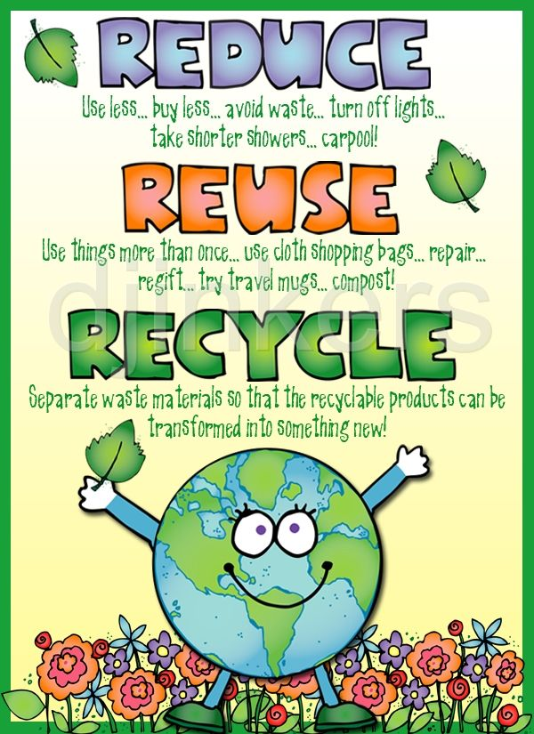
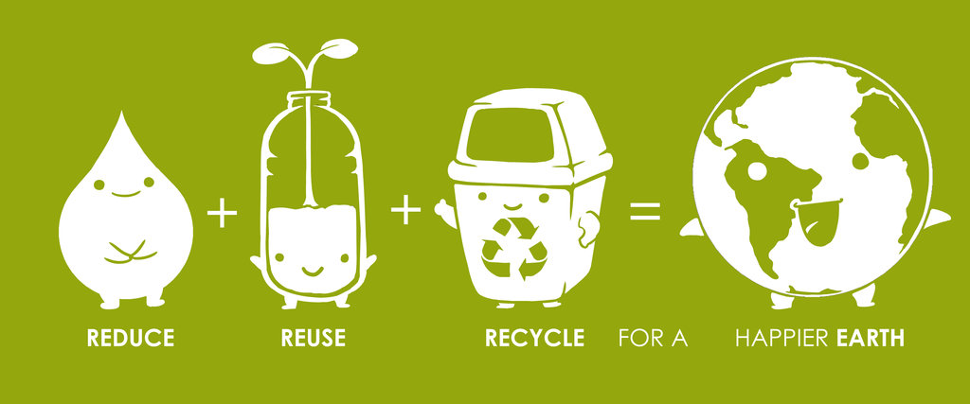
Reduce Reuse Recycle
If we can reuse and recycle products then we will reduce the demand on raw materials, reduce energy consumption, reduce waste and reduce the environmental impact that we are having on this Earth.

Slide 15
Review
Which of these does not feature in a life cycle assessment?
cost b) energy required c) disposal
2. Which of these methods of disposal is likely to have the least environmental impact?
landfill b) incineration c) recycling
3. The life cycle assessment for a product will be different if we:
use a different material b) make more product c) take longer making the product
4. A wooden window frame may have less environmental impact than a uPVC window frame because it...
is heavier b) is more sustainable c) can be burned

